Slide 1
Journey to the Cloud:
Guida per l’organizzazione che vuole migrare al Cloud
Giuseppe Di Natale, Business Developer Manager – AWS Public Sector Italia
15 Maggio 2019, Forum PA
Notes:
[INTRODUCTION]
Hello my name is … My role at AWS is … My background is…
I am here to share with you how you can use AWS Migration Services to “Simplify and accelerate migrations to the AWS Cloud”
10 Best Practices to accelerate Migration
Migration Readiness Assessment
1. Executive support and business owners engagement
2. Understand business drivers, compelling events, and definitions of done
Migration Preparation and first learnings
3. CAF - address all the six perspectives
4. Six patterns - try to transform one level up if possible
Application Discovery Services
Migration Hub
Database Migration Services
partners (?)
5. Revolving door decisions
6. Learn by doing + amplify with more training
start simple
AWS Enterprise support, IEM on cut-overs
7. Security - get it embedded from the start
8. Operations - automate and design for ops (use migration as an opportunity to embed it in), monitor everything
Migration on a scale
9. COE - the “brains” behind migration
find patterns and create blueprints
over-communication
10. Scale up (divide and conquer, teams working on different stages)
set benchmarks
onboarding process
team rotation
11. (partners)

Slide 2

Percorso verso il cloud
Optimization
Migration
Foundation
Project
Notes:
Cloud Adoption is a journey
- It requires detailed planning and an adoption roadmap
- Cloud Adoption strategy should be aligned closely with business goals and objectives
- It can be disruptive and will drive significant change
- Most start small, learn, iterate and expand
- Value can be achieved quickly
Most customer pass through a common set of stages in their journey:
Project
AWS is evaluated and vetted on a project-by-project basis to solve specific needs on a one-off basis
(e.g., deploying Proof of Concept workloads).
Foundation
Enterprises in this stage have begun to see the benefits of cloud, and are making foundational investments.
Migration
Enterprises in this stage migrate existing applications, including mission-critical applications, or entire data centers to the cloud as they look to scale their adoption
Optimization & Innovation
Enterprises in this stage have migrated a meaningful portion of their IT portfolio to the cloud and are optimizing business capabilities using a “cloud-first” approach.

Slide 3
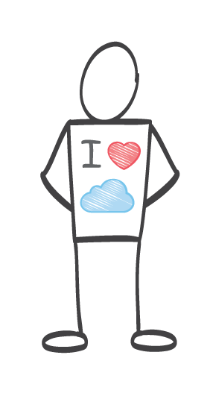

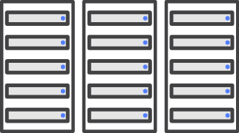
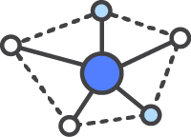
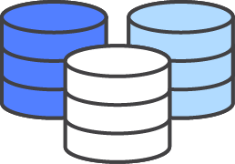
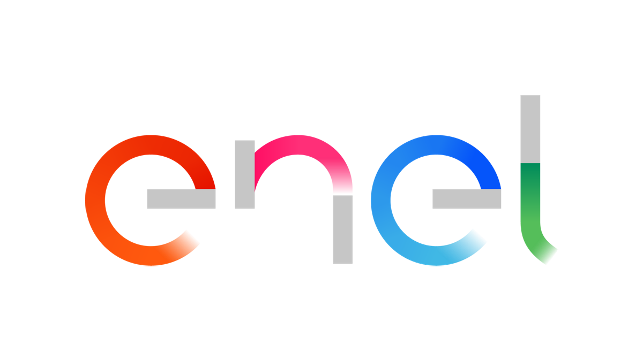
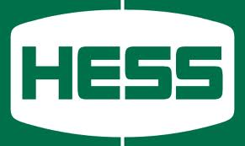

I driver di business e le cause scatenanti
Cost Savings (TCO/CO)
Resource Efficiency
Operational Resilience
Business Agility
Criticità
Infrastructure cost savings / avoidance from moving to the cloud
Efficiency improvement by function on a task-by-task basis
Benefit of improving SLAs & reducing unplanned outage
Deploying new features / applications faster and reducing errors
Esempi
Consolidated 56 data centers down to 6, re-allocated >$100M toward key business drivers.
Reduced storage costs 50%, compute costs 20%, and speed up provisioning by 10x (4 weeks to 2 days).
Migrated 8 of 12 data centers to AWS, improving performance, reliability, and cost.
Migrated data center assets for several divested business units in 6 months.
Typical Focus
Most Compelling Cloud Benefits
Notes:
Best Practice 1: Business drivers and compelling events define migration principles and outlook

Slide 4
L’adozione del Cloud richiede il supporto degli Executive dell’organizzazione
value
MIGRATION
CLOUD-NATIVE INNOVATION
RETIRING TECHNICAL DEBT
FOUNDATION
REINVENTION
PROJECT
Innovators
Early Adopters
Early Majority
Late Majority
Sceptics
time
Notes:
Best Practice 2: Executive Support
Once we understand why we are migrating and what our business goals are, we next need to think about how we begin our migration project. It is important to understand that migration to the cloud is a transformational change that affects every aspect of your organisation; this is a big deal. Most companies begin looking at the Cloud with small projects undertaken by those in the organisation that are their innovators. These projects are often used to understand the business value and prove to themselves that they can solve real business problems using the cloud. Next they setup a hybrid environment and cloud center of excellence to lay the foundation for their future delivery model.
They are starting to see some value of the Cloud in a fairly short space of time but to really start seeing the benefits and accelerating to the next phase of scaling out they need to secure internal Executive Support. This will enable them to cross the chasm and really start making progress, migrating workloads and fully seeing the benefits of the cloud which will then bring alone a cloud first organization that is innovative and starting to retire technical debt. We now have an organization that has a cloud
We’ve observed this pattern within organizations that are leveraging AWS as a platform to transform their business.
Once a hybrid architecture and a cloud center of excellence have been established, enterprises typically scale their cloud efforts across different business units, begin to consider and execute substantial migrations, and many look for this as an opportunity to retire technical debt.
Finally, we’re seeing many of enterprises hit a tipping point, where they become more proficient in managing their cloud environment than their on-premises environments, and they can begin to optimize both their IT and business functions in light of the possibilities that have been opened from leveraging a cloud platform across their business.

Slide 5
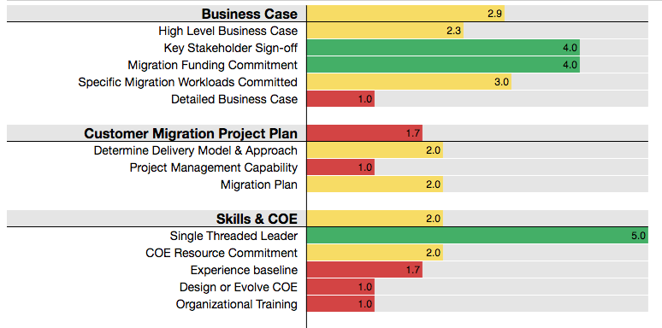
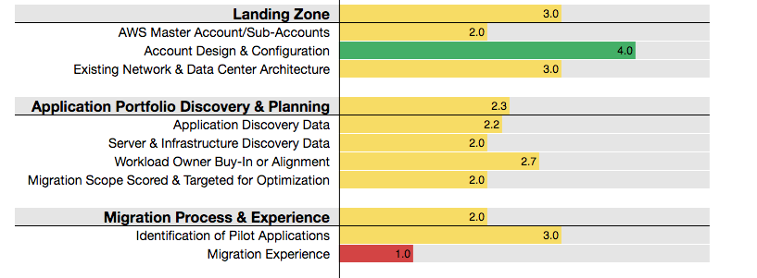
La vostra organizzazione è pronta per migrare?
Business Capability Focused | Business Value Realization
 | People Roles and Readiness
 | Governance Prioritization and Control
Technical Capability Focused | Platform Applications and Infrastructure
 | Security Risk and Compliance
 | Operations Hybrid and Dynamic
Cloud Adoption Framework workshop
Migration Readiness Assessment (MRA)
Notes:
Best Practice 3: Migration Readiness. It is important to understand how ready you are before you begin your cloud migration journey. At AWS we can help with this using two mechanisms; our Cloud Adoption Framework workshop and our Migration Readiness Assessment phase of migration
AWS Cloud Adoption Framework (AWS CAF): It is usually conducted as a one day workshop and/or interviews with key stakeholders around six perspectives. Each perspective covers distinct responsibilities owned or managed by functionally related stakeholders. In general, the Business, People, and Governance Perspectives focus on business capabilities; while the Platform, Security, and Operations Perspectives focus on technical capabilities.
AWS CAF Action Plans help you prepare for the transition to cloud based IT. The journey begins with your leadership team reviewing the six CAF perspectives. Each perspective is used to create work streams that uncover gaps in your existing skills and processes, which are then recorded as inputs. These inputs are the basis for creating an Action Plan that will help to guide your organization's change management as you journey to the cloud.
AWS MRA (Migration Readiness Assessment) Following on from your CAF action plan you can then look at your Migration Readiness Assessment. The idea behind the assessment is to evaluate your organisation’s cloud competence, capability and commitment. he MRA will help identify any gaps your organization may have that need to be addressed in next phases of migration - Migration Readiness and Planning and finally the Migration itself.
The MRA helps you to analyse the different areas of your business that will need to be considered (including outside of the standard technology teams) that are required to work together to successfully migrate to the cloud. These workstreams are Business Case – which drives your business drivers and goals, Migration Project Plan – which drives your actual migration delivery and approach, Skills and Centre of Excellence – which ensures your staff have the right skills and you have your vehicle for building the foundation needed to drive you workload migrations, Landing Zone – which helps ensure you have an account, security and network strategy suitable for your organisation, Application Portfolio & Planning – that helps you understand your estate migration patterns and finally Migration Planning and Experience that identifies your pilot applications and migration experience
As you can see, and are hopefully aware, Cloud adoption requires buy-in from many areas, not just the technology teams but with your clear understanding of your business goals and your executive sponsorship this should be easy for you!

Slide 6

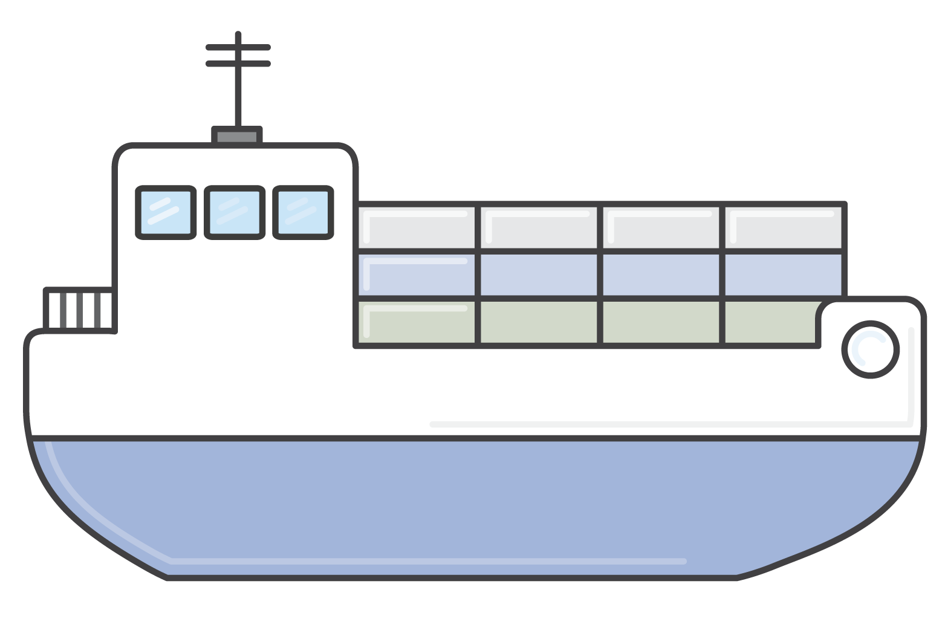
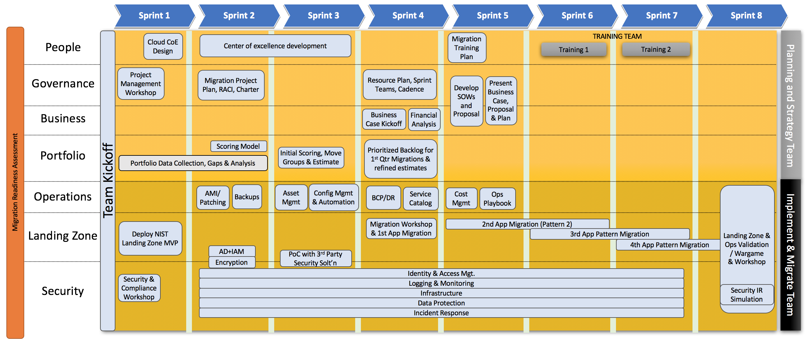
Metodologia composta da 3 fasi
4-6 mesi
1 settimana
12-48 mesi
Valutazione preparazione
Preparazione e pianificazione
Migrazione
Notes:
The Migration Readiness Assessment is component of the Migration Acceleration Program or MAP. The MAP program helps customer accelerate their journey to AWS by codifying our collective experience helping customers prepare for a migration through a series of work streams collectively called the MRP Migration Readiness & Planning phase or MRP. The MAP program also provides financial benefits to customers and incentives for partners.
The migration readiness assessment is a mechanism to measure a customer’s commitment, competence, and capability for a migration of workloads to AWS. The MRA is executed post qualification but before the start of the Migration Readiness & Planning activity.

Slide 7

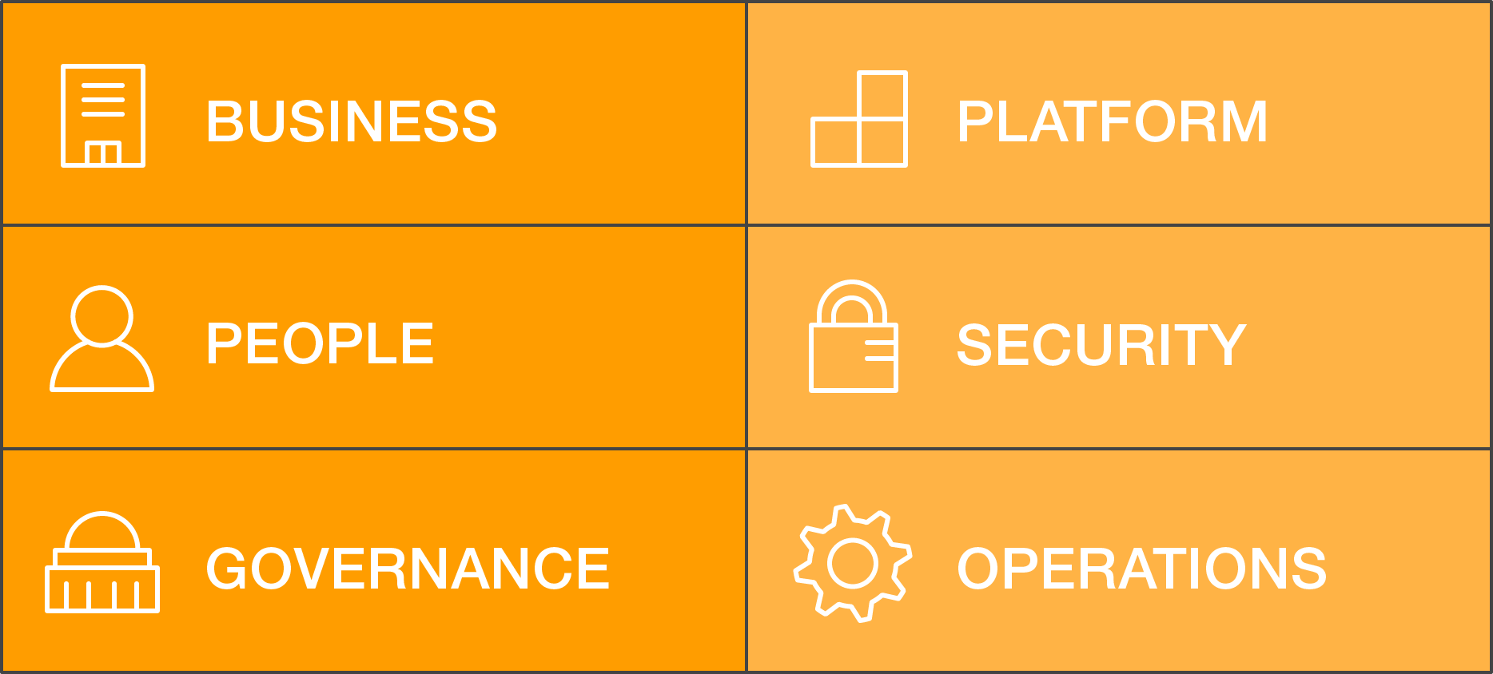
MRA
MRP
Migration
Valutazione preparazione
71
6
1
domande
prospettive
settimana
Notes:
A process of assessing a customer’s current state and recommending next action
71 CAF Aligned Questions
Consensus on current state
Awareness of gaps
AWS and Partner evaluation of customer capabilities
Action plan to increase capability

Slide 8




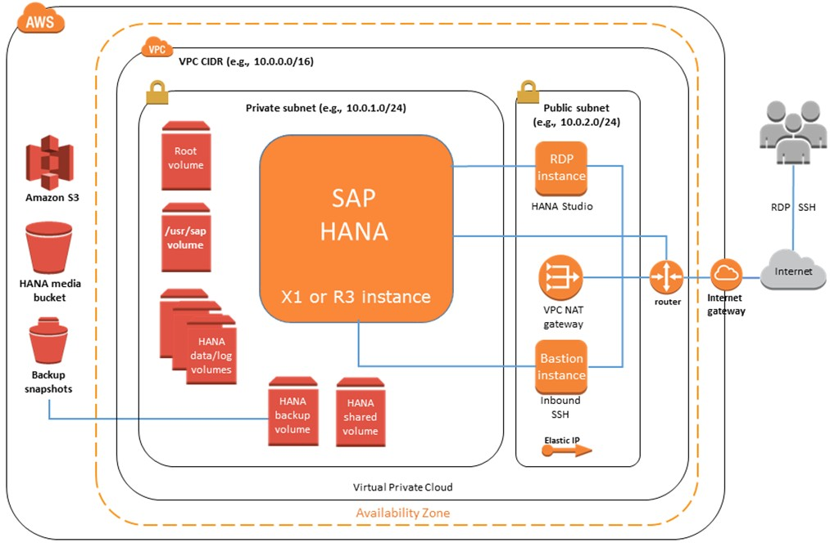

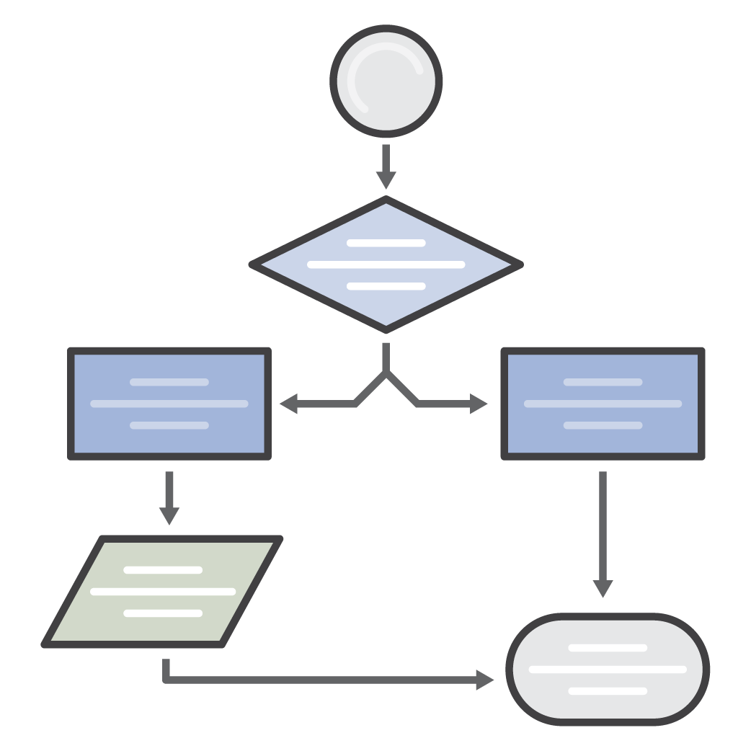

MRA
MRP
Migration
Preparazione e pianificazione
8
5
16
flussi di lavoro
app
migrate
settimane
Planning
Business case
Discovery
Landing Zone
People, Skills
Operations
Security
Esperienza di migrazione
Notes:
8 Workstreams
16 Weeks
5 Application Migrated
What is Migration Readiness? Demonstrated capability to migrate and operate production applications at scale.
Mission Statement: Build a Migration Plan with the methodology, processes, tools and resources to accelerate your migration to the AWS platform.
Goal:
Evaluate your readiness to execute a Mass Migration Project
Define Team Model and Agile Work Streams to Deliver Migration Plans
Define Agile Methodology, Tools, Project Controls
Review current AWS Architecture, Governance and Security Posture
Plan to scale your Enterprise Operations to AWS
Develop Cost and Resource Model for the Migration of a Defined Portfolio
Identify Application Patterns (re-host, re-platform, re-factor, etc.) to Migrate
Ensure Customer adoption of the AWS platform and initial architecture are in line with best practices
Typical Duration: 4-6 months

Slide 9
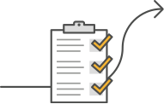
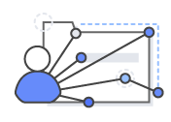
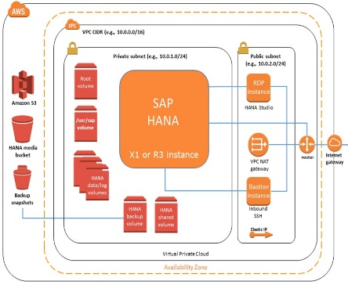


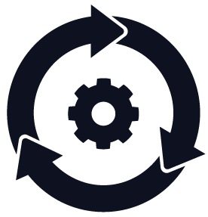

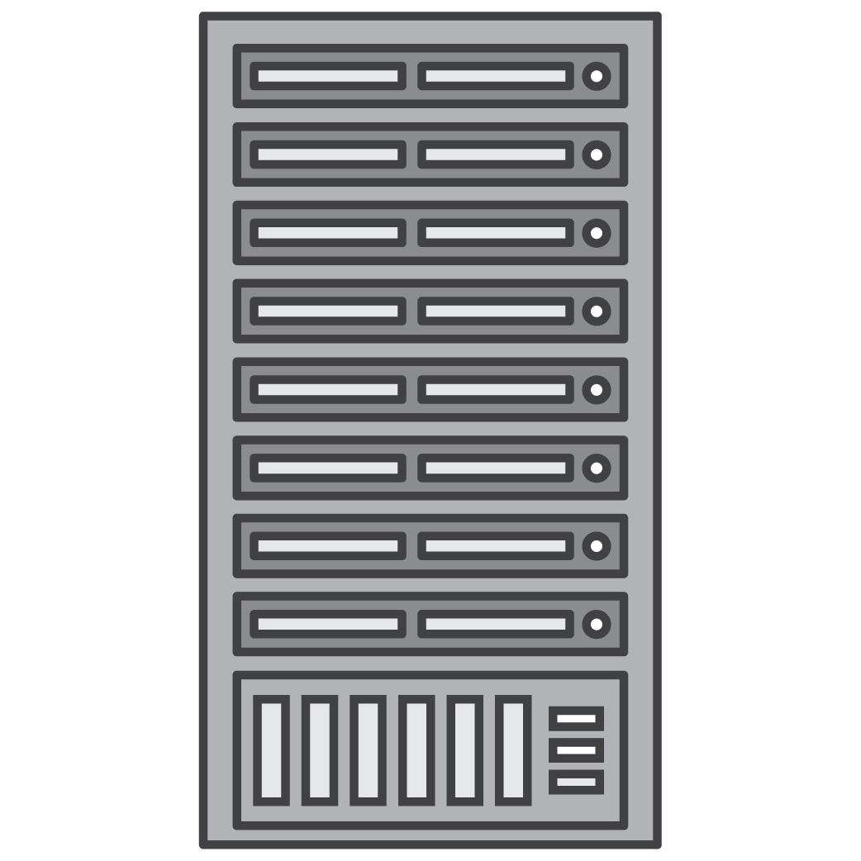
Una migrazione non coinvolge solo la tecnologia
Discovery & Business engagement
Business( Migration Business Case)
Platform (landing zone)
(People)
Skills/Center of Excellence
Practice-proven migration approach
(Governance) Migration Plan & Change management
(Operations)
Operating Model
(Security)
Security & Compliance
Notes:
Having the baseline defined, we can make sure that our immediate actions are being addressed as soon as possible. To bring more structure, we tend to continue with CAF-like structure on our engagements, even for mature organizations. Let me walk you trough the six standard blocks:
Landing Zone (Account structure, Network design including VPC, VPN, DX, & multi-region , Identity Access Management)
Skills/Center of Excellence (Cloud expertise across IT, Security and Business, key roles, training, tooling
Migration Business Case (TCO Modelling, Business Value Assessment, Options to Optimize)
Security & Compliance (Governance, risk, and compliance models, Preventive measures to protect & mitigate threats, Security Responses playbook)
Operating Model (Operational Run Books for: Monitoring, Logging, Provisioning, Asset Management, and Configuration Management, Business Continuity Planning and Disaster Recovery)
Migration Plan (Project Plans, Cost Estimate, Communication Plans, Change Management
To accelerate this phase we usually have two additional workstreams defined.
Discovery & Planning (Defining Application Patterns and Grouping, Application Design Process, Initial backlog of applications ready to migrate)
Migration Experience (Start Migrations Day 1, Migrate a series of Application Patterns)

Slide 10
Lift-and-shift non significa copy-and-paste
Notes:
We tend to think about this stage being more assessment, than discovery. Each application migration tends to follow one of 6 different paths, which builds upon the 5 R’s that Gartner coined in 2011. We’ve outlined 6, and they include:
Rehost aka lift-and-shift. We find that most of this can be automated with tools, though in some cases customers will prefer to do this manually as a learning experience
Replatforming - media co weblogic-tomcat example
Repurchasing - a lot of our customers are moving toward the SaaS model and toward solutions like Workday, Drupal, and Salesforce
Rearchitect - in some cases, you may want to completely re-imagine your application architecture and skip right toward state-of-the-art
Retain and Retire.You never know what you’re going to find until you look, and common for us to find that no one knows what 10-20% of an enterprise IT portfolio does and it can simply be shut off. This part is very important too, as you don’t want to spend your money and efforts on something that is not needed.
Re-host is a very balanced choice with some immediate value and some operate/agility advantages, whereas Re-architect has the lowest potential cost to operate and offer a lot of agility, but it may take you a while to reach that state, so if you pick that path you better make sure it’s an application that is worthy of the effort. Is re-host is the best choice in 100% cases? Speaking from your business goals, our fist best practice, if you had strong business need to improve on resiliency of your applications, then, maybe the best solution for you will be to avoid moving your singe database application as is and maybe consider resilient managed database. Or, you wanted to optimize your licensing spend, then, maybe, the idea is to look, again for managed database with the license built-in, or even go for re-platforming.
All the migration strategies have to time, cost, and agility, which we then applied at a high-level to the total opportunity calculation. Clearly, it’s a trade-off, as you are trading some of money and time for these improvements. The key is to look for a good ratio, when a small change will amplify your benefits. So, the best practice number four is to look for small incremental improvements you can afford while doing your discovery.

Slide 11
Stima dei costi vs. Agilità
Bassa
 | Tempo di migrazione | Costo di migrazione | Costo di esercizio | Agilità risultante
Retire | N/A | N/A | N/A | N/A
Retain | + | N/A | ++++ | +
Rehost | + | + | +++ | ++
Repurchase | ++ | ++ | ++ | +++
Replatform | +++ | +++ | ++ | +++
Refactor | ++++ | ++++ | + | ++++
Complessità della migrazione
Alta
Notes:
This table shows the relationships that the migration strategies have to time, cost, and agility, which we then applied at a high-level to the total opportunity calculation. As you dig into this table, you can see some pretty interesting inverse relationships like the relationship between Time and Cost to Migrate and how much it will cost to operate and the agility you will have after the application is migrated. You can see right in the middle that Re-host is a very balanced choice with some immediate value and some operate/agility advantages, whereas Refactor has the lowest potential cost to operate and offer a lot of agility, but it may take you a while to reach that state, so if you pick that path you better make sure it’s an application that is worthy of that investment and has a long expected life in your portfolio.

Slide 12

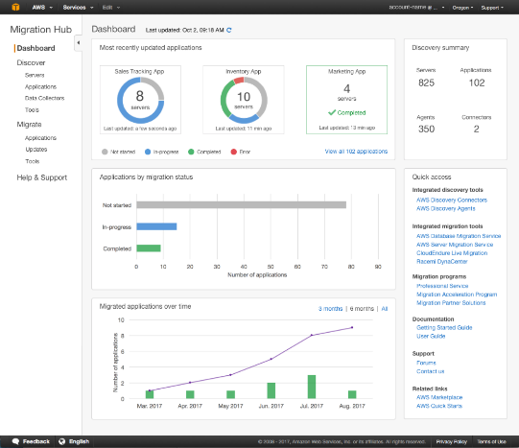









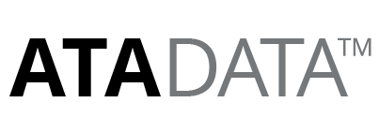


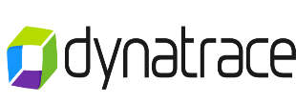


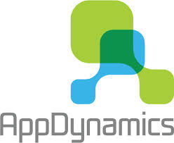



Tool AWS e di Partner per Accelerare la Migrazione
AWS MIGRATION HUB
AWS MIGRATION SERVICES
AWS DATA TRANSFER
AWS Application Discovery Service
S3 Transfer Acceleration
A single location to track the progress of application migrations across AWS and partner solutions
AWS Server Migration Service
AWS Storage & File Gateway
AWS Database Migration Service
AWS Snowball & Snowmobile
AWS Schema Conversion Tool
AWS Direct Connect
VMware Cloud on AWS
Amazon Kinesis Firehose
Inventory
Business Case
Deep Discovery & Planning
App Dependency Mapping
Workload & Data Migration
Validation
Deloitte
Deloitte
Deloitte
Deloitte
Partner migrations tools found on
Notes:
[MIGRATION TOOLS]
PRIMARY MESSAGE: There are many tools (both AWS and Partner tools) to help you accelerate your migration journey. AWS tools are across the top half of the screen. Partner tools are listed across the bottom half, grouped by where they apply through the different stages and tasks of the migration process. AWS Services are typically free to use and we feature the Migration Hub which helps you track the progress of application migrations as well as Migration Services and Data Transfers Services to support your migration. AWS has worked with many partners to vet and identify the best vendor tools that assist and accelerate migration across all phases of the migration journey. We have worked with partners for agreements to give them exposure them to MAP customers while assuring best pricing for MAP customers. These tools are available through the AWS Marketplace.
DETAILED MESSAGE:
There are many tools (both AWS and Partner tools) to help you accelerate your migration journey. AWS tools are on the top half of the screen. Partner tools are on the bottom half, grouped by where they apply through the different stages of the migration process.
[MIGRATION HUB]: A recent offering is the AWS Migration Hub. We often hear about three common challenges customers have tracking migrations across different tools 1) Workload migrations require different migration tools, 2) No easy way to track state of migrations in single location. 3) Existing tools don’t track migrations by application (groupings of servers and database. The AWS Migration Hub addresses all three of these challenges by giving you a single place to track migrations from multiple tools, both AWS and partner tools. When moving workloads to AWS, you track the migration of each set of resources as an application. The hub also provides a top-level dashboard that shows the latest status and key metrics for your entire migration portfolio. This allows you to quickly understand the progress of your migrations, as well as identify and troubleshoot any issues that arise.
[AWS MIGRATION SERVICES]: AWS has a number of migration services to leverage – application discovery, server and database migration. AWS also has a large number of services to facilitate data migration and network connectivity to accelerate migration. AWS also has released VMware Cloud on AWS – this service allows you to run applications across vSphere-based cloud environments with access to a broad range of AWS services.
[MIGRATION TOOL PARTNERS]: AWS has worked with many partners to identify tools that assist and accelerate migration across all phases of the migration journey – whether it’s in Application Inventory, Business Case, Deep Discovery, Application Dependency, Workload Migration or Application Validation. Here is a look at the tool partners available.
Important note: All of the partner tools have been vetted by AWS and are offered through AWS MarketPlace with pre-negotiated discounts.

Slide 13


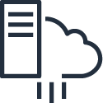






I servizi di Migrazione AWS
Discover, Plan & Track
A single location to discover, plan, and track the progress of application migrations across AWS and partner solutions
AWS Migration Hub
Discovery
AWS Application Discovery Service
Discover on-premises server inventory and behavior
Server Migration
AWS Server Migration Service
Migrate your on-premises workloads to AWS
VMware Cloud on AWS
Migrate and Extend VMware Environments to the AWS Cloud
Database Migration
AWS Database Migration Service
Migrate your databases to AWS with minimal downtime
Convert your existing database schema from one database engine to another
AWS Schema Conversion Tool
Data Migration
AWS DataSync
Copy, move, sync large amounts of data between on-prem & AWS
AWS Snow Family
Physical devices to migrate data into and out of AWS
Data Access
AWS Transfer for SFTP
Migrate files with a fully managed SFTP service
AWS Storage Gateway
Enable on-premises apps to seamlessly use AWS cloud storage

Slide 14
VMware Cloud on AWS: la migrazione “Fast Track”
A
B
C
D
Cloud
Migrations
Data Center
Extension
Next-Generation Applications
Disaster
Recovery
Consolidate
Migrate
Expand
Primary
Secondary
Maintain
Primary
Application Specific
Footprint Expansion
Protect Additional Workloads
Application Modernization
Data Center Wide
On-Demand Capacity
DR Data Center Replacement
Next-Gen App
Build Out
Infrastructure Refresh
Test / Dev
Add or Modernize DR solutions
Enterprise Workloads
Customer Decides and Places Workloads between On-Premises and AWS

Slide 15
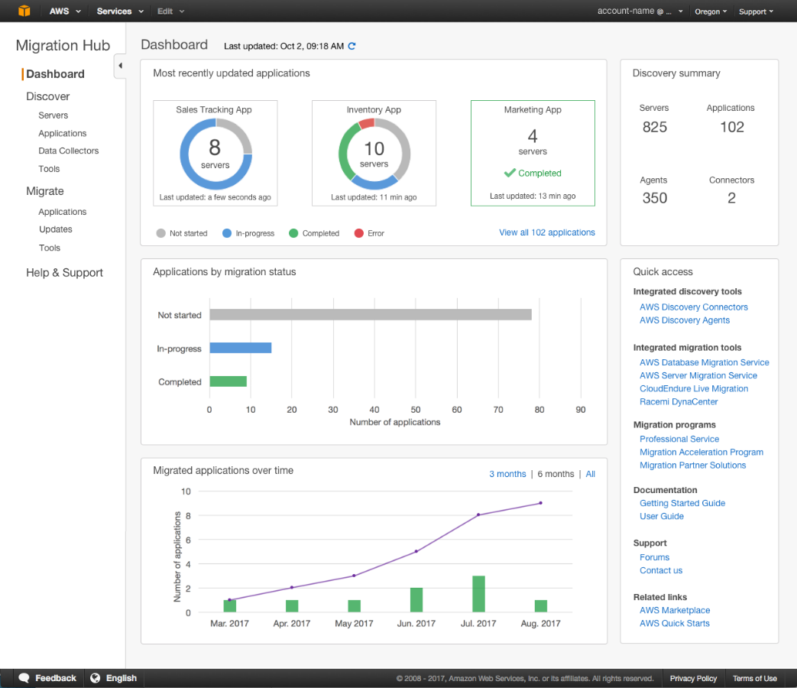
Il servizio AWS Migration Hub
Track the migration status of your applications across multiple tools in one place
Discover using AWS ADS or Import discovery data from existing sources
Use the migration tools that best fit your needs – AWS or Partner tools integrated
Available to all AWS customers at no additional charge
Notes:
[AWS Migration Hub]
AWS Migration Hub is designed to be a single location to track the progress of application migrations across AWS and partner solutions. With AWS Migration Hub, you can discover your on-premise portfolio using AWS Application Discovery Service and/or import discovery data from existing sources (such as your CMDB) or from other discovery tools. You can view sever information and group servers into applications to help plan your migration. You can track the progress of your migration using the migration tools that best fit your needs (AWS and AWS partner).
AWS Migration Hub can manage migrations in any AWS Region that has the necessary migration tools available. AWS Migration Hub itself runs in the US West (Oregon) Region.
Migration Hub is available to all AWS customers at no additional charge. You only pay for the cost of the migration tools you use, and any resources being consumed on AWS.

Slide 16

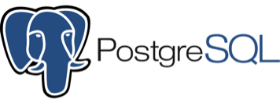
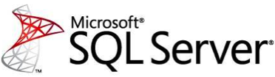

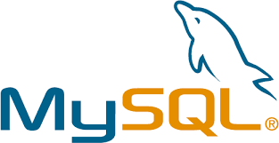
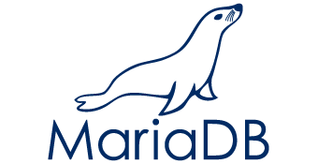
Il servizio AWS Database Migration Service: migrazione omogenea oppure eterogenea
Oracle
Oracle
Aurora
Replication instance
SQL Server
MySQL
Replication instance
Esempio
Oracle
Aurora
Replication instance

Slide 17


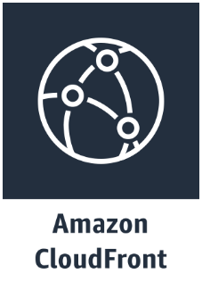
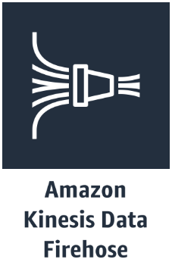


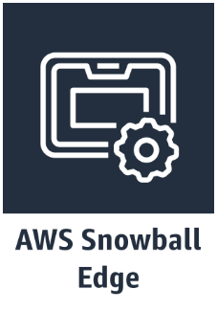
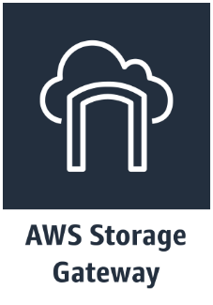
I servizi AWS di data transfer & hybrid storage
Offline
data transfer
Online
data transfer
Hybrid
storage
Edge locations for S3 enabled applications
Load streaming data into Amazon S3
Managed file transfers into Amazon S3
Online transfer of active data
Ship static data into and out of Amazon S3
Storage and compute in disconnected environments
Access AWS storage from
on-premises
Amazon S3
Transfer
Acceleration
AWS Transfer for SFTP
AWS DataSync
Notes:
[Discovery and Migration using AWS Migration Hub]
To use AWS Migration Hub for both discovering on-premises assets and migrating, the following steps are performed:
The first step is to deploy an AWS ASDS Discovery Connector and/or AWS ADS Agents on-premise to collect the necessary information.
Discovery data collected is sent to the AWS Application Discovery Service and made visible in the AWS Migration Hub.
Additionally, discovery data can also be imported into AWS Migration Hub from existing sources or from previously collected discovery data from other discovery tools.
Once the discovery has kicked-off, customers can view and then group the servers discovered by using tags to identify application groups.
Then, the decision around which migration tool to leverage has to be made, connecting the migration tool to customer’s AWS Migration Hub.
Next, customers initiate the migration once ready
Customers can track their status in parallel of all the other activities in the AWS Migration Hub.
Lastly, once proper testing and cutover has been completed, customers can decommission their application infrastructure from on-premises

Slide 18
Domande ?
Grazie! gnnatale@amazon.it
Notes:
[Conclusion]
Thanks for your time today – helpfully we helped you to understand how AWS Migration Services can simplify and accelerate migrations to the AWS Cloud.
Do you have any questions I can help answer?

Slide 19
La Migrazione non è a costo zero
Assessment
Readiness and Planning
Migration and Operation
$
Migration Cost
Current / Do Nothing
Cost
TCO
AWS Environment
Payback Period
Cost Optimising / BAU
Time
Notes:
So we have our business drivers and goals and our executive support so the next step is to begin our migration programme. Here at AWS we have a very prescriptive approach to migrating workloads to the Cloud over three main phases. You may have heard about them – MRA (Migration Readiness Assessment), MRP (Migration Readiness and Planning) and Migration and Operations.
The first phase – MRA is all about exploring how mature an organization is from a cloud perspective and how ready they are to progress to a migration. The second phase MRP begins the acceleration of migration where we actually start to migrate some workloads incorporating 6 workstreams including security, operations, people etc. and finally we move onto the main migration project.
As you can see on the diagram behind me, when you start the MRP phase of your migration programme you will normally see some additional costs that can’t really be avoided such as duplicate environments, staff training, consultancy costs and potentially lease penalties. You should take every opportunity to accelerate this phase as much as you can to minimize the impact of what we call the “Migration Bubble”.

Slide 20
Valutazione preparazione
Business Case
Customer Migration Project Plan
Skills & COE
Landing Zone
High Level Business Case
Determine Delivery Model & Approach
Single Threaded Leader
AWS Master Account/Sub-Accounts
Key Stakeholder Sign-off
Project Management Capability
COE Resource Commitment
Account Design & Configuration
Migration Funding Commitment
Migration Plan
Experience baseline
Existing Network & Data Center Architecture
Specific Migration Workloads Committed
Design or Evolve COE
Detailed Business Case
Organizational Training
Application Portfolio Discovery & Planning
Migration Process & Experience
Operating Model
Security & Compliance
Application Discovery Data
Identification of Pilot Applications
Current Operations Model
Shared Responsibility Model Understood
Server & Infrastructure Discovery Data
Migration Experience
Future Requirements
Security RACI
Workload Owner Buy-In or Alignment
Managed Service Provider Identified
Security Cartography
Migration Scope Scored & Targeted for Optimization
AMI/Patching
3rd Party Risk
Backup
Identity & Access Management
Asset Management
Logging & Monitoring
Config Management & Change Management
Infrastructure Security
BCP/DR
Data Protection
Service Catalog
Incident Response
Pre-MRP/Areas that need attention early-on
Cost Management
Cloud Security Readiness Tested
Cloud Ready Operational Processes & Run Books
Compliance Design
CI/CD Pipelines

Slide 21
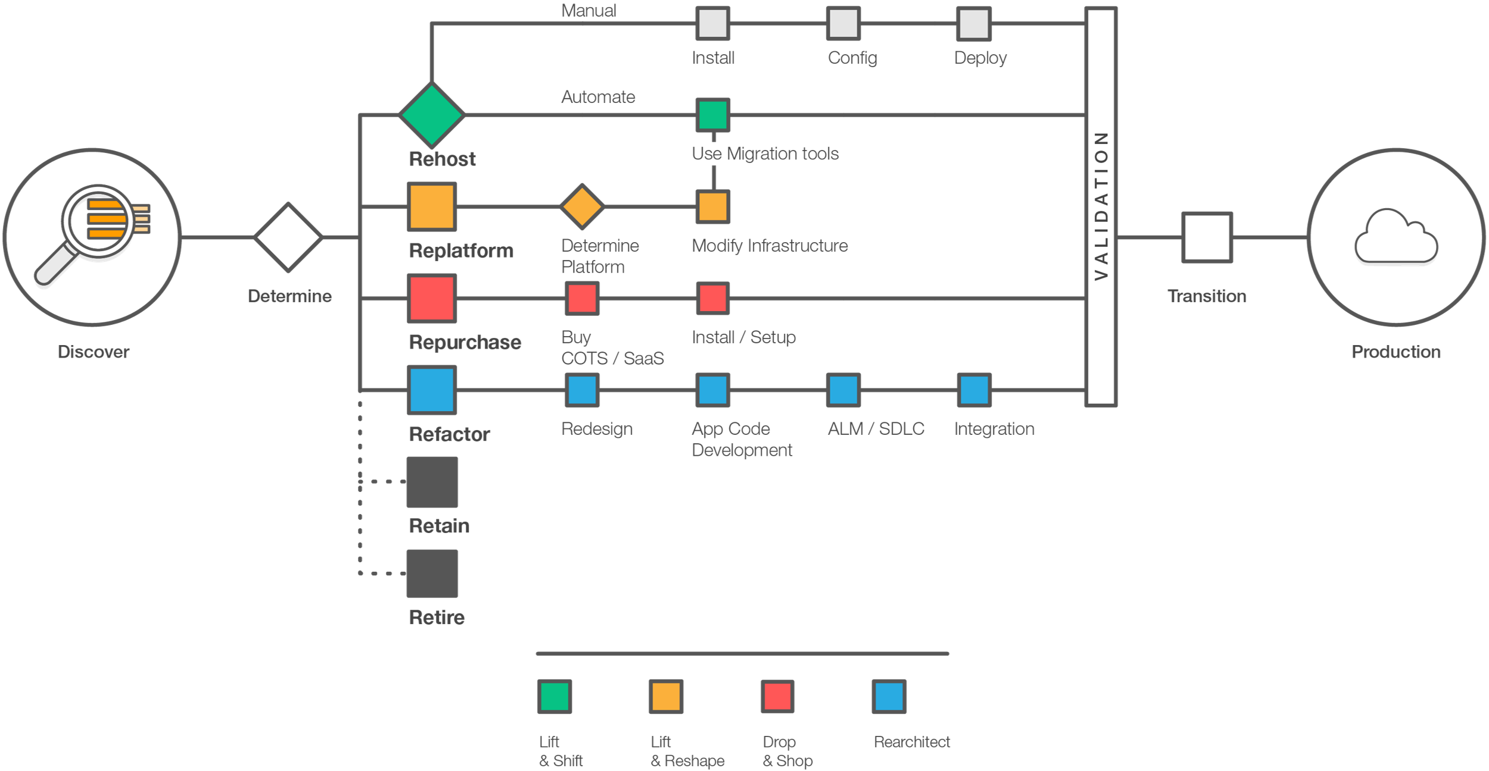
6 strategie di migrazione
Notes:
Without this info cannot make decision about disposition, which impact cost, time, staff drivers
6Rs come up in all phases of app mig
Identify disposition and then modify runbook for that workload
Throughout all the phases, consider the ways to move an app
Retain – keep it as-is (lowest risk and value)
Retire – no longer needed / duplicative
Rehost – 1:1 move to AWS (servers and DBs) – medium complexity/value («lift & shift»)
Repurchase – Buy in AWS Marketplace and backup/restore data
Replatform – Upgrade underlying OS/dependencies/DBs – ie, RHEL 6 to RHEL7, or MySQL upgrade – security/support benefits, lower complexity than Refactor (usually on OS but apps/db remain unchanged)
Refactor – Re-architect the app to take advantage of native AWS services (high value, high complexity) (Complete Re-engineering)
Need to gather required data in discovery to make disposition decision

Slide 22





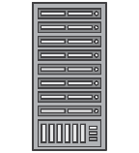
Le sfide nella fase di Migrazione
MRA
MRP
Migration
Migration Preparation & Business Case
Portfolio Discovery & Planning
Application Design, Migration & Validation
What are my current on-premise costs?
My CMDB is
out-of-date
Large volumes of data - difficult & time consuming to process/plan
Different workloads require different tools
How do I compare costs to AWS?
What’s my actual utilization?
How do I know an app migration is complete?
What is my cost to migrate?
What software is running on each server?
What, how, and when should I migrate which applications?
How do I track progress without slowing down?
How do I select AWS EC2 instances?
What are my application dependencies?
Notes:
[Migration execution challenges]
Throughout the migration process, you will face significant challenges, and if unprepared to face these challenges, your migration project will have issues and delays.
During Migration Planning, you will ask “what are my on-premise costs? what are my migration costs? how to I pick EC2 instances on AWS? what are my costs on AWS?”
During Portfolio Discovery & Planning, you will come to the realization that your CMDB is likely out of date, you will need to understand the actual utilization of your servers, and what apps are on each server? and what are the application network dependencies?
Even when detailed discovery data is available, you will find that discovery generates a lot of data and that existing tools are cumbersome and time consuming to analyze. You will be asking what apps to migrate, when, and what order? And how do I do migrate?
While migrating, you will find that you lack visibility into application migrations. You will be using different toots to migrate different applications and tracking across multiple use cases and migration tools is complex. You will ask how do I keep track of all my migrations without slowing down progress and velocity.
So lets talk how AWS migration tools to help you with these challenges…

Slide 23




Il servizio AWS Application Discovery Service
Capture and visualize system inventory, performance, and dependencies
AWS Application Discovery Service
Visualize Discovery
Data
Capture
Data Center
Agents
(Windows/
Linux)
Discovery
Connector
(vCenter)
Import from
existing sources
Encrypted
data
Notes:
[AWS Application Discovery Service]
Application Discovery Service is a discovery tool that captures details of your on-premises infrastructure including server details such as OS name, ip addresses, mac address and time series utilization data such as CPU utilization, memory utilization, and IOPS throughput. In addition, it also captures the network connections and process information. You can further analyze the captured information to evaluate the cost of migration to AWS to plan migration.
Application Discovery Service supports three ways to collect data:
Agent-based discovery can be performed on any given virtual machine or physical server that is part of your on-premises environment (Windows or Linux). The agent is deployed on each virtual machine or physical server separately and runs only in the user space. The Agent supports all major Linux versions such as Red Hat, CentOS, Ubuntu etc. and Windows Server versions such as 2003, 2008, 2012 etc.
Agentless Discovery Connector designed for VMware environment that is used by deploying an OVA file on a VMware host that allows it to collect data from each VM server. Agentless discovery process is OS agnostic and is able to read data for any VM irrespective of the OS. Agentless discovery does collect less information than Agent-based collection, however.
Import from existing data sources – You are also able to import data that you may already have (such as data from your CMDB or ServiceNow data) or that you may have already collected using a partner tool (such as RISC Networks).
Data from all of the sources is visible directly in AWS Migration Hub console, as well as, via an API or an export file.
For data collected with Agent-based discovery, data can be automatically exported to directly to Amazon Athena where it may be queried directly or visualized using Amazon QuickSight. Using Amazon QuickSight provides you the flexibility to analyze the data to view the network dependencies between servers and identify the processes that are running on a given server (we will talk more about this later).

Slide 24

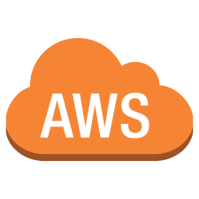

Discovery e Migrazione con AWS Migration Hub
2
Deploy ADS Discovery Connectors and/or Agents
Discovery data sent to AWS Migration Hub
1
View and group servers into applications
3
Decommission migrated servers
2
7
Data Center
Discovery data imported from existing sources
Select and connect migration tools
4
AWS
Migration
Hub
5
Migrate application
6
Track Status
Notes:
[Discovery and Migration using AWS Migration Hub]
To use AWS Migration Hub for both discovering on-premises assets and migrating, the following steps are performed:
The first step is to deploy an AWS ASDS Discovery Connector and/or AWS ADS Agents on-premise to collect the necessary information.
Discovery data collected is sent to the AWS Application Discovery Service and made visible in the AWS Migration Hub.
Additionally, discovery data can also be imported into AWS Migration Hub from existing sources or from previously collected discovery data from other discovery tools.
Once the discovery has kicked-off, customers can view and then group the servers discovered by using tags to identify application groups.
Then, the decision around which migration tool to leverage has to be made, connecting the migration tool to customer’s AWS Migration Hub.
Next, customers initiate the migration once ready
Customers can track their status in parallel of all the other activities in the AWS Migration Hub.
Lastly, once proper testing and cutover has been completed, customers can decommission their application infrastructure from on-premises

Slide 25
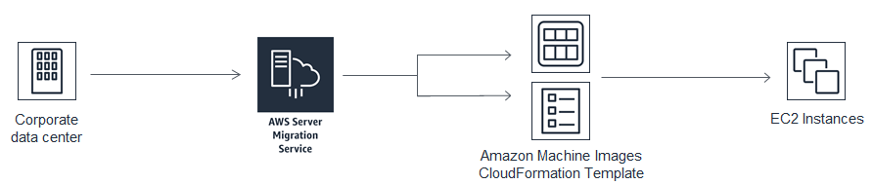
Il servizio AWS Server Migration Service
Agentless VM migration from on-premises datacenters to Amazon EC2
Supports VMware & Hyper-V Virtual Machines
Automate, schedule, and track incremental replications
Simplified application migration using multi-server grouping
Auto-generates AMIs and CloudFormation Template for ease of deployment
Free of cost

Slide 26
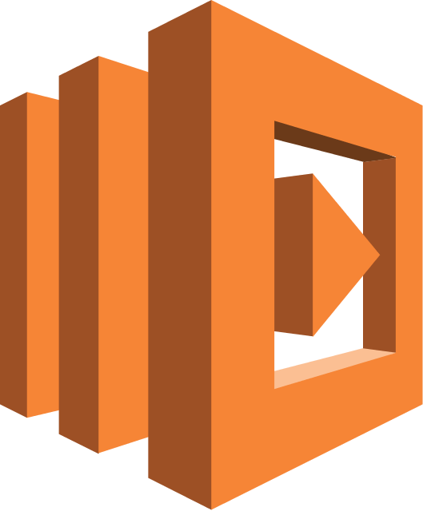






VMware Cloud on AWS Hybrid & Integration Connectivity
VMware vRealize Suite, PowerCLI
AWS CloudFormation, CLI
On-Prem
VMware Cloud on AWS
  AWS services
Hybrid
linked-mode
Elastic Network Interface
vCenter
vCenter
AWS
Lambda
Amazon
S3
Amazon
RDS
vSphere
vSAN
NSX
Amazon Redshift
Amazon
Kinesis
Customer
data center
AWS global infrastructure
Notes:
VMware Cloud on AWS is sold, delivered, supported, and billed by VMware. It supports custom-sized VMs, runs any OS that is supported by VMware. It makes use of single-tenant bare-metal AWS infrastructure so that you can bring your own licenses such as Windows server to the cloud. Each SDDC (Software-Defined Data Center) consists of 4 to 16 instances, each with 36 cores, 512 GB of memory, and 15.2 TB of NVMe storage and clusters that can span across AWS Availability Zone (AZ). You can spin up an entire VMware SDDC in a couple of hours, and scale host capacity up and down in minutes.
The NSX networking platform, powered by the AWS Elastic Networking Adapter running at up to 25 Gbps supports multicast traffic, separate networks for management and compute, and IPSec VPN tunnels to on-premises firewalls, routers, and so forth.
The VMware and third-party management tools including vCenter Server, PowerCLI, and vRealize Suite, that you use today will work just fine when you build a hybrid VMware environment that combines your existing on-premises resources and those that you launch in AWS. This hybrid environment will use a new VMware Hybrid Linked Mode to create a single, unified view of your on-premises and cloud resources. You can use familiar VMware tools to manage your applications, without having to purchase any new or custom hardware, rewrite applications, or modify your operating model. Your applications and your code can access the full range of AWS services including database, analytical, and AI . Use for these services is billed separately and the customer will need to create an AWS account.

