Slide 1
Serverless: build cloud native application
| piergiorgio malusardi | Solution Architect – Public Sector | Amazon Web Services |
16/05/2019

Slide 2
Microservices allow you to decompose for agility
Notes:
From monolith to microservices.
Advantages:
Innovation: The fact that small teams can act autonomously and choose the appropriate technologies, frameworks, and tools for their domains is an important driver for innovation. Responsibility and accountability foster a culture of ownership for services.
Quality: Organizing software engineering around microservices can also improve the quality of code. The benefits of dividing software into small and well-defined modules are similar to those of object-oriented software engineering: improved reusability, composability, and maintainability of code.
Scalability: Fine-grained decoupling of microservices is a best practice for building large- scale systems. It’s a prerequisite for performance optimization since it allows choosing the appropriate and optimal technologies for a specific service.
Availability: Microservices architectures make it easier to implement failure isolation.

Slide 3
Microservices eliminate the need to focus on infrastructure as your critical differentiator
10%
90%
FOCUS ON INFRASTRUCTURE
FOCUS ON APPLICATIONS
Installing, configuring, and managing
my compute infrastructure is critical
to achieving my goals
Having a standardized, flexible, and
on-demand compute environment
is critical to achieving my goals

Slide 4
Amazon views serverless as the native architecture of the cloud
No provisioning,
no management
Automatic
scaling
Pay for
value
Highly available
and secure
Source: Digital Rewrites The Rules Of Business, Forrester, February 2018

Slide 5
Serverless is an operational construct
COMPUTE
ELASTIC
BEANSTALK
ECS/EKS
DATABASES
RDS ON
MYSQL
AMAZON REDSHIFT
STORAGE
MESSAGING
RDS
AURORA
EC2
MYSQL
ON EC2
AMAZON
MQ
ANALYTICS
EMR
FARGATE
HADOOP
ON EC2
AURORA
SERVERLESS
AMAZON ES
More
operations
VM
ON-PREM
MYSQL
ON-PREM
STORAGE
ON-PREM
EBS
ON-PREM
HADOOP
ON-PREM
ATHENA
SNS/SQS
STEP
FUNCTIONS
S3
DYNAMODB
LAMBDA
Less
operations
Source: Digital Rewrites The Rules Of Business, Forrester, February 2018
Notes:
You have heard us talk about shared responsibility in the past. Simply stated, a shared responsibility model implies there are parts of the system that AWS is responsible for and there are parts of the systems that you as a customer must take responsibility for. In many cases we provide tools and there is a rich ecosystem of open source and commercial products that makes it easier for all of you to own your side of the responsibility box.
There is no one hard line on where this line is drawn between the two parts of shared responisbility. One one side of the spectrum you can leverage the power and flexibility of EC2 to run your own database. You can use something like RDS to simplify the management of the database or use RDS Aurora to completely offload the database storage infrastructure to an AWS managed backend. Alternatively you can move to a fully managed database like DynamoDB where you create tables, put data in those tables, and query the data. There is no infrastructure to manage. QoS is part of the the database service with sufficient knobs and dials to give you the right level of control.
The question we keep asking ourselves is: how can we draw this line in a way that allows our customers to innovate on business problems, but makes the underlying infrastructure less visible. Any time you spend coraling infrastructure is undifferentiated heavy lifting. Over the last 12 years as more and more people start in the cloud or move major applications to the cloud, this definition of "undifferentiated havy lifting has evolved"

Slide 6
Options for architecting your microservices
Containers
Serverless
Amazon ECS
AWS Lambda
Amazon EKS
AWS Fargate

Slide 7
Containers: ECS, EKS, Fargate
Platforms to run containerized applications on AWS
Easily run and scale applications to meet your needs
Native integration with other AWS services
Pairs well with CI/CD
Benefits
  Portability
  Control
  Rich ecosystem

Slide 8




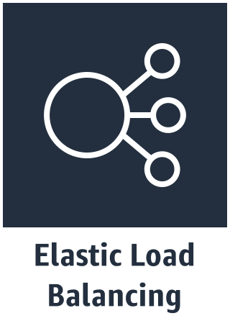


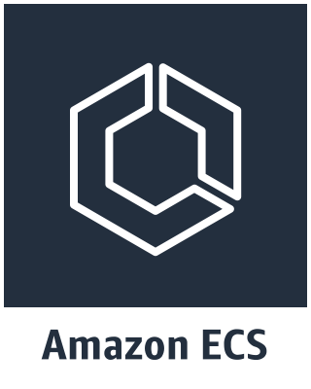

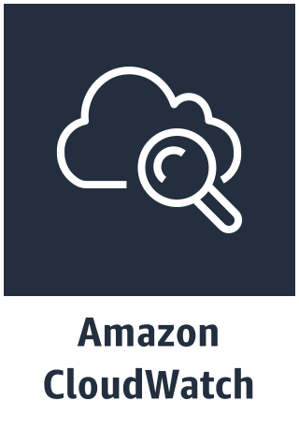
AWS container web architecture
VPC
Internet Gateway
Availability Zone A
Availability Zone B
Public Subnet
Public Subnet
NAT Gateway
NAT Gateway
Private Subnet
Private Subnet
ECS Cluster
Auto Scaling Group
Instances
Instances

Slide 9
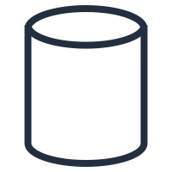
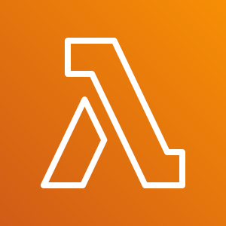
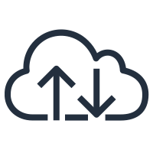
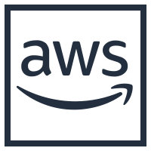

Serverless Computing
EVENT SOURCE
FUNCTION
SERVICES (ANYTHING)
Changes in data state
Node.js
Python
Java
C#
Go
PowerShell
Ruby
Requests to endpoints
Changes in resource state
Notes:
The model of compute is simple: you have an event coming from an AWS service or an invocation, a request coming from an endpoint or a change on a resource and your code gets executed.
This code can be built with virtually any kind of language. We, out of the box, support and manage these ones but you can build you custom runtime.
From this code, do what your business need! Connect to services, public endpoints, calculations, DBs, transformation. Basically, code.
15 mins execution limit
Event driven

Slide 10
Serverless: Lambda
Platform to run code without thinking about servers
Our definition
  No servers to provision or manage
  Scales with usage
  Never pay for idle
  High availability built in, fault tolerance made easier
Native integration with other AWS services
Benefits
  Event-driven framework
  Multiple invocation models
  Opinionated

Slide 11


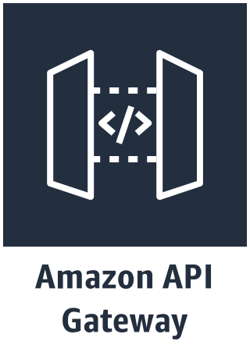
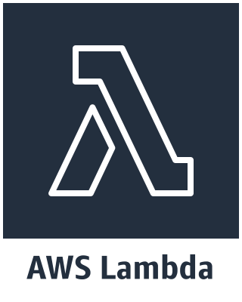
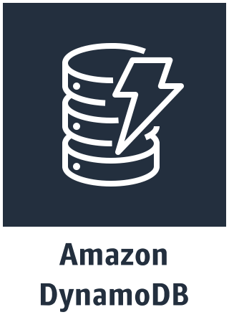
AWS serverless web architecture
AWS Cloud

Slide 12
Architectural considerations
Containers
Serverless
Custom code & services: Build your own environment
Numerous choices
Requires management and orchestration*
Standardized choices
Opinionated approach drives scalable platform
Security and scaling managed by AWS
Serverless and “containerless”
* - Fargate changes this model

Slide 13
Other considerations
Containers
Serverless
Wide array of power options
  Power level managed by container, scoped by host
  Fargate offers streamlined model
Multiple networking modes
Mature tooling
Easy power level selection
  128MB to 3GB
  Network and CPU assigned proportionally
Can overwhelm backends
Developing tooling
Organizational readiness?
* - Fargate changes this model

Slide 14
So how do we decide?

Slide 15
Ideas on selecting … containers
When you need …
Lower startup latency
Support for long running compute jobs (> 15 minutes)
Predictable, high traffic usage
Persistence of data
When you want …
Complete control of compute environment
  But not just for the sake of control

Slide 16
Ideas on selecting … serverless
When you need …
To trigger action on an event
Support for varying utilization
Ability to handle unknown demand
When you want to …
Quickly prove business value
Hand operational complexity (for example, patching, scaling) to AWS
Make fewer decisions

Slide 17
What if I can’t decide?
Load
balancer
Your
business
logic
Event
Function
Context

Slide 18
Decision Tree – well, almost!
Runtime environment compatible with AWS Lambda?
.NET Core, Go, Java, Python, or Node.js
Deployment Package size
<= 50MB
Desired Service runtime <= 15 minutes?
Unknown demand and below RPS breakeven
Inter-container communication* or storage-intensive?
Yes
Yes
Yes
Yes
No
AWS Lambda
No
No
No
No
Yes
Desire orchestration portability OR open source fan?
Yes
Amazon EKS
No
Are you comfortable managing your own infrastructure?
AWS Fargate
No
Yes
Amazon ECS

Slide 19
Architecting microservices

Slide 20


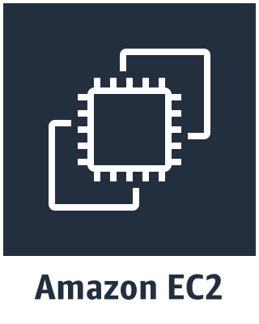



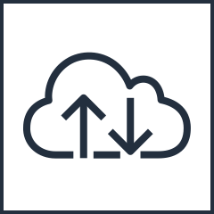
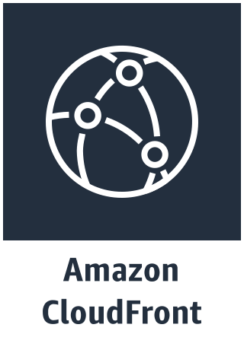

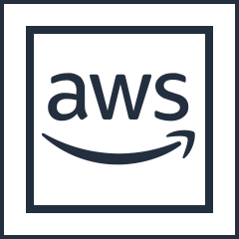
API Gateway integrations
AWS Cloud
YOUR VPC
API Gateway Cache
Mobile Apps
Endpoints on Amazon EC2
Websites
Internet
Regional API Endpoints
Services
All publicly accessible endpoints
Any other AWS service

Slide 21
Amazon API Gateway
Enables best practices for distributed systems
Throttling
Retry with exponential fallback
Fail fast
Support for public and private services

Slide 22
AWS AppSync
Enables data-driven, real-time apps
Multiple data sources, one endpoint
Client specifies payload
Subscription to latest data

Slide 23
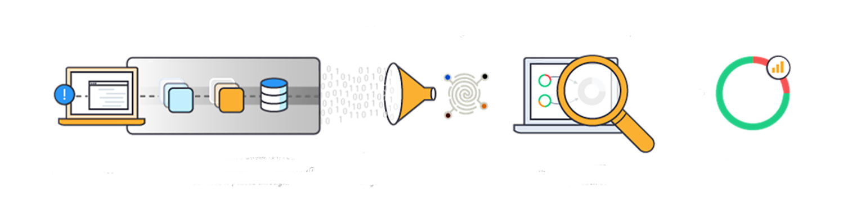
AWS X-Ray
Delivers insight into distributed applications
Uncover application issues
Improve application performance
Ready for ECS, Lambda, and more

Slide 24
Containers: https://aws.amazon.com/containers/
Serverless: https://aws.amazon.com/serverless/

