Slide 1

Amazon Web Services
Introduction to AWS
Fabrizio Pappalardo
Partner Development Manager Public Sector
pappalf@amazon.it

Slide 2

Agenda
What is cloud computing and its benefits?
Partner opportunities
The AWS platform
Joining the AWS Partner Network (APN)

Slide 3
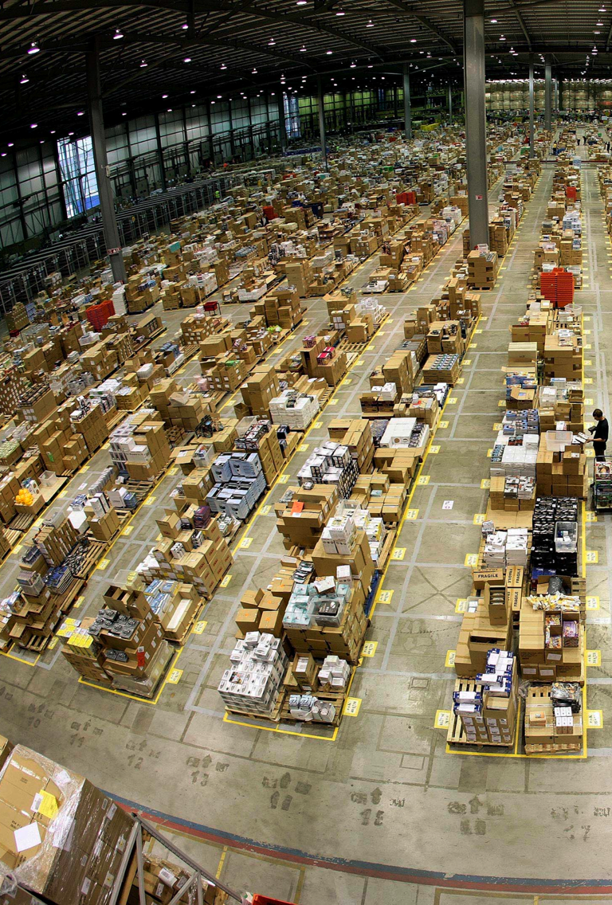
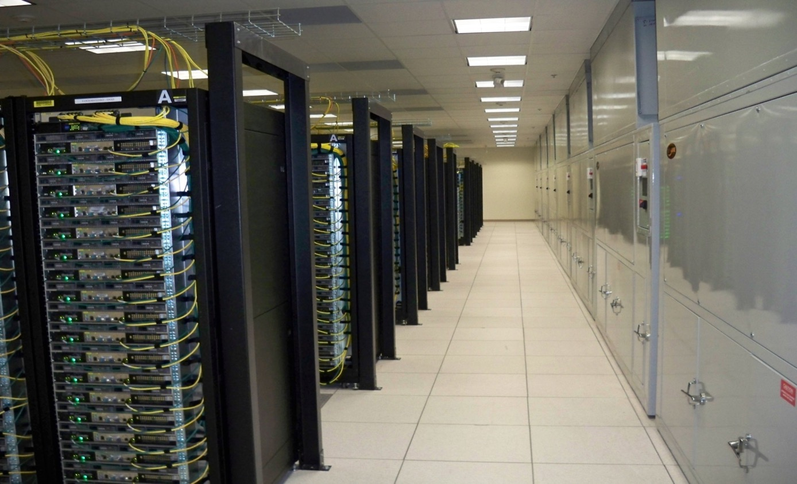


Slide 4
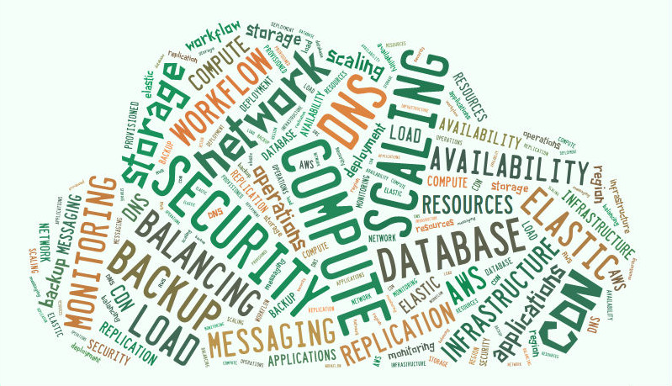
What Is Cloud Computing?
The on-demand delivery of IT resources over public or private networks with zero up-front costs, no long-term contracts, and pay-as-you-go pricing

Slide 5

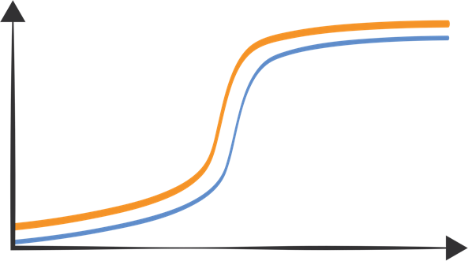



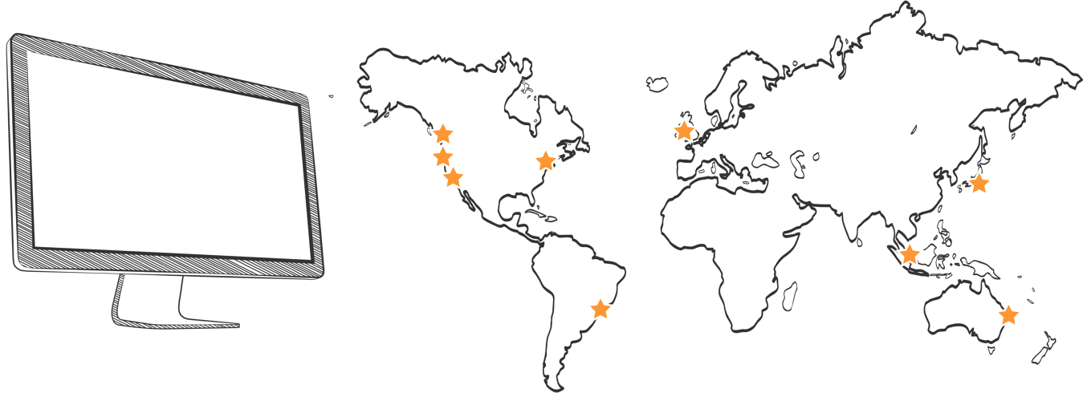

BENEFIT OF CLOUD
65 Price
Reductions
in last 11 years
Capacity
Benefit from massive economies of scale
Stop guessing capacity
Increase speed and agility
Stop spending money on running and maintaining datacenters
Go global in minutes
Demand
$$$$
AWS
Notes:
took out Trade capital expense for variable expense
66 Price reductions based on PY – 11 May

Slide 6























EMEA Public Sector Customers

Slide 7



Italy Public Sector Customers
Leggi la Storia
https://aws.amazon.com/solutions/case-studies/european-space-agency/
Leggi la Storia
https://aws.amazon.com/solutions/case-studies/corte-dei-conti/
Istituto Nazionale di Astrofisica: Istituto Nazionale di Astrofisica conducts scientific research in astronomy and astrophysics. The use of AWS Lambda, AWS SQS and AWS EC2 allowed to deliver an ad-hoc cloud architecture for specific workload in the quickest way possible. The organization turned to the AWS Cloud for particular heavy simulations workload and using the serverless architecture processed hundreds of TBs of data into the cloud.
Leggi la Storia Ottobre 2017
https://aws-de-media.s3.amazonaws.com/images/whitepaper/AWS-City-of-Cagliari-case-study.pdf

Slide 8
AWS in Italian Sector
AWS helps Public Sector Customers in
Central Government
Local Government
Education
Healthcare

Slide 9
TAKE A CLOSER LOOK AT AWS

Slide 10
The AWS PLATFORM Difference
SCALE
CHOICE
COST OPTIMIZATION

Slide 11
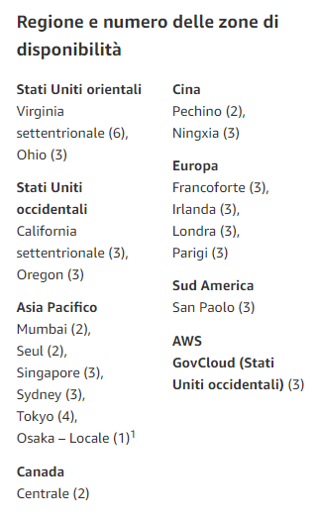
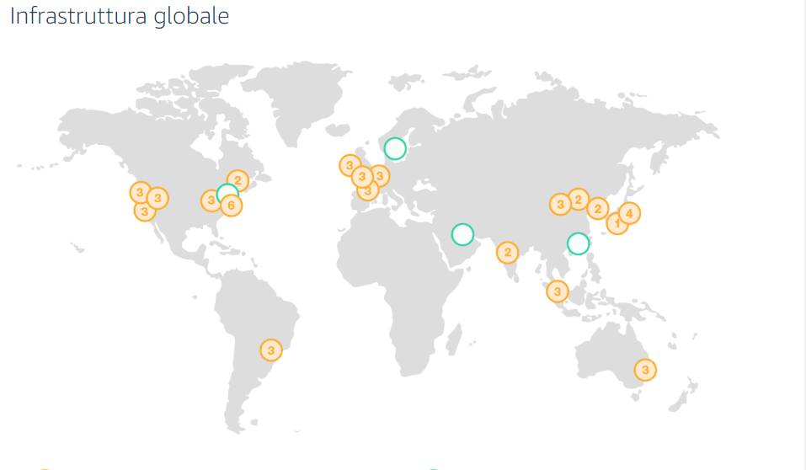
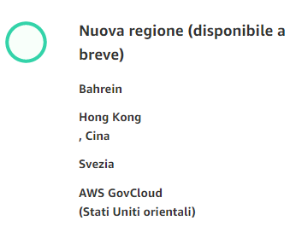
Deploy faster wherever you like
21 Regions – 64 Availability Zones – 169 Points of Presence
2
Announced Regions
Notes:
https://aws.amazon.com/it/about-aws/global-infrastructure/

Slide 12
  ZOOM IN: AWS REGION
Sample Availability Zone
Sample US Region
Datacenter
Datacenter
Availability
Zone A
Availability
Zone B
Datacenter
Availability
Zone C
  ZOOM IN: AWS AZ

Slide 13






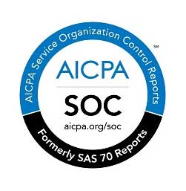
















Architected for Government Security Requirements
And many more…
https://aws.amazon.com/compliance/

Slide 14
With AWS, Security Is a Shared Responsibility
Customer Data
Customers are responsible for security ‘in’ the Cloud
Platform, Applications,
Identity & Access Management
Operating System, Network &
Firewall Configuration
Client-side Data Encryption & Data Integrity Authentication
Server-side Encryption (File System and/or Data)
Network Traffic Protection (Encryption / Integrity
/ Identity)
Compute
Storage
Database
Networking
AWS is responsible for security ‘of’ the Cloud
AWS Global Infrastructure
Regions
Edge Locations
Avail. Zones

Slide 15
The AWS PLATFORM Difference
SCALE
CHOICE
COST OPTIMIZATION

Slide 16


















Broad and Deep services
Beyond 100 Services
Advanced Services
Intelligenza artificiale
Dispositivi mobili
Internet of Things
Sviluppo di videogiochi
AWS Marketplace
Analisi
Platform Services
Strumenti per sviluppatori
Streaming
di desktop e applicazioni
Supporto tecnico e aziendale
Strumenti
di gestione
Produttività aziendale
Servizi applicativi
Core Services
Reti e distribuzione di contenuti
Architettura cloud ibrida
Calcolo
Storage
Database
Messaggistica

Slide 17
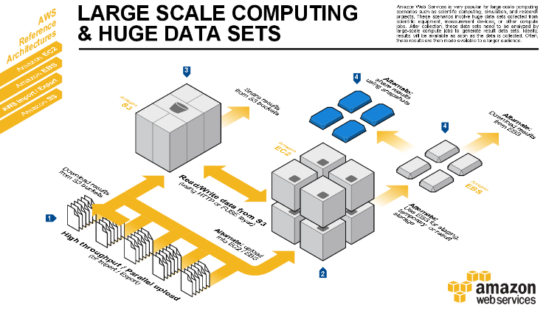
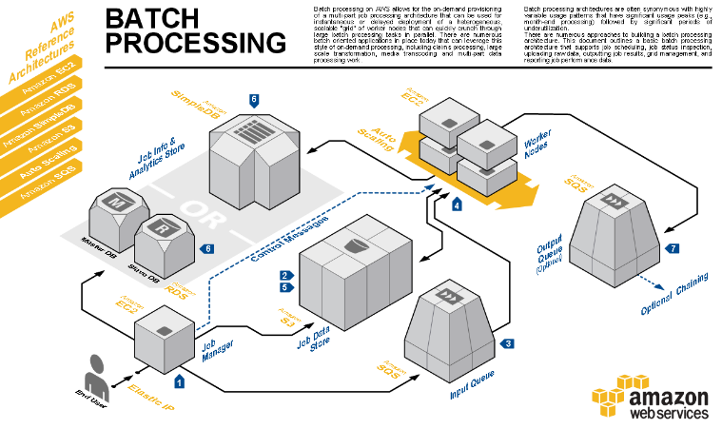
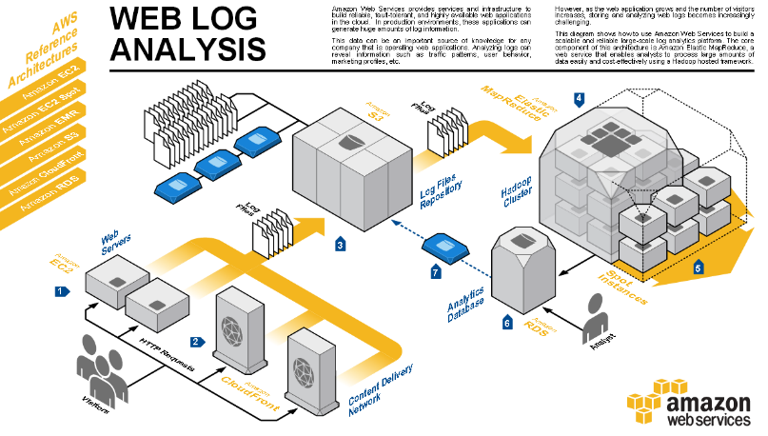
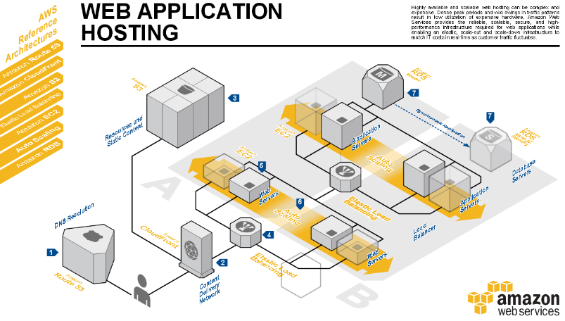
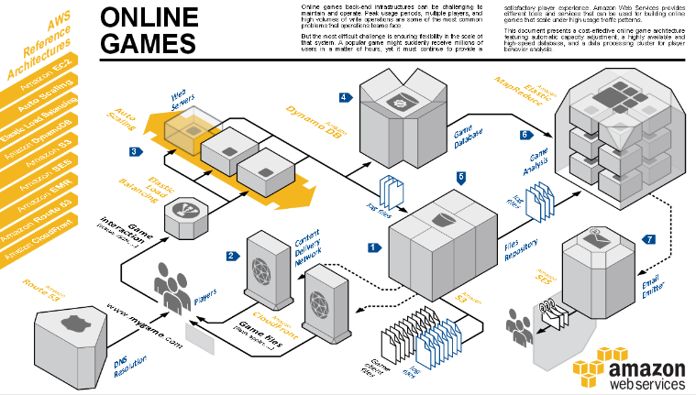

Slide 18

M5: general-purpose instances
Balance of compute, memory, and networking resources
Powered by 2.5 GHz Intel Xeon Scalable Processors (Skylake)
Largest instance size, m5.24xlarge has 96 vCPUs and 384 GiB of memory
Up to 24% instance savings* by migrating from M4 to M5
Improved network and EBS performance on smaller sizes
Support for Intel AVX-512 offering up to twice the performance for vector and floating point workloads
M5d variant available with local NVMe-based SSD storage
M5a variant also available
*Source: TSO Logic Research - https://tsologic.com/wp-content/uploads/2018/11/TSOLogic_Intel_Research_Final_2018-1.pdf
Notes:
The general-purpose (M) instances go all the way back to 2006 when we launched the m1.small. We continued to evolve along this branch of our family tree, launching the M2 (2009), M3 (2012), and the M4 (2015) instances. Our customers use the general-purpose instances to run web & app servers, host enterprise applications, support online games, and build cache fleets.
Available now, M5 instances are the next generation of Amazon EC2 General Purpose instances, powered by 2.5 GHz Intel Xeon Platinum 8000 series (Skylake-SP) processors. Intel® Advanced Vector Extension 512 (Intel® AVX-512) offers accelerated application performance 2x better than previous generation technologies, enabling significant improvements in workload speed and data application. With Enhanced Networking, and a new larger instance size that provides up to 96 vCPUs and 384 GiB of memory, M5 instances have up to 50 percent more vCPUs, 50 percent more memory, and 25 percent more network bandwidth than M4, making them ideal for web and application servers, backend enterprise applications, gaming servers, caching fleets, and application development environments.

Slide 19
High memory instances: certified for SAP HANA
NEW!
12 TB
Up to 12TB Memory; SAP-Certified
Custom Intel® Xeon® Scalable Processor
Native to AWS; Out-of-box integration
Simple management: AWS CLI, Console, IAM
Flexibility to scale; Resize in minutes
18 and 24 TB instance coming in 2019
9 TB
6 TB
4 TB
2 TB
768 GB
1 TB
244 GB
488 GB
EC2 High Memory Instances
Notes:
A new class of EC2 instances built for running mission-critical deployments of SAP HANA
EC2 Bare Metal instances; available on EC2 Dedicated Hosts in Amazon VPC
o
Launch and manage the instances through the AWS portal and CLI/SDK
o Out-of-the-box connectivity to other Amazon EC2 Instances without the need for custom networking configuration or hybrid architecture
o Take advantage of other AWS services, including EBS, S3, Cloud Formation, CloudWatch, AWS Config, etc.
o Available within the same IAM framework as the rest of AWS for authentication, authorization, and auditing
First ever EC2 instances powered by an 8-socket server platform based on Intel Skylake processors
• EBS as the storage for running HANA. Take advantage of elastic storage capacity. [Key competitive differentiation]
• Just like SAP certified EC2 X1 and X1e instances, designed to support enterprise-class data protection and business continuity capabilities, including multi-AZ high availability and multi-region disaster recovery configurations, backups, and EBS snapshots.

Slide 20
The AWS PLATFORM Difference
SCALE
CHOICE
COST OPTIMIZATION

Slide 21
Amazon EC2 Purchasing Options
On-Demand Instances
Reserved Instances
Scheduled Instances
Spot Instances
Dedicated Instances
Dedicated Hosts
Pay by
the hour.
Purchase, at a significant discount, instances that are always available
Purchase instances that are always available on the specified recurring schedule, for a one-year term.
Bid on unused instances, which can run as long as they are available and your bid is above the Spot price.
Pay, by the hour, for instances that run on single-tenant hardware.
Pay for a physical host that is fully dedicated to running your instances.
1-year to 3-year terms.

Slide 22



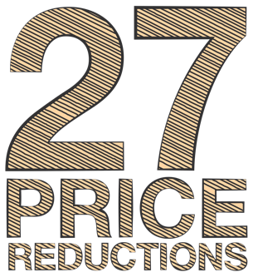

AWS Pricing Philosophy
Reduced Prices
More Customers
72
Lower Infrastructure Costs
More AWS Usage
We pass the savings along to our customers in the form of low prices and continuous reductions
Economies of Scale
More Infrastructure

Slide 23

Summary: What sets AWS apart?
Experience
Building and managing cloud since 2006
Service Breadth & Depth
165 services to support any cloud workload
Global Footprint
21 regions, 64 availability zones, 169 points of presence
Pricing Philosophy
72 proactive price reductions to date
Ecosystem
35000 partners; 4800 Marketplace products

Slide 24
Cloud Procurement

Slide 25

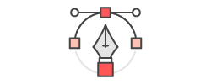

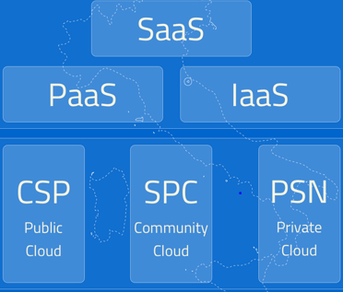


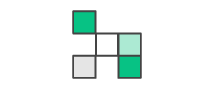
Come acquisire Cloud
https://cloud.italia.it/marketplace/supplier/market/index.html
“Cloud PA” Marketplace di AgID al link:
Implementazione & Migrazione in Produzione
Marketplace Cloud PA
Acquisizione
(Consip SDAPA
Cloud)
Definire ambito
del Progetto
Notes:
According to Italy Cloud Policy, the Public Administrations can procure Public Cloud services from the Cloud PA Marketplace (see step 2 in the picture, after “scoping the project”).
Qualified CSPs are one of the Pillars of this Marketplace (the other two pillars are SPC (PA community cloud), and PSN (PA private cloud), and AWS has been just qualified by AgID as CSP!
Note that according to the Policy, starting Nov 20th, the Public Administrations can acquire IaaS/PaaS public cloud services - through procurement vehicles such as Consip SDAPA - only from qualified CSPs.
AWS is actively supporting our Partners in the qualification process of their SaaS services on top of AWS platform and AWS is evaluating its own AgID qualification as SaaS Provider, for its own cloud application “pay-as-you-go” services.

Slide 26

Il Procurement Cloud è differente dal tradizionale IT
Tradizionale Procurement IT
Avverso al rischio
Contratti di lunga durata (anni)
Altamente prescrittivo
Termini e condizioni rigidi
Approccio alla sicurezza tradizionale
Prezzo fisso
Pagamento prevedibile
Best Practice Cloud Procurement
Focus su benefici agli utenti finali
Basato sulle prestazioni
Dare priorità ai risultati
Non riciclare approcci IT tradizionali
Abbracciare il self service e
«pay as you go pricing”
Coinvolgere presto gli stakeholders
Consentire una rapida innovazione
Notes:
How do we think about making the transition to cloud?

Slide 27
Comune di Cagliari

Slide 28
Business Problem
Proposed Solution
Improve transparency during elections
Allowing citizens track elections’ results in real time
Support a population 0f 400,000 inhabitants
Export election results from existing DCs to AWS
Use Lambda to create static Web Pages to be hosted on S3
Use Cloudfront to distribute the Web Pages
Use Route53 to load balance requests between 2 AWS regions

Slide 30
Outcomes
Managed almost 8 millions unique contacts on the Web Pages over 24 hours
Managed peaks of 200 contacts per second
No perfromance impact and fluid experience for all citizens
At a cost that is difficult to imagine: 125 Euro
Developed in a time frame of: 2 weeks
For a total consulting and development cost of the partner worth: Euro 40,000

Slide 32
Corepla

Slide 33
Business Problem
Proposed Solution
Coordinate recycling process through 60 sites all over Italy
Control production process
Guarantee that only quality material gets into the production line
Reduce the amount of «fraud»
Create an Artificial Intelligence algorythm to analyse images from different production sites
Use the manually classified images set to create the model
Use Sagemaker to create the algorythm

Slide 34




Solution
Built it algorithm to recognize images
REST API
Requests
Training images
Amazon SageMaker Training and Tuning services
Model
Amazon SageMaker Hosting service

Slide 35
Outcomes
Managed to accurately identify 6 different stages of production
Reduction of 80% of the time 2 full headcounts were investing in image recognition
Accuracy level achieved: 93% (higher than human accuracy)
Development time: 2 months from idea to POC conclusion
AWS Consumption: Euro 850 per month
Cost of partner consultancy and development: Euro 18,000

Slide 36
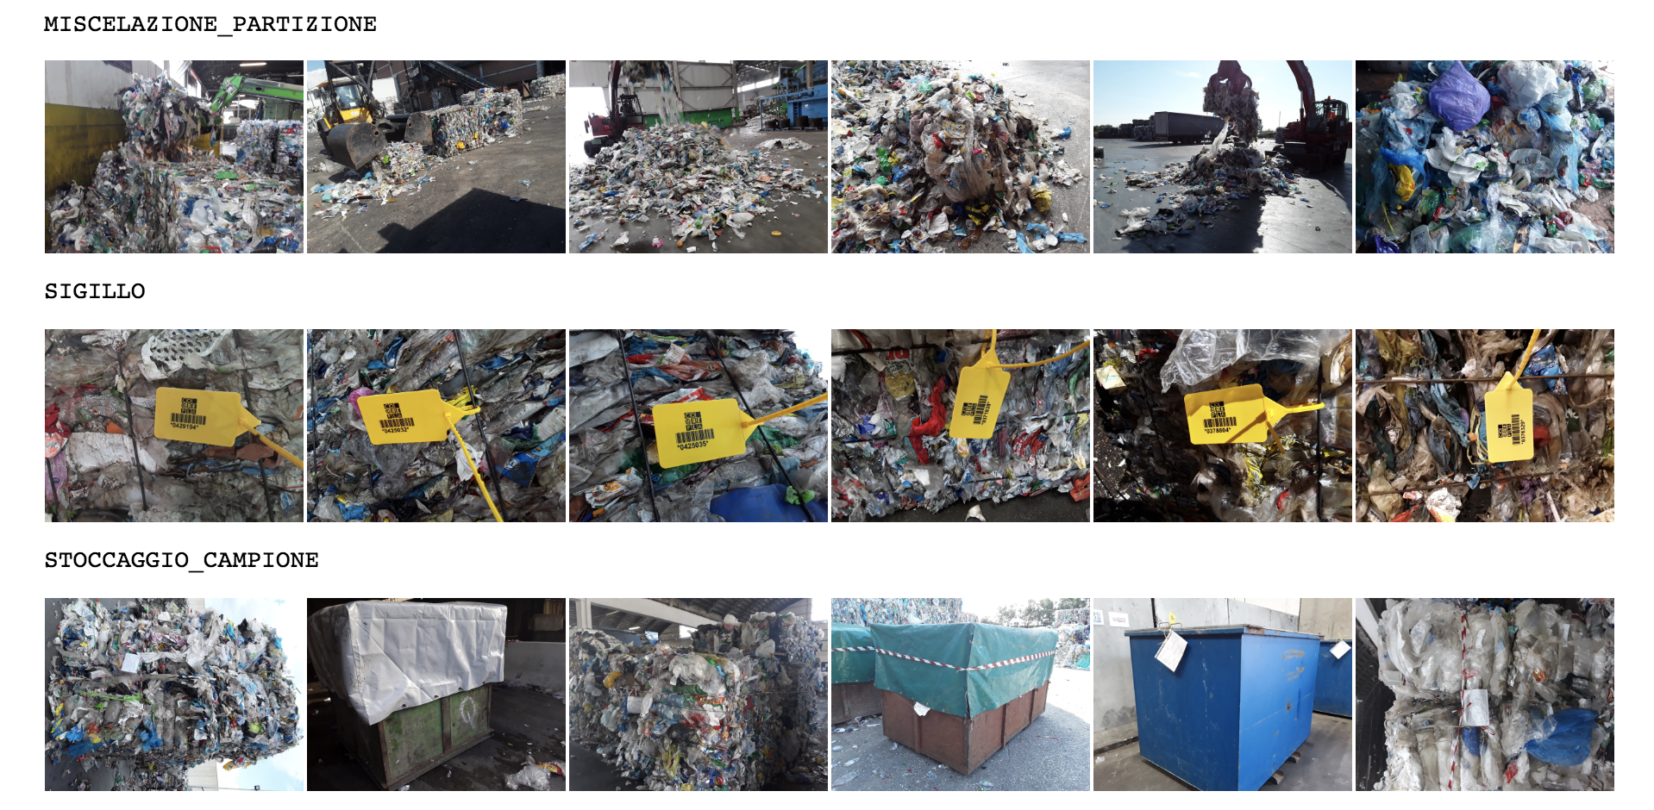
Quality Analisys Stages

Slide 37
THANKS, QUESTIONS?

