Slide 1
Navigating GDPR Compliance on AWS
Carmela Gambardella
AWS Solutions Architect

Slide 2
What is the GDPR?

Slide 3
What is the GDPR?
The "GDPR" is the General Data Protection Regulation, a significant new EU Data Protection Regulation
Introduces robust requirements that will raise and harmonize standards for data protection, security, and compliance across the EU
The GDPR is enforceable May 25, 2018 and it replaces the EU Data Protection Directive (Directive 95/46/EC)
In scope: Organizations established in the EU and Organizations without an EU presence who target or monitor EU individuals
Notes:
Il Regolamento generale sulla protezione dei dati (GDPR) dell'Unione Europea tutela il diritto fondamentale alla privacy e alla protezione dei dati personali dei cittadini dell'Unione europea.
Introduce requisiti rigorosi che definiscono e armonizzano nuovi standard in materia di compliance, sicurezza e protezione dei dati.

Slide 4
Content vs. Personal Data
Content
= anything that a customer (or any end user) stores or processes using AWS services, including:
Software ǀ Data ǀ Text ǀ Audio ǀ Video
Personal Data
= information from which a living individual may be identified or identifiable (under EU data protection law)
Customer’s “content” might include “personal data”
Notes:
Traduzioni dall’inglese:
- Data Controller: Titolare del trattamento. si intende che il titolare è il soggetto che tratta i dati forniti dall’interessato per i suoi scopi
- Data Processor: Responsabile del trattamento: “la persona fisica o giuridica, l’autorità pubblica, il servizio o altro organismo che tratta dati per conto del titolare”
Content [CLICK]
<<read contents of the box>>
For example, a customer’s “content” includes objects that the customer stores using S3, files sorted on EBS or the contents of an Amazon DynamoDB table.
Personal Data [CLICK]
<<read contents of the box>>
“Personal data” includes names, email addresses, social security numbers, payroll ID numbers, etc. There’s also a recent line of cases in Europe that have determined that, in some cases, IP addresses can be “personal data”.

Slide 5
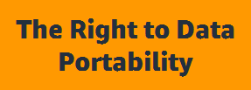
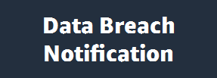
What Else Comes with GDPR?
Individuals have the right to a copy of all the personal data that controllers have regarding him or her. It also must be provided in a way that facilitates reuse.
Notes:
Gli individui hanno il diritto a una copia di tutti i dati personali che i controllori hanno riguardo a lui o lei. Deve anche essere fornito in un modo che facilita il riutilizzo.

Slide 6
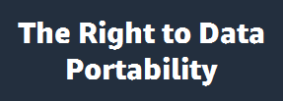
What Else Comes with GDPR?
This gives individuals the right to have certain personal data deleted so third parties can no longer trace them.
Notes:
Diritto all’oblìo
Ciò conferisce agli individui il diritto di cancellare determinati dati personali in modo che terzi non possano più rintracciarli.

Slide 7
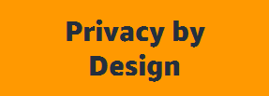
What Else Comes with GDPR?
This helps to facilitate the inclusion of policies, guidelines, and work instructions related to data protection in the earliest stages of projects including personal data.
Notes:
l'inclusione di politiche, linee guida e istruzioni relative alla protezione dei dati nelle primissime fasi dei progetti, compresi i dati personali.

Slide 8
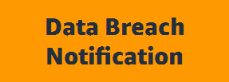
What Else Comes with GDPR?
Controllers must report personal data breaches to the relevant supervisory authority within 72 hours. If there is a high risk to the rights and freedoms of data subjects, they must also notify the data subjects.
Notes:
I controllori devono segnalare violazioni dei dati personali all'autorità di vigilanza competente entro 72 ore. Se esiste un alto rischio per i diritti e le libertà degli interessati, questi devono anche notificare gli interessati.

Slide 9
What problems are customers trying to solve?
What type of data am I collecting?
Where do I collect it?
Where do I store it?
Do I have the appropriate legal collection statements?
How and when do I delete data?
How do I secure the data?
What responsibility do I have?
Why do I collect the data?
What is my legal basis for processing and using the data?
Where is a list of all my data?
Do I communicate with the subject I am collecting from?
Who do I share it with?
Who has access to my data? How do I control it?
What are the use cases for the data? Are they permitted? Who provided permission?
How do I find my data?

Slide 10
How AWS can help customers achieve GDPR compliance

Slide 11
Data Protection – A Shared Responsibility
Data Subjects
Customers are Data Controllers
AWS as Data Processor
Controllers and Processors have obligations under GDPR
Data Controller: Titolare del trattamento
Data Processor: Responsabile del trattamento
Data Subject: Interessato al trattamento

Slide 12
AWS Shared Responsibility Model
Customer content
Customers are responsible for their security and compliance IN the Cloud
Platform, Applications, Identity & Access Management
Customers
Operating System, Network & Firewall Configuration
Client-side Data Encryption
Server-side Data Encryption
Network Traffic Protection
AWS Foundation Services
AWS is responsible for the security OF
the Cloud
Compute
Storage
Database
Networking
Availability Zones
AWS Global Infrastructure
Edge Locations
Regions

Slide 13
AWS Shared Responsibility Model
Will one model work for all services?
Infrastructure Services
Container Services
Abstract Services

Slide 14
How AWS can help customers achieve GDPR compliance?
AWS completed the entirety of our GDPR service readiness audit on March 26, 2018—validating that all generally available services and features adhere to the high privacy bar and data protection standards required of data processors by the GDPR.
What does this mean to you?
Customers can deploy AWS services as a key part of their GDPR compliance plans.
https://aws.amazon.com/blogs/security/all-aws-services-gdpr-ready/
Notes:
Traduzioni dall’inglese:
- Data Controller: Titolare del trattamento. si intende che il titolare è il soggetto che tratta i dati forniti dall’interessato per i suoi scopi
- Data Processor: Responsabile del trattamento: “la persona fisica o giuridica, l’autorità pubblica, il servizio o altro organismo che tratta dati per conto del titolare”
Content [CLICK]
<<read contents of the box>>
For example, a customer’s “content” includes objects that the customer stores using S3, files sorted on EBS or the contents of an Amazon DynamoDB table.
Personal Data [CLICK]
<<read contents of the box>>
“Personal data” includes names, email addresses, social security numbers, payroll ID numbers, etc. There’s also a recent line of cases in Europe that have determined that, in some cases, IP addresses can be “personal data”.

Slide 15
GDPR is also a “shared responsibility”
Legal Compliance
(both controllers and processors)
System Security and Data Protection by Design
(both controllers and processors; AWS has tooling to help)
Records of Processing Activities
(both controllers and processors; AWS has tooling to help)
Encryption
(both controllers and processors; AWS has tooling to help)
Managing Data Subject Consent
(controller responsibility)
Managing Personal Data Deletion
(both controllers and processors; AWS has tooling to help)
Managing Personal Data Portability
(controller responsibility)
Security of Personal Data
(controller responsibility)

Slide 16
GDPR in Practice: Implementing TOMs
Under GDPR, Controllers and Processors are required to implement appropriate Technical and Organization Measures (“TOMs”) …
(1) Pseudonymization and encryption of personal data | (2) Ensure ongoing confidentiality, integrity, availability, and resilience of processing systems and services
(3) Ability to restore availability and access to personal data in a timely manner in the event of a physical or technical incident | (4) Process for regularly testing, assessing, and evaluating the effectiveness of TOMs

Slide 17
Implementing TOMs – What AWS Provides to You
Tools and services
Compliance framework
Partner network
§§
§§
Data protection terms

Slide 18
AWS security solutions
Detective control
Infrastructure security
Data protection
Incident response
Identity
AWS Identity & Access Management (IAM)
AWS Single Sign-On
AWS Directory Service
Amazon Cognito
AWS Organizations
AWS Secrets Manager
AWS Resource Access Manager
AWS Security Hub
Amazon GuardDuty
AWS Config
AWS CloudTrail
Amazon CloudWatch
VPC Flow Logs
AWS Systems Manager
AWS Shield
AWS WAF – Web application firewall
AWS Firewall Manager
Amazon Inspector
Amazon Virtual Private Cloud (VPC)
AWS Key Management Service (KMS)
AWS CloudHSM
AWS Certificate Manager
Amazon Macie
Server-Side Encryption
AWS Config Rules
AWS Lambda
Notes:
Come detto, essendo la sicurezza uno dei principali obiettivi che vogliamo perseguire, la stragrande maggioranza dei servizi della nostra piattaforma ha delle funzionalità di sicurezza built-in. Sto pensando ad esempio ad S3, il nostro servizio di object storage, o a RDS, il servizio di database relazionale gestito, che consentono in modo veramente semplice, di attivare la cifratura dei dati a riposo. Ma oltre a queste funzioanlità di sicurezza, troviamo anche interi servizi dedicati alla sicurezza. Servizi per la gestione dell’autenticazione e dell’autorizzazione, sia che parliamo di utenti AWS e di conseguenza di come gestire i permessi affinché questi utenti possano agire sulla pittaforma, sia che parliamo di utenti applicativi nel qual caso abbiamo srivzi specifici come AWS Directory servie e amazon Cognito; servizi per incrementare il livello di visibilità e tenere sempre sotto controllo le vostre risorse, monitorare eventuali drift di configurazione e che vi segnalano se c’è qualcosa che non va..
Ci sono poi i servizi classificati come sicurezza infrastrutturale, e qui facciamo riferimento a tecnologie di firewall, definizione del network, protezione da attachi dos
Ci sono i serivizi dedicati alla protezione dei dati, nello specifico per abilitare sia la protezione dei dati sia in transit sia at rest, con servizi di cifratura e gestione delle chiavi e dei certificati.
Ed infine i servizi sfruttabili per automatizzare la risposta agli incidenti, di cui parleremo più approfonditamente nel seguito.

Slide 19
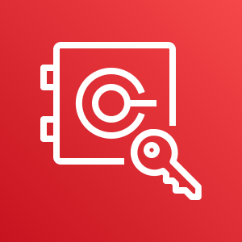
Implementing TOMs with AWS Services
“Data protection by design and default”
“Security of processing”
AWS
KMS
AWS
CloudHSM
Amazon S3
Server-Side
Encryption
AWS Storage Gateway
Amazon API
Gateway
Amazon
Virtual Private Cloud (VPC)
“Records of processing activities”
AWS Identity and Access Management
AWS
WAF
AWS
CloudFormation
Amazon CloudWatch
AWS
CloudTrail
AWS
Config

Slide 20
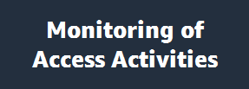
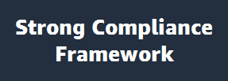
Implementing TOMs with AWS Services - Examples
The controller “shall implement appropriate technical and organizational measures for ensuring that, by default, only personal data that are necessary for each specific purpose of the processing are processed.”
AWS Identity & Access Management
API-Request Authentication
Temporary Access Tokens
AWS Systems Manager
AWS WAF

Slide 21
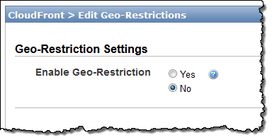
Implementing TOMs with AWS Services
Data Access Control
Amazon CloudFront
Notes:
Puoi utilizzare la restrizione geografica, nota anche come geoblocking, per impedire agli utenti in specifiche aree geografiche di accedere al contenuto che stai distribuendo tramite una distribuzione Web CloudFront.

Slide 22
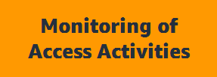
Implementing TOMs with AWS Services – Examples
GDPR Compliance Tools
“Each controller and, where applicable, the controller’s representative, shall maintain a record of processing activities under their responsibility.”
Amazon
GuardDuty
Amazon Macie
Amazon Inspector
AWS
CloudTrail
AWS
Config

Slide 23
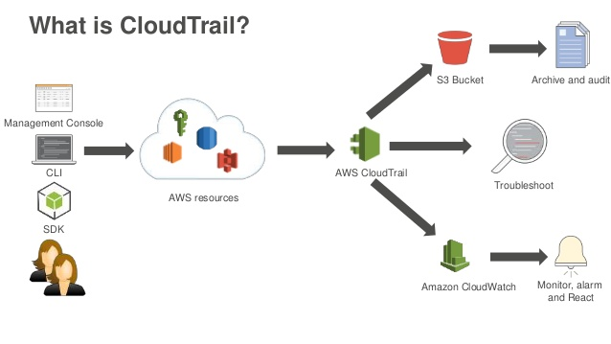
Implementing TOMs with AWS Services
Monitoring of access activities – AWS CloudTrail
AWS CloudTrail

Slide 24
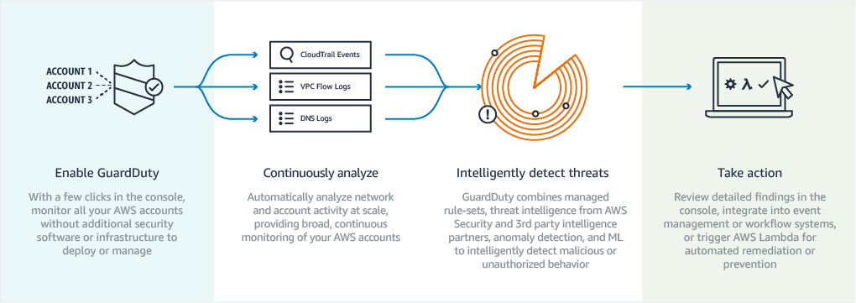
Implementing TOMs with AWS Services
Monitoring of access activities – Amazon GuardDuty
Amazon
GuardDuty
Detects items such as:
Unusual API calls
Potentially unauthorized deployments that indicate a possible account compromise
Potentially compromised instances or reconnaissance by attackers

Slide 25
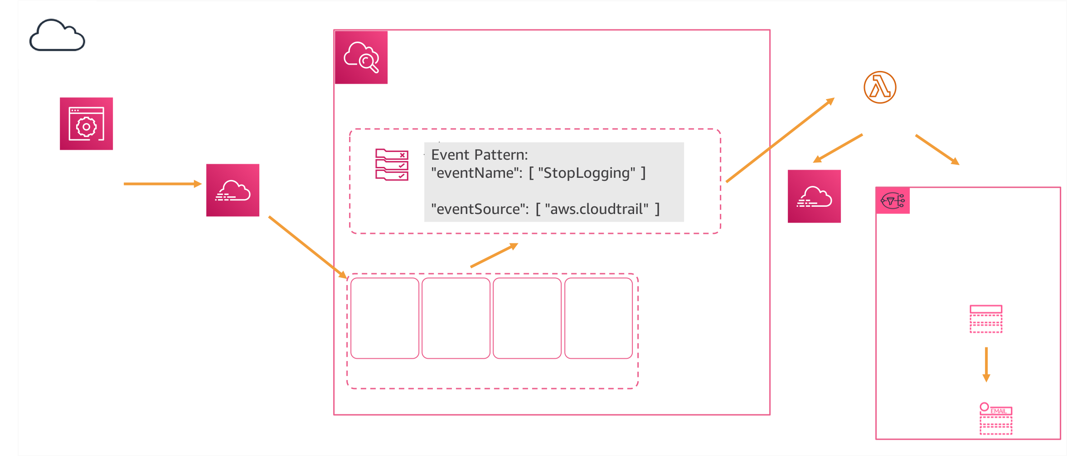
Implementing TOMs with AWS Services
Integrate with Amazon CloudWatch Events for:
Alerting
Remediation

Slide 26
Implementing TOMs with AWS Services
Security service that uses machine learning to continuously and automatically discover, classify, and protect sensitive data in AWS
Recognizes and classify sensitive data such as:
Personally identifiable information (PII)
Intellectual property
Sensitive AWS account information

Slide 27
Implementing TOMs with AWS Services – Examples
Organizations must “implement appropriate technical and organizational measures to ensure a level of security appropriate to the risk, including the pseudonymisation and encryption of personal data.”
Encryption of data at rest (Amazon EBS, Amazon S3, Amazon Glacier, Amazon RDS, etc.)
Centralized Regional Key Management with AWS KMS
IPsec VPN to your AWS environment with Virtual Private Gateway
Dedicated HSM in the cloud with AWS CloudHSM
AWS Key Management Service
AWS CloudHSM

Slide 28
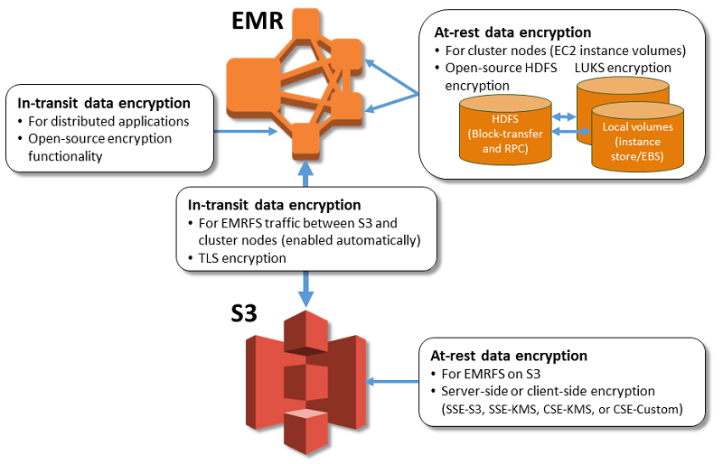
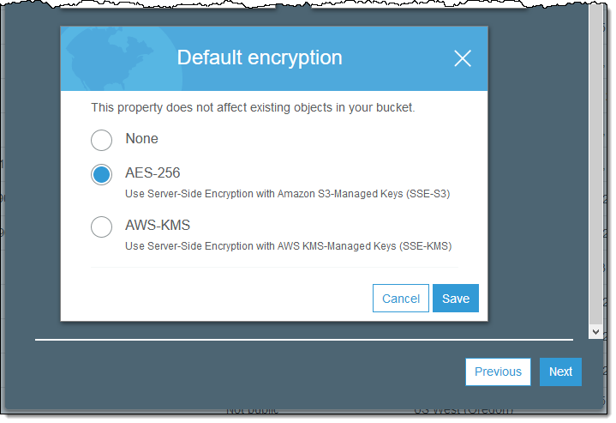
Implementing TOMs with AWS Services
Data encryption at rest
EMR
S3

Slide 29
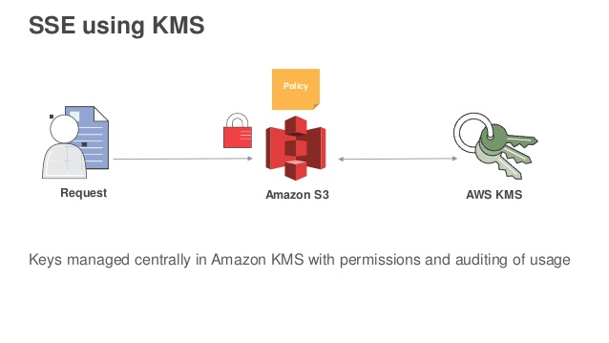
Implementing TOMs with AWS Services
Data Encryption – Key management of server-side encryption

Slide 30
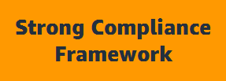
Implementing TOMs with AWS Services – Examples
Appropriate technical and organizational measures may need to include “the ability to ensure the ongoing confidentiality, integrity, availability, and resilience of the processing systems and services.”
SOC 1 / SSAE 16 / ISAE 3402 (formerly SAS 70) / SOC 2 / SOC 3
PCI DSS Level 1
ISO 9001 / ISO 27001 / ISO 27017 / ISO 27018
NIST FIPS 140-2
Common Cloud Computing Controls Catalog (C5)

Slide 31
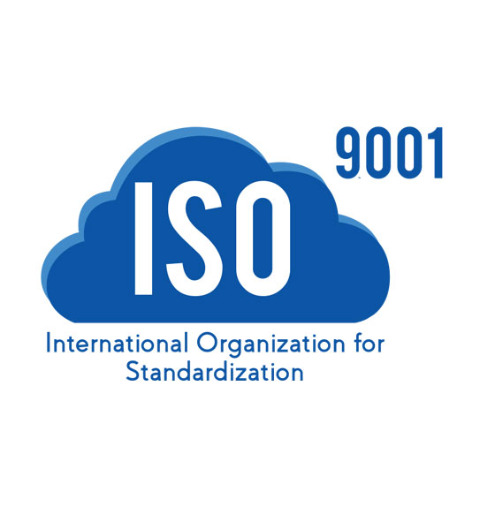
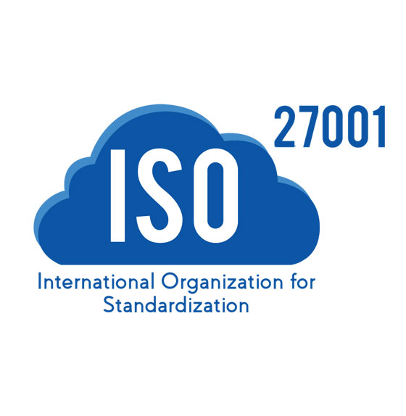
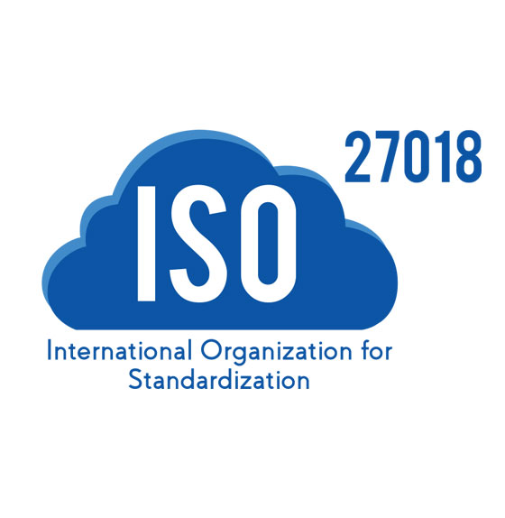
Meet Your Own Security Objectives
Your own accreditation
Your own certifications
Your own external audits
Customer scope and effort is reduced
Better results through focused efforts
Built on AWS consistent baseline controls
GDPR Code of Conduct
AWS Foundation Services
AWS Global Infrastructure

Slide 32
GDPR – Code of Conduct
CISPE Code (Cloud Infrastructure Service Providers in Europe)
The CISPE Code of Conduct :
An effective, easily accessed framework for complying with the EU’s GDPR
Excludes the reuse of customer data
Enables data storage and processing exclusively within the EU
Identifies cloud infrastructure services suitable for different types of data processing
Helps citizens retain control of their personal and sensitive data
AWS CISPE certified
CISPE Code of Conduct in evaluation by Article 29 WP
https://aws.amazon.com/it/compliance/cispe/
Notes:
il GDPR incoraggia le industrie a sviluppare codici di condotta per aiutare il controllore a dimostrare la propria conformità
Il Codice CISPE è uno di questi codici di condotta
CISPE (Cloud Infrastructure Services Providers in Europe) è una coalizione di leader del cloud computing al servizio di milioni di clienti in Europa.

Slide 33
Continuous Validation
Amazon Trusted Advisor
Helps you reduce cost, increase performance, and improve security by providing real-time guidance to help you provision your resources following AWS best practices
Comes with baked-in controls for:
Unrestricted security groups
MFA not on root accounts
Publically exposed AWS credentials

Slide 34
AWS Marketplace: Your One Stop Shop for Familiar Tools

Slide 35
AWS Partner Network (APN) & GDPR
Consulting Partner
Technology Partner
APN Consulting Partners can help your customers get ready for GDPR
APN Technology Partners offer security & identity solutions to help with GDPR

Slide 36
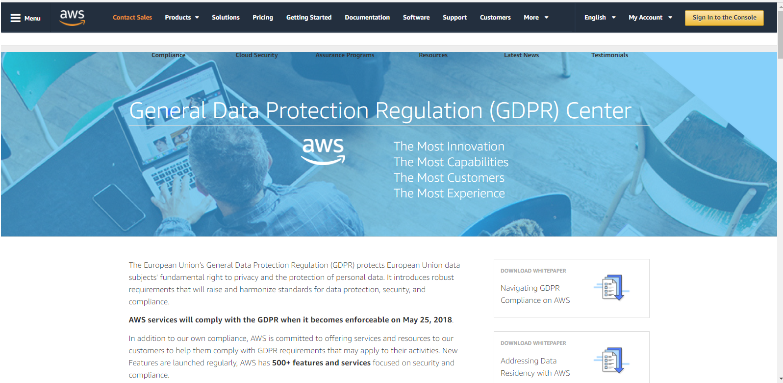
AWS GDPR Center
https://aws.amazon.com/compliance/gdpr-center/

Slide 37
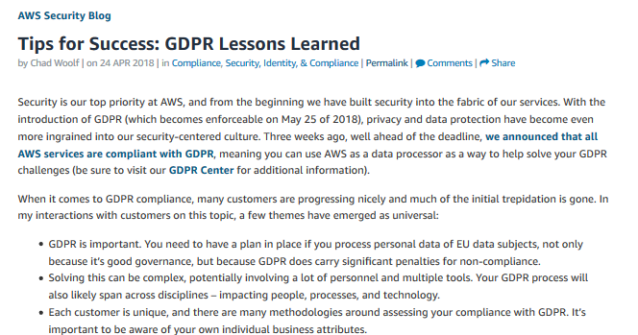
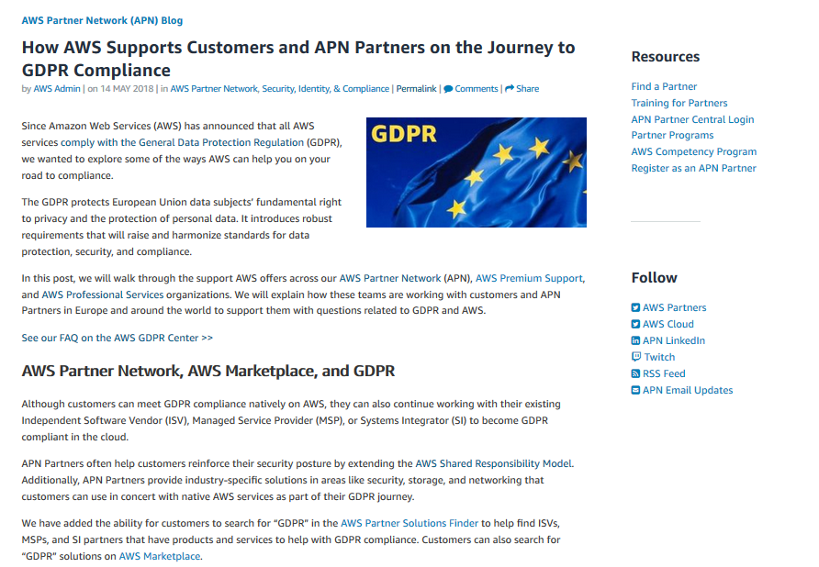
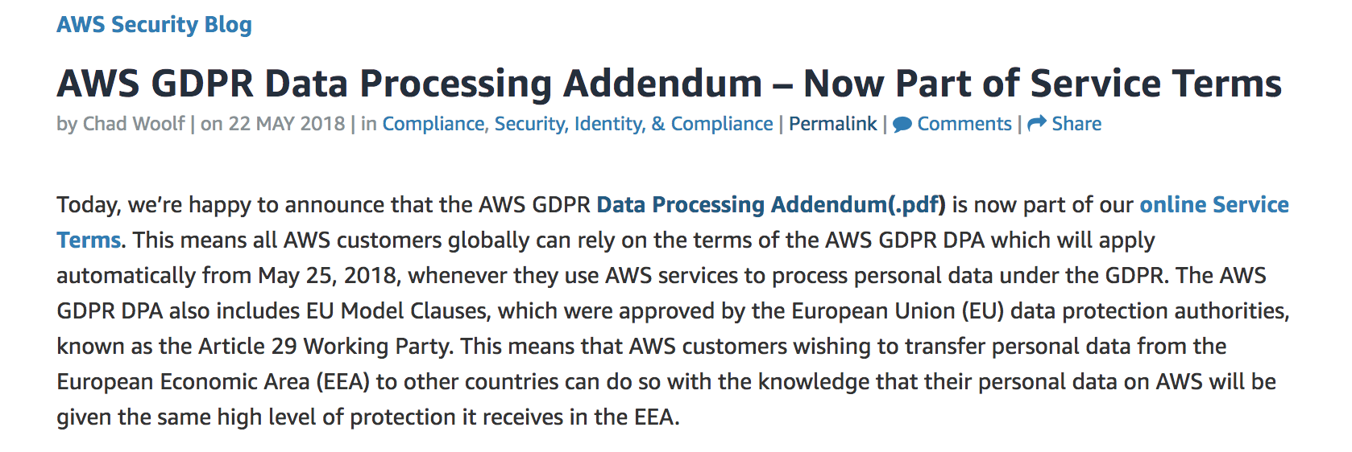
GDPR Resources
https://aws.amazon.com/blogs/security/tips-for-success-gdpr-lessons-learned/
https://aws.amazon.com/blogs/apn/how-aws-supports-customers-and-apn-partners-on-the-journey-to-gdpr-compliance/
https://aws.amazon.com/it/blogs/security/aws-gdpr-data-processing-addendum/

Slide 38
Other Resources
Get a consistent approach for customers and partners to evaluate architectures, and provides guidance to help implement designs that will scale with your application needs over time. AWS Well Architected Framework, https://aws.amazon.com/architecture/well-architected/
Leading insight and applications from AWS security experts on achieving provable security, the highest level of security assurance, in the cloud. Provable Security, https://aws.amazon.com/security/provable-security/

Slide 39
cgambard@amazon.it
Thanks!

