Slide 1
Data Visualization. Cos’è, come renderla al meglio
Maurizio Napolitano - membro comitato scientifico open data Campania

Slide 2
REGIONE CAMPANIA era ULTIMA
Finalità della lezione
capire come comunicare con i grafici
conoscere strumenti per la creazione di grafici

Slide 3
Infografiche e visualizzazione dei dati
SPIEGAZIONE
Infographics
Data Visualization
ESPLORAZIONE

Slide 4
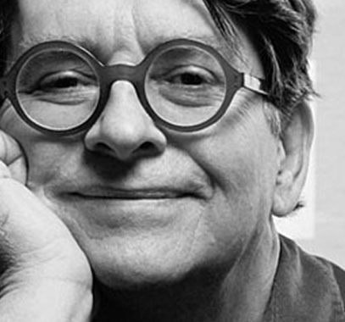
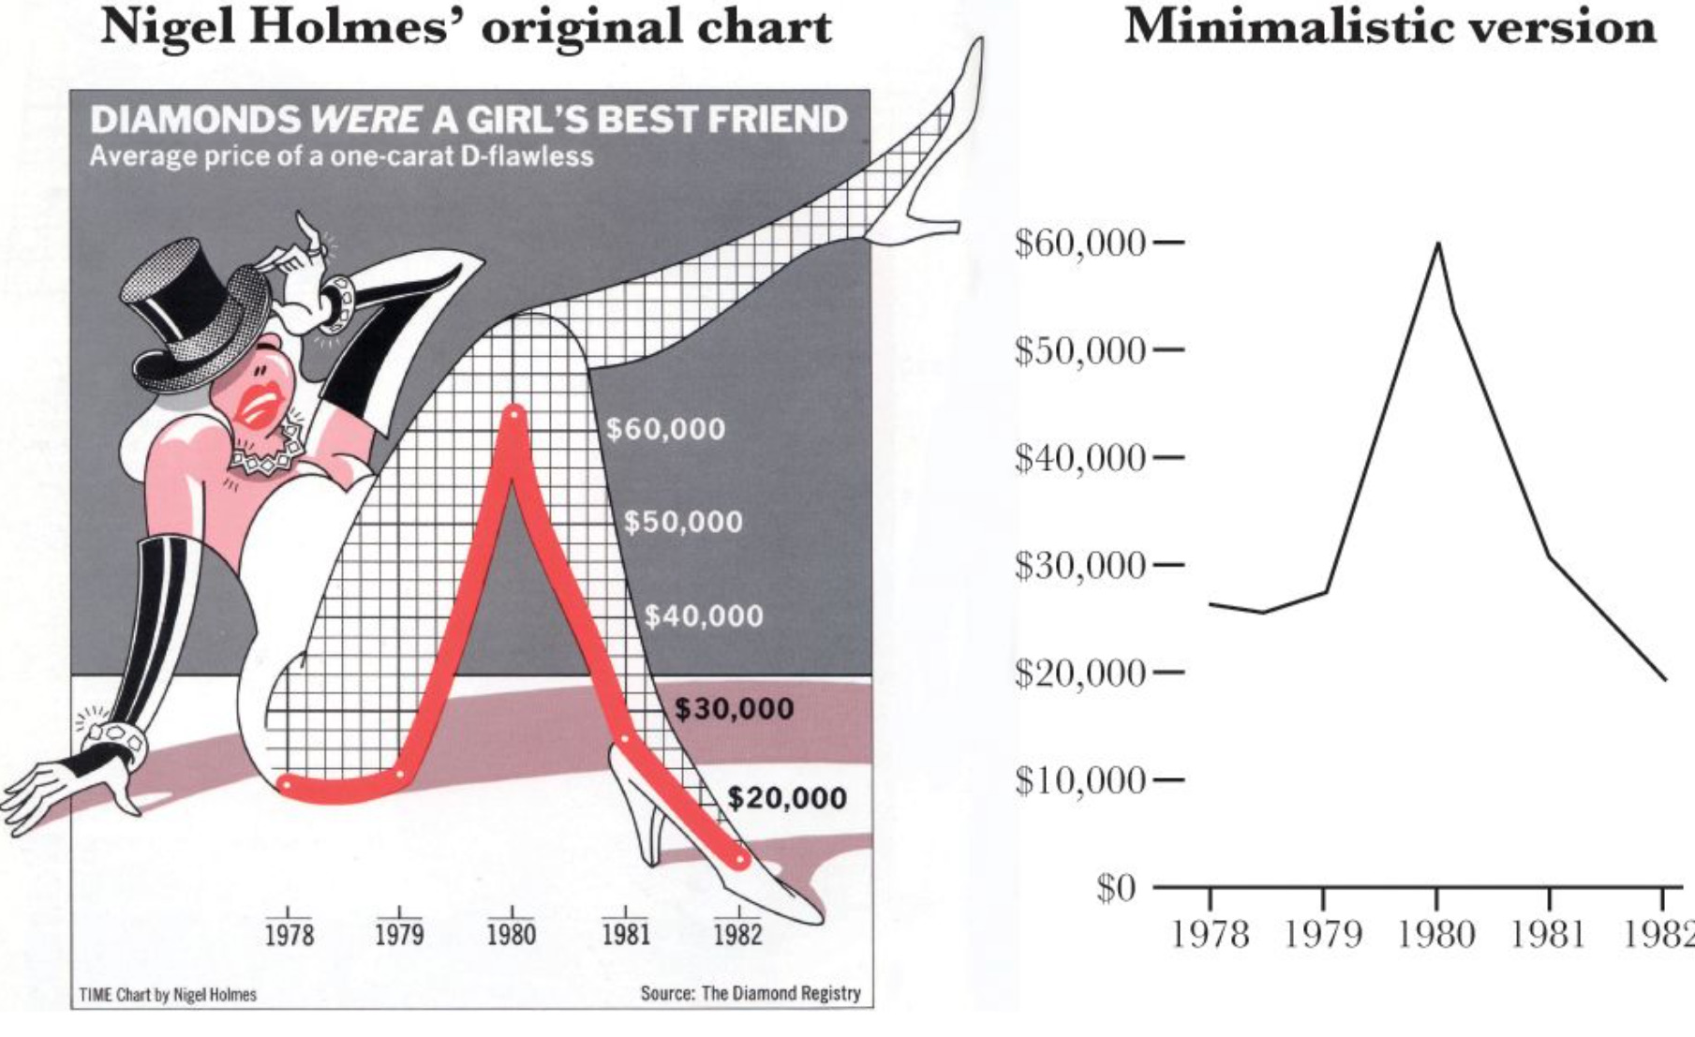
L’approccio di Nigel Holmes
Nigel Holmes

Slide 5

L’ottimo esempio di Matteo Moretti

Slide 6
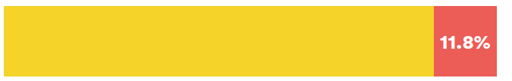
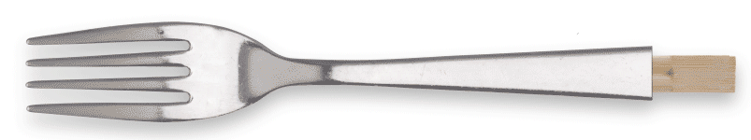
Come rappresentare i ristoranti cinesi a Bolzano
Cosa comunica meglio?
A Bolzano ci sono 261 ristoranti
32 sono gestiti da cinesi
11.8 %
Fonte:
Camera di Commercio di Bolzano

Slide 7
Quando il grafico non basta
STORY
VISUALIZE
FILTER
DATA
valore crescente verso il pubblico
credits: Mirko Lorenz

Slide 8
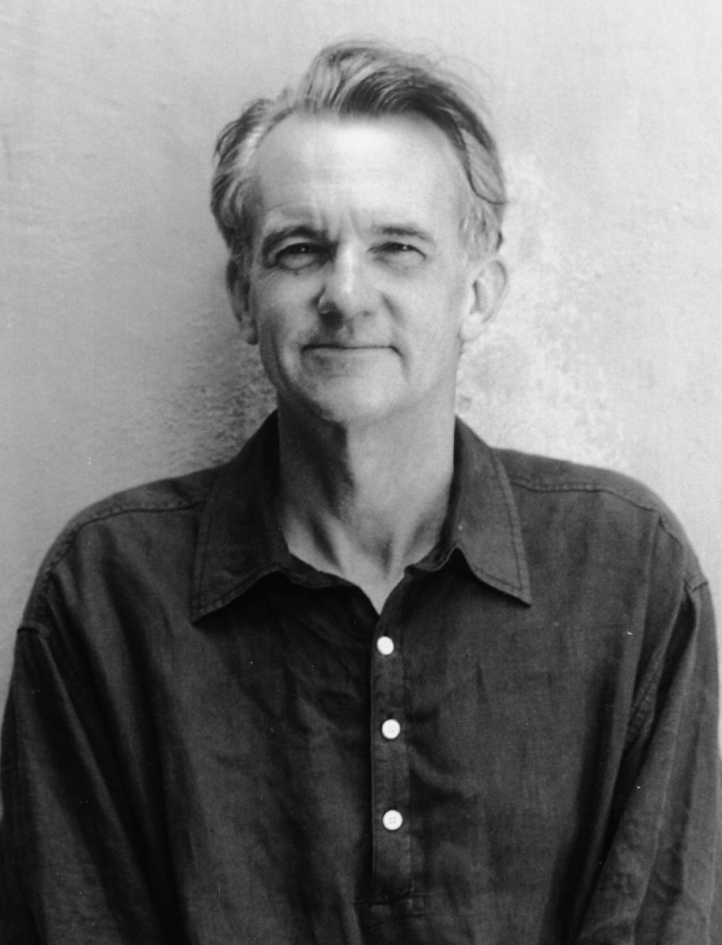
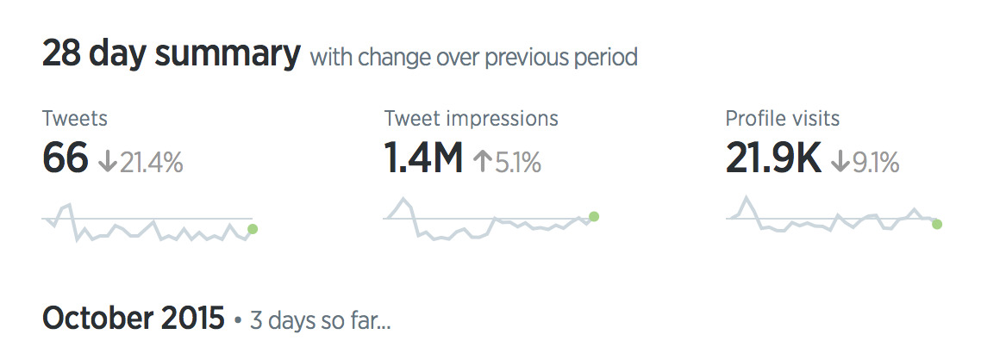
L’approccio di Tufte
Edward Tufte
“una rappresentazione visuale di dati dovrebbe essere abbastanza semplice da stare sul portellone di un furgone”.
principio di Feynman-Tufte
Inventore delle Sparkline
un piccolo e semplice grafico della grandezza di una parola, con risoluzione tipografica.

Slide 9
A cosa fare attenzione
PRINCIPALI ERRORI NEL CREARE GRAFICI
ABUSO DEI COLORI
TROPPA INFORMAZIONE
BELLO NON VUOL DIRE EFFICACE
LE VISUALIZZAZIONI PARTONO DAI BUONI DATI

Slide 10
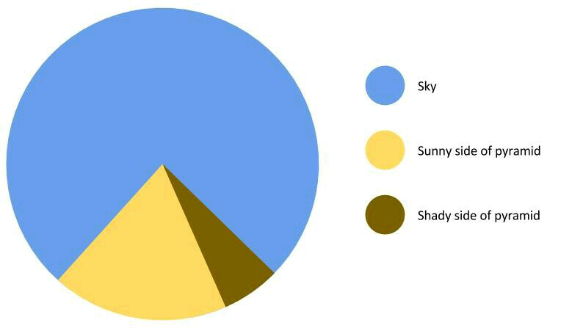
Come i colori ingannano
UN GRAFICO TORTA EGIZIANO
Cielo
Lato della piramide
esposto al sole
Lato della piramide
in ombra

Slide 11
Vadevecum
ATTENZIONE A COME USATE I GRAFICI
L'uso di grafici laddove non sono necessari può portare a inutili confusioni / interpretazioni .
Più un grafico ha bisogno di una spiegazione, meno il grafico è necessario.
I grafici non sempre trasmettono le informazioni come fanno invece le tabelle.
https://en.wikipedia.org/wiki/Misleading_graph

Slide 12
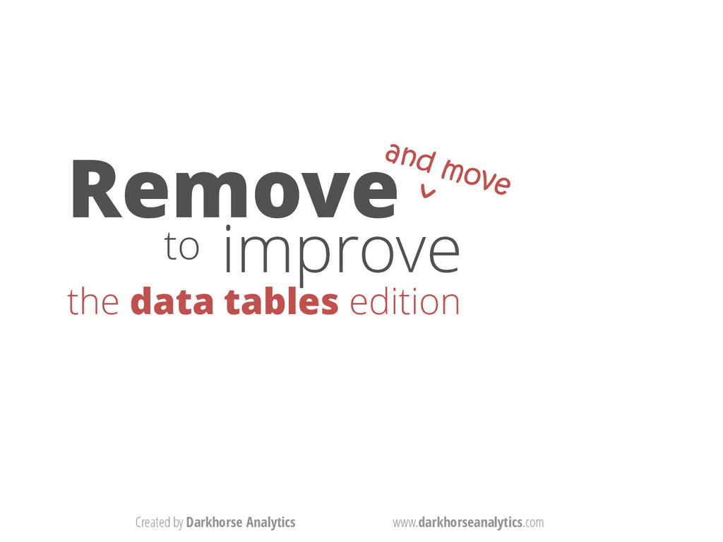
Le tabelle possono essere grafici molto efficaci se...
https://www.darkhorseanalytics.com/blog/clear-off-the-table

Slide 13
Remove
^{to} improve
the data tables edition
www.darkhorseanalytics.com

Slide 14

Remove
^{to} improve
the data tables edition
www.darkhorseanalytics.com

Slide 15
Remove the Colors
Role | Name | Year of the… | Debut | Number of Fans | Takedown Rate
Face (The Hero) | The Ultimate Warrior | Tiger | May-2011 | 97320.00 | 86.2
Face (The Hero) | Hulk Hogan | Oxen | Jan-2008 | 988551.00 | 61.978
Face (The Hero) | Macho Man Randy Savage | Monkey | Feb-2008 | 157618.00 | 59.29
Face (The Hero) | Hacksaw Jim Duggan | Pig | Mar-2008 | 30300.00 | 53.4332
Face (The Hero) | Superfly Jimmy Snuka | Dragon | Mar-2008 | 12341.00 | 52.7
Heel (The Bad Guy) | Rowdy Roddy Piper | Rooster | Jun-1968 | 71645.00 | 45.4
Heel (The Bad Guy) | The Million Dollar Man Ted DiBiase | Rat | Apr-1975 | 449342.00 | 43.7689
Heel (The Bad Guy) | Mr. Perfect Curt Henning | Rat | May-1980 | 13773.00 | 38
Heel (The Bad Guy) | Jake the Snake Roberts | Snake | Jul-1975 | 5609.00 | 37.99
Jobber (The Unknown) | Brad Smith | Sheep | Aug-2008 | 1103.00 | 36.316
Jobber (The Unknown) | Ted Duncan | Sheep | Aug-2008 | 200.00 | 33.61
Jobber (The Unknown) | Joey the Uber Nerd Cherdarchuk | Snake | Aug-2008 | 5.00 | 21.0196
www.darkhorseanalytics.com

Slide 16
Remove the Colors
Role | Name | Year of the… | Debut | Number of Fans | Takedown Rate
Face (The Hero) | The Ultimate Warrior | Tiger | May-2011 | 97320.00 | 86.2
Face (The Hero) | Hulk Hogan | Oxen | Jan-2008 | 988551.00 | 61.978
Face (The Hero) | Macho Man Randy Savage | Monkey | Feb-2008 | 157618.00 | 59.29
Face (The Hero) | Hacksaw Jim Duggan | Pig | Mar-2008 | 30300.00 | 53.4332
Face (The Hero) | Superfly Jimmy Snuka | Dragon | Mar-2008 | 12341.00 | 52.7
Heel (The Bad Guy) | Rowdy Roddy Piper | Rooster | Jun-1968 | 71645.00 | 45.4
Heel (The Bad Guy) | The Million Dollar Man Ted DiBiase | Rat | Apr-1975 | 449342.00 | 43.7689
Heel (The Bad Guy) | Mr. Perfect Curt Henning | Rat | May-1980 | 13773.00 | 38
Heel (The Bad Guy) | Jake the Snake Roberts | Snake | Jul-1975 | 5609.00 | 37.99
Jobber (The Unknown) | Brad Smith | Sheep | Aug-2008 | 1103.00 | 36.316
Jobber (The Unknown) | Ted Duncan | Sheep | Aug-2008 | 200.00 | 33.61
Jobber (The Unknown) | Joey the Uber Nerd Cherdarchuk | Snake | Aug-2008 | 5.00 | 21.0196
www.darkhorseanalytics.com

Slide 17
Remove Gridlines
Role | Name | Year of the… | Debut | Number of Fans | Takedown Rate
Face (The Hero) | The Ultimate Warrior | Tiger | May-2011 | 97320.00 | 86.2
Face (The Hero) | Hulk Hogan | Oxen | Jan-2008 | 988551.00 | 61.978
Face (The Hero) | Macho Man Randy Savage | Monkey | Feb-2008 | 157618.00 | 59.29
Face (The Hero) | Hacksaw Jim Duggan | Pig | Mar-2008 | 30300.00 | 53.4332
Face (The Hero) | Superfly Jimmy Snuka | Dragon | Mar-2008 | 12341.00 | 52.7
Heel (The Bad Guy) | Rowdy Roddy Piper | Rooster | Jun-1968 | 71645.00 | 45.4
Heel (The Bad Guy) | The Million Dollar Man Ted DiBiase | Rat | Apr-1975 | 449342.00 | 43.7689
Heel (The Bad Guy) | Mr. Perfect Curt Henning | Rat | May-1980 | 13773.00 | 38
Heel (The Bad Guy) | Jake the Snake Roberts | Snake | Jul-1975 | 5609.00 | 37.99
Jobber (The Unknown) | Brad Smith | Sheep | Aug-2008 | 1103.00 | 36.316
Jobber (The Unknown) | Ted Duncan | Sheep | Aug-2008 | 200.00 | 33.61
Jobber (The Unknown) | Joey the Uber Nerd Cherdarchuk | Snake | Aug-2008 | 5.00 | 21.0196
www.darkhorseanalytics.com

Slide 18
Remove Gridlines
Role | Name | Year of the… | Debut | Number of Fans | Takedown Rate
Face (The Hero) | The Ultimate Warrior | Tiger | May-2011 | 97320.00 | 86.2
Face (The Hero) | Hulk Hogan | Oxen | Jan-2008 | 988551.00 | 61.978
Face (The Hero) | Macho Man Randy Savage | Monkey | Feb-2008 | 157618.00 | 59.29
Face (The Hero) | Hacksaw Jim Duggan | Pig | Mar-2008 | 30300.00 | 53.4332
Face (The Hero) | Superfly Jimmy Snuka | Dragon | Mar-2008 | 12341.00 | 52.7
Heel (The Bad Guy) | Rowdy Roddy Piper | Rooster | Jun-1968 | 71645.00 | 45.4
Heel (The Bad Guy) | The Million Dollar Man Ted DiBiase | Rat | Apr-1975 | 449342.00 | 43.7689
Heel (The Bad Guy) | Mr. Perfect Curt Henning | Rat | May-1980 | 13773.00 | 38
Heel (The Bad Guy) | Jake the Snake Roberts | Snake | Jul-1975 | 5609.00 | 37.99
Jobber (The Unknown) | Brad Smith | Sheep | Aug-2008 | 1103.00 | 36.316
Jobber (The Unknown) | Ted Duncan | Sheep | Aug-2008 | 200.00 | 33.61
Jobber (The Unknown) | Joey the Uber Nerd Cherdarchuk | Snake | Aug-2008 | 5.00 | 21.0196
www.darkhorseanalytics.com

Slide 19
Remove Fills
Role | Name | Year of the… | Debut | Number of Fans | Takedown Rate
Face (The Hero) | The Ultimate Warrior | Tiger | May-2011 | 97320.00 | 86.2
Face (The Hero) | Hulk Hogan | Oxen | Jan-2008 | 988551.00 | 61.978
Face (The Hero) | Macho Man Randy Savage | Monkey | Feb-2008 | 157618.00 | 59.29
Face (The Hero) | Hacksaw Jim Duggan | Pig | Mar-2008 | 30300.00 | 53.4332
Face (The Hero) | Superfly Jimmy Snuka | Dragon | Mar-2008 | 12341.00 | 52.7
Heel (The Bad Guy) | Rowdy Roddy Piper | Rooster | Jun-1968 | 71645.00 | 45.4
Heel (The Bad Guy) | The Million Dollar Man Ted DiBiase | Rat | Apr-1975 | 449342.00 | 43.7689
Heel (The Bad Guy) | Mr. Perfect Curt Henning | Rat | May-1980 | 13773.00 | 38
Heel (The Bad Guy) | Jake the Snake Roberts | Snake | Jul-1975 | 5609.00 | 37.99
Jobber (The Unknown) | Brad Smith | Sheep | Aug-2008 | 1103.00 | 36.316
Jobber (The Unknown) | Ted Duncan | Sheep | Aug-2008 | 200.00 | 33.61
Jobber (The Unknown) | Joey the Uber Nerd Cherdarchuk | Snake | Aug-2008 | 5.00 | 21.0196
www.darkhorseanalytics.com

Slide 20
Remove Fills
Role | Name | Year of the… | Debut | Number of Fans | Takedown Rate
Face (The Hero) | The Ultimate Warrior | Tiger | May-2011 | 97320.00 | 86.2
Face (The Hero) | Hulk Hogan | Oxen | Jan-2008 | 988551.00 | 61.978
Face (The Hero) | Macho Man Randy Savage | Monkey | Feb-2008 | 157618.00 | 59.29
Face (The Hero) | Hacksaw Jim Duggan | Pig | Mar-2008 | 30300.00 | 53.4332
Face (The Hero) | Superfly Jimmy Snuka | Dragon | Mar-2008 | 12341.00 | 52.7
Heel (The Bad Guy) | Rowdy Roddy Piper | Rooster | Jun-1968 | 71645.00 | 45.4
Heel (The Bad Guy) | The Million Dollar Man Ted DiBiase | Rat | Apr-1975 | 449342.00 | 43.7689
Heel (The Bad Guy) | Mr. Perfect Curt Henning | Rat | May-1980 | 13773.00 | 38
Heel (The Bad Guy) | Jake the Snake Roberts | Snake | Jul-1975 | 5609.00 | 37.99
Jobber (The Unknown) | Brad Smith | Sheep | Aug-2008 | 1103.00 | 36.316
Jobber (The Unknown) | Ted Duncan | Sheep | Aug-2008 | 200.00 | 33.61
Jobber (The Unknown) | Joey the Uber Nerd Cherdarchuk | Snake | Aug-2008 | 5.00 | 21.0196
www.darkhorseanalytics.com

Slide 21
Remove Fills
Role | Name | Year of the… | Debut | Number of Fans | Takedown Rate
Face (The Hero) | The Ultimate Warrior | Tiger | May-2011 | 97320.00 | 86.2
Face (The Hero) | Hulk Hogan | Oxen | Jan-2008 | 988551.00 | 61.978
Face (The Hero) | Macho Man Randy Savage | Monkey | Feb-2008 | 157618.00 | 59.29
Face (The Hero) | Hacksaw Jim Duggan | Pig | Mar-2008 | 30300.00 | 53.4332
Face (The Hero) | Superfly Jimmy Snuka | Dragon | Mar-2008 | 12341.00 | 52.7
Heel (The Bad Guy) | Rowdy Roddy Piper | Rooster | Jun-1968 | 71645.00 | 45.4
Heel (The Bad Guy) | The Million Dollar Man Ted DiBiase | Rat | Apr-1975 | 449342.00 | 43.7689
Heel (The Bad Guy) | Mr. Perfect Curt Henning | Rat | May-1980 | 13773.00 | 38
Heel (The Bad Guy) | Jake the Snake Roberts | Snake | Jul-1975 | 5609.00 | 37.99
Jobber (The Unknown) | Brad Smith | Sheep | Aug-2008 | 1103.00 | 36.316
Jobber (The Unknown) | Ted Duncan | Sheep | Aug-2008 | 200.00 | 33.61
Jobber (The Unknown) | Joey the Uber Nerd Cherdarchuk | Snake | Aug-2008 | 5.00 | 21.0196
www.darkhorseanalytics.com

Slide 22
Remove the Border
Role | Name | Year of the… | Debut | Number of Fans | Takedown Rate
Face (The Hero) | The Ultimate Warrior | Tiger | May-2011 | 97320.00 | 86.2
Face (The Hero) | Hulk Hogan | Oxen | Jan-2008 | 988551.00 | 61.978
Face (The Hero) | Macho Man Randy Savage | Monkey | Feb-2008 | 157618.00 | 59.29
Face (The Hero) | Hacksaw Jim Duggan | Pig | Mar-2008 | 30300.00 | 53.4332
Face (The Hero) | Superfly Jimmy Snuka | Dragon | Mar-2008 | 12341.00 | 52.7
Heel (The Bad Guy) | Rowdy Roddy Piper | Rooster | Jun-1968 | 71645.00 | 45.4
Heel (The Bad Guy) | The Million Dollar Man Ted DiBiase | Rat | Apr-1975 | 449342.00 | 43.7689
Heel (The Bad Guy) | Mr. Perfect Curt Henning | Rat | May-1980 | 13773.00 | 38
Heel (The Bad Guy) | Jake the Snake Roberts | Snake | Jul-1975 | 5609.00 | 37.99
Jobber (The Unknown) | Brad Smith | Sheep | Aug-2008 | 1103.00 | 36.316
Jobber (The Unknown) | Ted Duncan | Sheep | Aug-2008 | 200.00 | 33.61
Jobber (The Unknown) | Joey the Uber Nerd Cherdarchuk | Snake | Aug-2008 | 5.00 | 21.0196
www.darkhorseanalytics.com

Slide 23
Remove the Border
Role | Name | Year of the… | Debut | Number of Fans | Takedown Rate
Face (The Hero) | The Ultimate Warrior | Tiger | May-2011 | 97320.00 | 86.2
Face (The Hero) | Hulk Hogan | Oxen | Jan-2008 | 988551.00 | 61.978
Face (The Hero) | Macho Man Randy Savage | Monkey | Feb-2008 | 157618.00 | 59.29
Face (The Hero) | Hacksaw Jim Duggan | Pig | Mar-2008 | 30300.00 | 53.4332
Face (The Hero) | Superfly Jimmy Snuka | Dragon | Mar-2008 | 12341.00 | 52.7
Heel (The Bad Guy) | Rowdy Roddy Piper | Rooster | Jun-1968 | 71645.00 | 45.4
Heel (The Bad Guy) | The Million Dollar Man Ted DiBiase | Rat | Apr-1975 | 449342.00 | 43.7689
Heel (The Bad Guy) | Mr. Perfect Curt Henning | Rat | May-1980 | 13773.00 | 38
Heel (The Bad Guy) | Jake the Snake Roberts | Snake | Jul-1975 | 5609.00 | 37.99
Jobber (The Unknown) | Brad Smith | Sheep | Aug-2008 | 1103.00 | 36.316
Jobber (The Unknown) | Ted Duncan | Sheep | Aug-2008 | 200.00 | 33.61
Jobber (The Unknown) | Joey the Uber Nerd Cherdarchuk | Snake | Aug-2008 | 5.00 | 21.0196
www.darkhorseanalytics.com

Slide 24
Remove Bolding
Role | Name | Year of the… | Debut | Number of Fans | Takedown Rate
Face (The Hero) | The Ultimate Warrior | Tiger | May-2011 | 97320.00 | 86.2
Face (The Hero) | Hulk Hogan | Oxen | Jan-2008 | 988551.00 | 61.978
Face (The Hero) | Macho Man Randy Savage | Monkey | Feb-2008 | 157618.00 | 59.29
Face (The Hero) | Hacksaw Jim Duggan | Pig | Mar-2008 | 30300.00 | 53.4332
Face (The Hero) | Superfly Jimmy Snuka | Dragon | Mar-2008 | 12341.00 | 52.7
Heel (The Bad Guy) | Rowdy Roddy Piper | Rooster | Jun-1968 | 71645.00 | 45.4
Heel (The Bad Guy) | The Million Dollar Man Ted DiBiase | Rat | Apr-1975 | 449342.00 | 43.7689
Heel (The Bad Guy) | Mr. Perfect Curt Henning | Rat | May-1980 | 13773.00 | 38
Heel (The Bad Guy) | Jake the Snake Roberts | Snake | Jul-1975 | 5609.00 | 37.99
Jobber (The Unknown) | Brad Smith | Sheep | Aug-2008 | 1103.00 | 36.316
Jobber (The Unknown) | Ted Duncan | Sheep | Aug-2008 | 200.00 | 33.61
Jobber (The Unknown) | Joey the Uber Nerd Cherdarchuk | Snake | Aug-2008 | 5.00 | 21.0196
www.darkhorseanalytics.com

Slide 25
Remove Bolding
Role | Name | Year of the… | Debut | Number of Fans | Takedown Rate
Face (The Hero) | The Ultimate Warrior | Tiger | May-2011 | 97320.00 | 86.2
Face (The Hero) | Hulk Hogan | Oxen | Jan-2008 | 988551.00 | 61.978
Face (The Hero) | Macho Man Randy Savage | Monkey | Feb-2008 | 157618.00 | 59.29
Face (The Hero) | Hacksaw Jim Duggan | Pig | Mar-2008 | 30300.00 | 53.4332
Face (The Hero) | Superfly Jimmy Snuka | Dragon | Mar-2008 | 12341.00 | 52.7
Heel (The Bad Guy) | Rowdy Roddy Piper | Rooster | Jun-1968 | 71645.00 | 45.4
Heel (The Bad Guy) | The Million Dollar Man Ted DiBiase | Rat | Apr-1975 | 449342.00 | 43.7689
Heel (The Bad Guy) | Mr. Perfect Curt Henning | Rat | May-1980 | 13773.00 | 38
Heel (The Bad Guy) | Jake the Snake Roberts | Snake | Jul-1975 | 5609.00 | 37.99
Jobber (The Unknown) | Brad Smith | Sheep | Aug-2008 | 1103.00 | 36.316
Jobber (The Unknown) | Ted Duncan | Sheep | Aug-2008 | 200.00 | 33.61
Jobber (The Unknown) | Joey the Uber Nerd Cherdarchuk | Snake | Aug-2008 | 5.00 | 21.0196
www.darkhorseanalytics.com

Slide 26
Left Align Text
Role | Name | Year of the… | Debut | Number of Fans | Takedown Rate
Face (The Hero) | The Ultimate Warrior | Tiger | May-2011 | 97320.00 | 86.2
Face (The Hero) | Hulk Hogan | Oxen | Jan-2008 | 988551.00 | 61.978
Face (The Hero) | Macho Man Randy Savage | Monkey | Feb-2008 | 157618.00 | 59.29
Face (The Hero) | Hacksaw Jim Duggan | Pig | Mar-2008 | 30300.00 | 53.4332
Face (The Hero) | Superfly Jimmy Snuka | Dragon | Mar-2008 | 12341.00 | 52.7
Heel (The Bad Guy) | Rowdy Roddy Piper | Rooster | Jun-1968 | 71645.00 | 45.4
Heel (The Bad Guy) | The Million Dollar Man Ted DiBiase | Rat | Apr-1975 | 449342.00 | 43.7689
Heel (The Bad Guy) | Mr. Perfect Curt Henning | Rat | May-1980 | 13773.00 | 38
Heel (The Bad Guy) | Jake the Snake Roberts | Snake | Jul-1975 | 5609.00 | 37.99
Jobber (The Unknown) | Brad Smith | Sheep | Aug-2008 | 1103.00 | 36.316
Jobber (The Unknown) | Ted Duncan | Sheep | Aug-2008 | 200.00 | 33.61
Jobber (The Unknown) | Joey the Uber Nerd Cherdarchuk | Snake | Aug-2008 | 5.00 | 21.0196
www.darkhorseanalytics.com

Slide 27
Left Align Text
Role | Name | Year of the… | Debut | Number of Fans | Takedown Rate
Face (The Hero) | The Ultimate Warrior | Tiger | May-2011 | 97320.00 | 86.2
Face (The Hero) | Hulk Hogan | Oxen | Jan-2008 | 988551.00 | 61.978
Face (The Hero) | Macho Man Randy Savage | Monkey | Feb-2008 | 157618.00 | 59.29
Face (The Hero) | Hacksaw Jim Duggan | Pig | Mar-2008 | 30300.00 | 53.4332
Face (The Hero) | Superfly Jimmy Snuka | Dragon | Mar-2008 | 12341.00 | 52.7
Heel (The Bad Guy) | Rowdy Roddy Piper | Rooster | Jun-1968 | 71645.00 | 45.4
Heel (The Bad Guy) | The Million Dollar Man Ted DiBiase | Rat | Apr-1975 | 449342.00 | 43.7689
Heel (The Bad Guy) | Mr. Perfect Curt Henning | Rat | May-1980 | 13773.00 | 38
Heel (The Bad Guy) | Jake the Snake Roberts | Snake | Jul-1975 | 5609.00 | 37.99
Jobber (The Unknown) | Brad Smith | Sheep | Aug-2008 | 1103.00 | 36.316
Jobber (The Unknown) | Ted Duncan | Sheep | Aug-2008 | 200.00 | 33.61
Jobber (The Unknown) | Joey the Uber Nerd Cherdarchuk | Snake | Aug-2008 | 5.00 | 21.0196
www.darkhorseanalytics.com

Slide 28
Left Align Text
Role | Name | Year of the… | Debut | Number of Fans | Takedown Rate
Face (The Hero) | The Ultimate Warrior | Tiger | May-2011 | 97320.00 | 86.2
Face (The Hero) | Hulk Hogan | Oxen | Jan-2008 | 988551.00 | 61.978
Face (The Hero) | Macho Man Randy Savage | Monkey | Feb-2008 | 157618.00 | 59.29
Face (The Hero) | Hacksaw Jim Duggan | Pig | Mar-2008 | 30300.00 | 53.4332
Face (The Hero) | Superfly Jimmy Snuka | Dragon | Mar-2008 | 12341.00 | 52.7
Heel (The Bad Guy) | Rowdy Roddy Piper | Rooster | Jun-1968 | 71645.00 | 45.4
Heel (The Bad Guy) | The Million Dollar Man Ted DiBiase | Rat | Apr-1975 | 449342.00 | 43.7689
Heel (The Bad Guy) | Mr. Perfect Curt Henning | Rat | May-1980 | 13773.00 | 38
Heel (The Bad Guy) | Jake the Snake Roberts | Snake | Jul-1975 | 5609.00 | 37.99
Jobber (The Unknown) | Brad Smith | Sheep | Aug-2008 | 1103.00 | 36.316
Jobber (The Unknown) | Ted Duncan | Sheep | Aug-2008 | 200.00 | 33.61
Jobber (The Unknown) | Joey the Uber Nerd Cherdarchuk | Snake | Aug-2008 | 5.00 | 21.0196
www.darkhorseanalytics.com

Slide 29
Left Align Text
Role | Name | Year of the… | Debut | Number of Fans | Takedown Rate
Face (The Hero) | The Ultimate Warrior | Tiger | May-2011 | 97320.00 | 86.2
Face (The Hero) | Hulk Hogan | Oxen | Jan-2008 | 988551.00 | 61.978
Face (The Hero) | Macho Man Randy Savage | Monkey | Feb-2008 | 157618.00 | 59.29
Face (The Hero) | Hacksaw Jim Duggan | Pig | Mar-2008 | 30300.00 | 53.4332
Face (The Hero) | Superfly Jimmy Snuka | Dragon | Mar-2008 | 12341.00 | 52.7
Heel (The Bad Guy) | Rowdy Roddy Piper | Rooster | Jun-1968 | 71645.00 | 45.4
Heel (The Bad Guy) | The Million Dollar Man Ted DiBiase | Rat | Apr-1975 | 449342.00 | 43.7689
Heel (The Bad Guy) | Mr. Perfect Curt Henning | Rat | May-1980 | 13773.00 | 38
Heel (The Bad Guy) | Jake the Snake Roberts | Snake | Jul-1975 | 5609.00 | 37.99
Jobber (The Unknown) | Brad Smith | Sheep | Aug-2008 | 1103.00 | 36.316
Jobber (The Unknown) | Ted Duncan | Sheep | Aug-2008 | 200.00 | 33.61
Jobber (The Unknown) | Joey the Uber Nerd Cherdarchuk | Snake | Aug-2008 | 5.00 | 21.0196
www.darkhorseanalytics.com

Slide 30
Right Align Numbers
Role | Name | Year of the… | Debut | Number of Fans | Takedown Rate
Face (The Hero) | The Ultimate Warrior | Tiger | May-2011 | 97320.00 | 86.2
Face (The Hero) | Hulk Hogan | Oxen | Jan-2008 | 988551.00 | 61.978
Face (The Hero) | Macho Man Randy Savage | Monkey | Feb-2008 | 157618.00 | 59.29
Face (The Hero) | Hacksaw Jim Duggan | Pig | Mar-2008 | 30300.00 | 53.4332
Face (The Hero) | Superfly Jimmy Snuka | Dragon | Mar-2008 | 12341.00 | 52.7
Heel (The Bad Guy) | Rowdy Roddy Piper | Rooster | Jun-1968 | 71645.00 | 45.4
Heel (The Bad Guy) | The Million Dollar Man Ted DiBiase | Rat | Apr-1975 | 449342.00 | 43.7689
Heel (The Bad Guy) | Mr. Perfect Curt Henning | Rat | May-1980 | 13773.00 | 38
Heel (The Bad Guy) | Jake the Snake Roberts | Snake | Jul-1975 | 5609.00 | 37.99
Jobber (The Unknown) | Brad Smith | Sheep | Aug-2008 | 1103.00 | 36.316
Jobber (The Unknown) | Ted Duncan | Sheep | Aug-2008 | 200.00 | 33.61
Jobber (The Unknown) | Joey the Uber Nerd Cherdarchuk | Snake | Aug-2008 | 5.00 | 21.0196
www.darkhorseanalytics.com

Slide 31
Right Align Numbers
Role | Name | Year of the… | Debut | Number of Fans | Takedown Rate
Face (The Hero) | The Ultimate Warrior | Tiger | May-2011 | 97320.00 | 86.2
Face (The Hero) | Hulk Hogan | Oxen | Jan-2008 | 988551.00 | 61.978
Face (The Hero) | Macho Man Randy Savage | Monkey | Feb-2008 | 157618.00 | 59.29
Face (The Hero) | Hacksaw Jim Duggan | Pig | Mar-2008 | 30300.00 | 53.4332
Face (The Hero) | Superfly Jimmy Snuka | Dragon | Mar-2008 | 12341.00 | 52.7
Heel (The Bad Guy) | Rowdy Roddy Piper | Rooster | Jun-1968 | 71645.00 | 45.4
Heel (The Bad Guy) | The Million Dollar Man Ted DiBiase | Rat | Apr-1975 | 449342.00 | 43.7689
Heel (The Bad Guy) | Mr. Perfect Curt Henning | Rat | May-1980 | 13773.00 | 38
Heel (The Bad Guy) | Jake the Snake Roberts | Snake | Jul-1975 | 5609.00 | 37.99
Jobber (The Unknown) | Brad Smith | Sheep | Aug-2008 | 1103.00 | 36.316
Jobber (The Unknown) | Ted Duncan | Sheep | Aug-2008 | 200.00 | 33.61
Jobber (The Unknown) | Joey the Uber Nerd Cherdarchuk | Snake | Aug-2008 | 5.00 | 21.0196
www.darkhorseanalytics.com

Slide 32
Right Align Numbers
Role | Name | Year of the… | Debut | Number of Fans | Takedown Rate
Face (The Hero) | The Ultimate Warrior | Tiger | May-2011 | 97320.00 | 86.2
Face (The Hero) | Hulk Hogan | Oxen | Jan-2008 | 988551.00 | 61.978
Face (The Hero) | Macho Man Randy Savage | Monkey | Feb-2008 | 157618.00 | 59.29
Face (The Hero) | Hacksaw Jim Duggan | Pig | Mar-2008 | 30300.00 | 53.4332
Face (The Hero) | Superfly Jimmy Snuka | Dragon | Mar-2008 | 12341.00 | 52.7
Heel (The Bad Guy) | Rowdy Roddy Piper | Rooster | Jun-1968 | 71645.00 | 45.4
Heel (The Bad Guy) | The Million Dollar Man Ted DiBiase | Rat | Apr-1975 | 449342.00 | 43.7689
Heel (The Bad Guy) | Mr. Perfect Curt Henning | Rat | May-1980 | 13773.00 | 38
Heel (The Bad Guy) | Jake the Snake Roberts | Snake | Jul-1975 | 5609.00 | 37.99
Jobber (The Unknown) | Brad Smith | Sheep | Aug-2008 | 1103.00 | 36.316
Jobber (The Unknown) | Ted Duncan | Sheep | Aug-2008 | 200.00 | 33.61
Jobber (The Unknown) | Joey the Uber Nerd Cherdarchuk | Snake | Aug-2008 | 5.00 | 21.0196
www.darkhorseanalytics.com

Slide 33
Right Align Numbers
Role | Name | Year of the… | Debut | Number of Fans | Takedown Rate
Face (The Hero) | The Ultimate Warrior | Tiger | May-2011 | 97320.00 | 86.2
Face (The Hero) | Hulk Hogan | Oxen | Jan-2008 | 988551.00 | 61.978
Face (The Hero) | Macho Man Randy Savage | Monkey | Feb-2008 | 157618.00 | 59.29
Face (The Hero) | Hacksaw Jim Duggan | Pig | Mar-2008 | 30300.00 | 53.4332
Face (The Hero) | Superfly Jimmy Snuka | Dragon | Mar-2008 | 12341.00 | 52.7
Heel (The Bad Guy) | Rowdy Roddy Piper | Rooster | Jun-1968 | 71645.00 | 45.4
Heel (The Bad Guy) | The Million Dollar Man Ted DiBiase | Rat | Apr-1975 | 449342.00 | 43.7689
Heel (The Bad Guy) | Mr. Perfect Curt Henning | Rat | May-1980 | 13773.00 | 38
Heel (The Bad Guy) | Jake the Snake Roberts | Snake | Jul-1975 | 5609.00 | 37.99
Jobber (The Unknown) | Brad Smith | Sheep | Aug-2008 | 1103.00 | 36.316
Jobber (The Unknown) | Ted Duncan | Sheep | Aug-2008 | 200.00 | 33.61
Jobber (The Unknown) | Joey the Uber Nerd Cherdarchuk | Snake | Aug-2008 | 5.00 | 21.0196
www.darkhorseanalytics.com

Slide 34
Align Titles with Data
Role | Name | Year of the… | Debut | Number of Fans | Takedown Rate
Face (The Hero) | The Ultimate Warrior | Tiger | May-2011 | 97320.00 | 86.2
Face (The Hero) | Hulk Hogan | Oxen | Jan-2008 | 988551.00 | 61.978
Face (The Hero) | Macho Man Randy Savage | Monkey | Feb-2008 | 157618.00 | 59.29
Face (The Hero) | Hacksaw Jim Duggan | Pig | Mar-2008 | 30300.00 | 53.4332
Face (The Hero) | Superfly Jimmy Snuka | Dragon | Mar-2008 | 12341.00 | 52.7
Heel (The Bad Guy) | Rowdy Roddy Piper | Rooster | Jun-1968 | 71645.00 | 45.4
Heel (The Bad Guy) | The Million Dollar Man Ted DiBiase | Rat | Apr-1975 | 449342.00 | 43.7689
Heel (The Bad Guy) | Mr. Perfect Curt Henning | Rat | May-1980 | 13773.00 | 38
Heel (The Bad Guy) | Jake the Snake Roberts | Snake | Jul-1975 | 5609.00 | 37.99
Jobber (The Unknown) | Brad Smith | Sheep | Aug-2008 | 1103.00 | 36.316
Jobber (The Unknown) | Ted Duncan | Sheep | Aug-2008 | 200.00 | 33.61
Jobber (The Unknown) | Joey the Uber Nerd Cherdarchuk | Snake | Aug-2008 | 5.00 | 21.0196
www.darkhorseanalytics.com

Slide 35
Align Titles with Data
Role | Name | Year of the… | Debut | Number of Fans | Takedown Rate
Face (The Hero) | The Ultimate Warrior | Tiger | May-2011 | 97320.00 | 86.2
Face (The Hero) | Hulk Hogan | Oxen | Jan-2008 | 988551.00 | 61.978
Face (The Hero) | Macho Man Randy Savage | Monkey | Feb-2008 | 157618.00 | 59.29
Face (The Hero) | Hacksaw Jim Duggan | Pig | Mar-2008 | 30300.00 | 53.4332
Face (The Hero) | Superfly Jimmy Snuka | Dragon | Mar-2008 | 12341.00 | 52.7
Heel (The Bad Guy) | Rowdy Roddy Piper | Rooster | Jun-1968 | 71645.00 | 45.4
Heel (The Bad Guy) | The Million Dollar Man Ted DiBiase | Rat | Apr-1975 | 449342.00 | 43.7689
Heel (The Bad Guy) | Mr. Perfect Curt Henning | Rat | May-1980 | 13773.00 | 38
Heel (The Bad Guy) | Jake the Snake Roberts | Snake | Jul-1975 | 5609.00 | 37.99
Jobber (The Unknown) | Brad Smith | Sheep | Aug-2008 | 1103.00 | 36.316
Jobber (The Unknown) | Ted Duncan | Sheep | Aug-2008 | 200.00 | 33.61
Jobber (The Unknown) | Joey the Uber Nerd Cherdarchuk | Snake | Aug-2008 | 5.00 | 21.0196
www.darkhorseanalytics.com

Slide 36
Align Titles with Data
Role | Name | Year of the… | Debut | Number of Fans | Takedown Rate
Face (The Hero) | The Ultimate Warrior | Tiger | May-2011 | 97320.00 | 86.2
Face (The Hero) | Hulk Hogan | Oxen | Jan-2008 | 988551.00 | 61.978
Face (The Hero) | Macho Man Randy Savage | Monkey | Feb-2008 | 157618.00 | 59.29
Face (The Hero) | Hacksaw Jim Duggan | Pig | Mar-2008 | 30300.00 | 53.4332
Face (The Hero) | Superfly Jimmy Snuka | Dragon | Mar-2008 | 12341.00 | 52.7
Heel (The Bad Guy) | Rowdy Roddy Piper | Rooster | Jun-1968 | 71645.00 | 45.4
Heel (The Bad Guy) | The Million Dollar Man Ted DiBiase | Rat | Apr-1975 | 449342.00 | 43.7689
Heel (The Bad Guy) | Mr. Perfect Curt Henning | Rat | May-1980 | 13773.00 | 38
Heel (The Bad Guy) | Jake the Snake Roberts | Snake | Jul-1975 | 5609.00 | 37.99
Jobber (The Unknown) | Brad Smith | Sheep | Aug-2008 | 1103.00 | 36.316
Jobber (The Unknown) | Ted Duncan | Sheep | Aug-2008 | 200.00 | 33.61
Jobber (The Unknown) | Joey the Uber Nerd Cherdarchuk | Snake | Aug-2008 | 5.00 | 21.0196
www.darkhorseanalytics.com

Slide 37
Resize Columns to Data
Role | Name | Year of the… | Debut | Number of Fans | Takedown Rate
Face (The Hero) | The Ultimate Warrior | Tiger | May-2011 | 97320.00 | 86.2
Face (The Hero) | Hulk Hogan | Oxen | Jan-2008 | 988551.00 | 61.978
Face (The Hero) | Macho Man Randy Savage | Monkey | Feb-2008 | 157618.00 | 59.29
Face (The Hero) | Hacksaw Jim Duggan | Pig | Mar-2008 | 30300.00 | 53.4332
Face (The Hero) | Superfly Jimmy Snuka | Dragon | Mar-2008 | 12341.00 | 52.7
Heel (The Bad Guy) | Rowdy Roddy Piper | Rooster | Jun-1968 | 71645.00 | 45.4
Heel (The Bad Guy) | The Million Dollar Man Ted DiBiase | Rat | Apr-1975 | 449342.00 | 43.7689
Heel (The Bad Guy) | Mr. Perfect Curt Henning | Rat | May-1980 | 13773.00 | 38
Heel (The Bad Guy) | Jake the Snake Roberts | Snake | Jul-1975 | 5609.00 | 37.99
Jobber (The Unknown) | Brad Smith | Sheep | Aug-2008 | 1103.00 | 36.316
Jobber (The Unknown) | Ted Duncan | Sheep | Aug-2008 | 200.00 | 33.61
Jobber (The Unknown) | Joey the Uber Nerd Cherdarchuk | Snake | Aug-2008 | 5.00 | 21.0196
www.darkhorseanalytics.com

Slide 38
Resize Columns to Data
Role | Name | Year of the… | Debut | Number of Fans | Takedown Rate
Face (The Hero) | The Ultimate Warrior | Tiger | May-2011 | 97320.00 | 86.2
Face (The Hero) | Hulk Hogan | Oxen | Jan-2008 | 988551.00 | 61.978
Face (The Hero) | Macho Man Randy Savage | Monkey | Feb-2008 | 157618.00 | 59.29
Face (The Hero) | Hacksaw Jim Duggan | Pig | Mar-2008 | 30300.00 | 53.4332
Face (The Hero) | Superfly Jimmy Snuka | Dragon | Mar-2008 | 12341.00 | 52.7
Heel (The Bad Guy) | Rowdy Roddy Piper | Rooster | Jun-1968 | 71645.00 | 45.4
Heel (The Bad Guy) | The Million Dollar Man Ted DiBiase | Rat | Apr-1975 | 449342.00 | 43.7689
Heel (The Bad Guy) | Mr. Perfect Curt Henning | Rat | May-1980 | 13773.00 | 38
Heel (The Bad Guy) | Jake the Snake Roberts | Snake | Jul-1975 | 5609.00 | 37.99
Jobber (The Unknown) | Brad Smith | Sheep | Aug-2008 | 1103.00 | 36.316
Jobber (The Unknown) | Ted Duncan | Sheep | Aug-2008 | 200.00 | 33.61
Jobber (The Unknown) | Joey the Uber Nerd Cherdarchuk | Snake | Aug-2008 | 5.00 | 21.0196
www.darkhorseanalytics.com

Slide 39
Resize Columns to Data
Role | Name | Year of the… | Debut | Number of Fans | Takedown Rate
Face (The Hero) | The Ultimate Warrior | Tiger | May-2011 | 97320.00 | 86.2
Face (The Hero) | Hulk Hogan | Oxen | Jan-2008 | 988551.00 | 61.978
Face (The Hero) | Macho Man Randy Savage | Monkey | Feb-2008 | 157618.00 | 59.29
Face (The Hero) | Hacksaw Jim Duggan | Pig | Mar-2008 | 30300.00 | 53.4332
Face (The Hero) | Superfly Jimmy Snuka | Dragon | Mar-2008 | 12341.00 | 52.7
Heel (The Bad Guy) | Rowdy Roddy Piper | Rooster | Jun-1968 | 71645.00 | 45.4
Heel (The Bad Guy) | The Million Dollar Man Ted DiBiase | Rat | Apr-1975 | 449342.00 | 43.7689
Heel (The Bad Guy) | Mr. Perfect Curt Henning | Rat | May-1980 | 13773.00 | 38
Heel (The Bad Guy) | Jake the Snake Roberts | Snake | Jul-1975 | 5609.00 | 37.99
Jobber (The Unknown) | Brad Smith | Sheep | Aug-2008 | 1103.00 | 36.316
Jobber (The Unknown) | Ted Duncan | Sheep | Aug-2008 | 200.00 | 33.61
Jobber (The Unknown) | Joey the Uber Nerd Cherdarchuk | Snake | Aug-2008 | 5.00 | 21.0196
www.darkhorseanalytics.com

Slide 40
Resize Columns to Data
Role | Name | Year of the… | Debut | Number of Fans | Takedown Rate
Face (The Hero) | The Ultimate Warrior | Tiger | May-2011 | 97320.00 | 86.2
Face (The Hero) | Hulk Hogan | Oxen | Jan-2008 | 988551.00 | 61.978
Face (The Hero) | Macho Man Randy Savage | Monkey | Feb-2008 | 157618.00 | 59.29
Face (The Hero) | Hacksaw Jim Duggan | Pig | Mar-2008 | 30300.00 | 53.4332
Face (The Hero) | Superfly Jimmy Snuka | Dragon | Mar-2008 | 12341.00 | 52.7
Heel (The Bad Guy) | Rowdy Roddy Piper | Rooster | Jun-1968 | 71645.00 | 45.4
Heel (The Bad Guy) | The Million Dollar Man Ted DiBiase | Rat | Apr-1975 | 449342.00 | 43.7689
Heel (The Bad Guy) | Mr. Perfect Curt Henning | Rat | May-1980 | 13773.00 | 38
Heel (The Bad Guy) | Jake the Snake Roberts | Snake | Jul-1975 | 5609.00 | 37.99
Jobber (The Unknown) | Brad Smith | Sheep | Aug-2008 | 1103.00 | 36.316
Jobber (The Unknown) | Ted Duncan | Sheep | Aug-2008 | 200.00 | 33.61
Jobber (The Unknown) | Joey the Uber Nerd Cherdarchuk | Snake | Aug-2008 | 5.00 | 21.0196
www.darkhorseanalytics.com

Slide 41
Resize Columns to Data
Role | Name | Year of the… | Debut | Number of Fans | Takedown Rate
Face (The Hero) | The Ultimate Warrior | Tiger | May-2011 | 97320.00 | 86.2
Face (The Hero) | Hulk Hogan | Oxen | Jan-2008 | 988551.00 | 61.978
Face (The Hero) | Macho Man Randy Savage | Monkey | Feb-2008 | 157618.00 | 59.29
Face (The Hero) | Hacksaw Jim Duggan | Pig | Mar-2008 | 30300.00 | 53.4332
Face (The Hero) | Superfly Jimmy Snuka | Dragon | Mar-2008 | 12341.00 | 52.7
Heel (The Bad Guy) | Rowdy Roddy Piper | Rooster | Jun-1968 | 71645.00 | 45.4
Heel (The Bad Guy) | The Million Dollar Man Ted DiBiase | Rat | Apr-1975 | 449342.00 | 43.7689
Heel (The Bad Guy) | Mr. Perfect Curt Henning | Rat | May-1980 | 13773.00 | 38
Heel (The Bad Guy) | Jake the Snake Roberts | Snake | Jul-1975 | 5609.00 | 37.99
Jobber (The Unknown) | Brad Smith | Sheep | Aug-2008 | 1103.00 | 36.316
Jobber (The Unknown) | Ted Duncan | Sheep | Aug-2008 | 200.00 | 33.61
Jobber (The Unknown) | Joey the Uber Nerd Cherdarchuk | Snake | Aug-2008 | 5.00 | 21.0196
www.darkhorseanalytics.com

Slide 42
Put Whitespace to Work
Role | Name | Year of the… | Debut | Number of Fans | Takedown Rate
Face (The Hero) | The Ultimate Warrior | Tiger | May-2011 | 97320.00 | 86.2
Face (The Hero) | Hulk Hogan | Oxen | Jan-2008 | 988551.00 | 61.978
Face (The Hero) | Macho Man Randy Savage | Monkey | Feb-2008 | 157618.00 | 59.29
Face (The Hero) | Hacksaw Jim Duggan | Pig | Mar-2008 | 30300.00 | 53.4332
Face (The Hero) | Superfly Jimmy Snuka | Dragon | Mar-2008 | 12341.00 | 52.7
Heel (The Bad Guy) | Rowdy Roddy Piper | Rooster | Jun-1968 | 71645.00 | 45.4
Heel (The Bad Guy) | The Million Dollar Man Ted DiBiase | Rat | Apr-1975 | 449342.00 | 43.7689
Heel (The Bad Guy) | Mr. Perfect Curt Henning | Rat | May-1980 | 13773.00 | 38
Heel (The Bad Guy) | Jake the Snake Roberts | Snake | Jul-1975 | 5609.00 | 37.99
Jobber (The Unknown) | Brad Smith | Sheep | Aug-2008 | 1103.00 | 36.316
Jobber (The Unknown) | Ted Duncan | Sheep | Aug-2008 | 200.00 | 33.61
Jobber (The Unknown) | Joey the Uber Nerd Cherdarchuk | Snake | Aug-2008 | 5.00 | 21.0196
www.darkhorseanalytics.com

Slide 43
Put Whitespace to Work
Role | Name | Year of the… | Debut | Number of Fans | Takedown Rate
Face (The Hero) | The Ultimate Warrior | Tiger | May-2011 | 97320.00 | 86.2
Face (The Hero) | Hulk Hogan | Oxen | Jan-2008 | 988551.00 | 61.978
Face (The Hero) | Macho Man Randy Savage | Monkey | Feb-2008 | 157618.00 | 59.29
Face (The Hero) | Hacksaw Jim Duggan | Pig | Mar-2008 | 30300.00 | 53.4332
Face (The Hero) | Superfly Jimmy Snuka | Dragon | Mar-2008 | 12341.00 | 52.7
Heel (The Bad Guy) | Rowdy Roddy Piper | Rooster | Jun-1968 | 71645.00 | 45.4
Heel (The Bad Guy) | The Million Dollar Man Ted DiBiase | Rat | Apr-1975 | 449342.00 | 43.7689
Heel (The Bad Guy) | Mr. Perfect Curt Henning | Rat | May-1980 | 13773.00 | 38
Heel (The Bad Guy) | Jake the Snake Roberts | Snake | Jul-1975 | 5609.00 | 37.99
Jobber (The Unknown) | Brad Smith | Sheep | Aug-2008 | 1103.00 | 36.316
Jobber (The Unknown) | Ted Duncan | Sheep | Aug-2008 | 200.00 | 33.61
Jobber (The Unknown) | Joey the Uber Nerd Cherdarchuk | Snake | Aug-2008 | 5.00 | 21.0196
www.darkhorseanalytics.com

Slide 44
Put Whitespace to Work
Role | Name | Year of the… | Debut | Number of Fans | Takedown Rate
Face (The Hero) | The Ultimate Warrior | Tiger | May-2011 | 97320.00 | 86.2
Face (The Hero) | Hulk Hogan | Oxen | Jan-2008 | 988551.00 | 61.978
Face (The Hero) | Macho Man Randy Savage | Monkey | Feb-2008 | 157618.00 | 59.29
Face (The Hero) | Hacksaw Jim Duggan | Pig | Mar-2008 | 30300.00 | 53.4332
Face (The Hero) | Superfly Jimmy Snuka | Dragon | Mar-2008 | 12341.00 | 52.7
Heel (The Bad Guy) | Rowdy Roddy Piper | Rooster | Jun-1968 | 71645.00 | 45.4
Heel (The Bad Guy) | The Million Dollar Man Ted DiBiase | Rat | Apr-1975 | 449342.00 | 43.7689
Heel (The Bad Guy) | Mr. Perfect Curt Henning | Rat | May-1980 | 13773.00 | 38
Heel (The Bad Guy) | Jake the Snake Roberts | Snake | Jul-1975 | 5609.00 | 37.99
Jobber (The Unknown) | Brad Smith | Sheep | Aug-2008 | 1103.00 | 36.316
Jobber (The Unknown) | Ted Duncan | Sheep | Aug-2008 | 200.00 | 33.61
Jobber (The Unknown) | Joey the Uber Nerd Cherdarchuk | Snake | Aug-2008 | 5.00 | 21.0196
www.darkhorseanalytics.com

Slide 45
Put Whitespace to Work
Role | Name | Year of the… | Debut | Number of Fans | Takedown Rate
Face (The Hero) | The Ultimate Warrior | Tiger | May-2011 | 97320.00 | 86.2
Face (The Hero) | Hulk Hogan | Oxen | Jan-2008 | 988551.00 | 61.978
Face (The Hero) | Macho Man Randy Savage | Monkey | Feb-2008 | 157618.00 | 59.29
Face (The Hero) | Hacksaw Jim Duggan | Pig | Mar-2008 | 30300.00 | 53.4332
Face (The Hero) | Superfly Jimmy Snuka | Dragon | Mar-2008 | 12341.00 | 52.7
Heel (The Bad Guy) | Rowdy Roddy Piper | Rooster | Jun-1968 | 71645.00 | 45.4
Heel (The Bad Guy) | The Million Dollar Man Ted DiBiase | Rat | Apr-1975 | 449342.00 | 43.7689
Heel (The Bad Guy) | Mr. Perfect Curt Henning | Rat | May-1980 | 13773.00 | 38
Heel (The Bad Guy) | Jake the Snake Roberts | Snake | Jul-1975 | 5609.00 | 37.99
Jobber (The Unknown) | Brad Smith | Sheep | Aug-2008 | 1103.00 | 36.316
Jobber (The Unknown) | Ted Duncan | Sheep | Aug-2008 | 200.00 | 33.61
Jobber (The Unknown) | Joey the Uber Nerd Cherdarchuk | Snake | Aug-2008 | 5.00 | 21.0196
www.darkhorseanalytics.com

Slide 46
Use Consistent Precision
Role | Name | Year of the… | Debut | Number of Fans | Takedown Rate
Face (The Hero) | The Ultimate Warrior | Tiger | May-2011 | 97320.00 | 86.2
Face (The Hero) | Hulk Hogan | Oxen | Jan-2008 | 988551.00 | 61.978
Face (The Hero) | Macho Man Randy Savage | Monkey | Feb-2008 | 157618.00 | 59.29
Face (The Hero) | Hacksaw Jim Duggan | Pig | Mar-2008 | 30300.00 | 53.4332
Face (The Hero) | Superfly Jimmy Snuka | Dragon | Mar-2008 | 12341.00 | 52.7
Heel (The Bad Guy) | Rowdy Roddy Piper | Rooster | Jun-1968 | 71645.00 | 45.4
Heel (The Bad Guy) | The Million Dollar Man Ted DiBiase | Rat | Apr-1975 | 449342.00 | 43.7689
Heel (The Bad Guy) | Mr. Perfect Curt Henning | Rat | May-1980 | 13773.00 | 38
Heel (The Bad Guy) | Jake the Snake Roberts | Snake | Jul-1975 | 5609.00 | 37.99
Jobber (The Unknown) | Brad Smith | Sheep | Aug-2008 | 1103.00 | 36.316
Jobber (The Unknown) | Ted Duncan | Sheep | Aug-2008 | 200.00 | 33.61
Jobber (The Unknown) | Joey the Uber Nerd Cherdarchuk | Snake | Aug-2008 | 5.00 | 21.0196
www.darkhorseanalytics.com

Slide 47
Use Consistent Precision
Role | Name | Year of the… | Debut | Number of Fans | Takedown Rate
Face (The Hero) | The Ultimate Warrior | Tiger | May-2011 | 97320.00 | 86.2
Face (The Hero) | Hulk Hogan | Oxen | Jan-2008 | 988551.00 | 62.0
Face (The Hero) | Macho Man Randy Savage | Monkey | Feb-2008 | 157618.00 | 59.3
Face (The Hero) | Hacksaw Jim Duggan | Pig | Mar-2008 | 30300.00 | 53.4
Face (The Hero) | Superfly Jimmy Snuka | Dragon | Mar-2008 | 12341.00 | 52.7
Heel (The Bad Guy) | Rowdy Roddy Piper | Rooster | Jun-1968 | 71645.00 | 45.4
Heel (The Bad Guy) | The Million Dollar Man Ted DiBiase | Rat | Apr-1975 | 449342.00 | 43.8
Heel (The Bad Guy) | Mr. Perfect Curt Henning | Rat | May-1980 | 13773.00 | 38.0
Heel (The Bad Guy) | Jake the Snake Roberts | Snake | Jul-1975 | 5609.00 | 38.0
Jobber (The Unknown) | Brad Smith | Sheep | Aug-2008 | 1103.00 | 36.3
Jobber (The Unknown) | Ted Duncan | Sheep | Aug-2008 | 200.00 | 33.6
Jobber (The Unknown) | Joey the Uber Nerd Cherdarchuk | Snake | Aug-2008 | 5.00 | 21.0
www.darkhorseanalytics.com

Slide 48
Round the Numbers
Role | Name | Year of the… | Debut | Number of Fans | Takedown Rate
Face (The Hero) | The Ultimate Warrior | Tiger | May-2011 | 97320.00 | 86.2
Face (The Hero) | Hulk Hogan | Oxen | Jan-2008 | 988551.00 | 62.0
Face (The Hero) | Macho Man Randy Savage | Monkey | Feb-2008 | 157618.00 | 59.3
Face (The Hero) | Hacksaw Jim Duggan | Pig | Mar-2008 | 30300.00 | 53.4
Face (The Hero) | Superfly Jimmy Snuka | Dragon | Mar-2008 | 12341.00 | 52.7
Heel (The Bad Guy) | Rowdy Roddy Piper | Rooster | Jun-1968 | 71645.00 | 45.4
Heel (The Bad Guy) | The Million Dollar Man Ted DiBiase | Rat | Apr-1975 | 449342.00 | 43.8
Heel (The Bad Guy) | Mr. Perfect Curt Henning | Rat | May-1980 | 13773.00 | 38.0
Heel (The Bad Guy) | Jake the Snake Roberts | Snake | Jul-1975 | 5609.00 | 38.0
Jobber (The Unknown) | Brad Smith | Sheep | Aug-2008 | 1103.00 | 36.3
Jobber (The Unknown) | Ted Duncan | Sheep | Aug-2008 | 200.00 | 33.6
Jobber (The Unknown) | Joey the Uber Nerd Cherdarchuk | Snake | Aug-2008 | 5.00 | 21.0
www.darkhorseanalytics.com

Slide 49
Round the Numbers
Role | Name | Year of the… | Debut | Number of Fans | Takedown Rate
Face (The Hero) | The Ultimate Warrior | Tiger | May-2011 | 97320 | 86.2
Face (The Hero) | Hulk Hogan | Oxen | Jan-2008 | 988551 | 62.0
Face (The Hero) | Macho Man Randy Savage | Monkey | Feb-2008 | 157618 | 59.3
Face (The Hero) | Hacksaw Jim Duggan | Pig | Mar-2008 | 30300 | 53.4
Face (The Hero) | Superfly Jimmy Snuka | Dragon | Mar-2008 | 12341 | 52.7
Heel (The Bad Guy) | Rowdy Roddy Piper | Rooster | Jun-1968 | 71645 | 45.4
Heel (The Bad Guy) | The Million Dollar Man Ted DiBiase | Rat | Apr-1975 | 449342 | 43.8
Heel (The Bad Guy) | Mr. Perfect Curt Henning | Rat | May-1980 | 13773 | 38.0
Heel (The Bad Guy) | Jake the Snake Roberts | Snake | Jul-1975 | 5609 | 38.0
Jobber (The Unknown) | Brad Smith | Sheep | Aug-2008 | 1103 | 36.3
Jobber (The Unknown) | Ted Duncan | Sheep | Aug-2008 | 200 | 33.6
Jobber (The Unknown) | Joey the Uber Nerd Cherdarchuk | Snake | Aug-2008 | 5 | 21.0
www.darkhorseanalytics.com

Slide 50
Round the Numbers More
Role | Name | Year of the… | Debut | Number of Fans | Takedown Rate
Face (The Hero) | The Ultimate Warrior | Tiger | May-2011 | 97320 | 86.2
Face (The Hero) | Hulk Hogan | Oxen | Jan-2008 | 988551 | 62.0
Face (The Hero) | Macho Man Randy Savage | Monkey | Feb-2008 | 157618 | 59.3
Face (The Hero) | Hacksaw Jim Duggan | Pig | Mar-2008 | 30300 | 53.4
Face (The Hero) | Superfly Jimmy Snuka | Dragon | Mar-2008 | 12341 | 52.7
Heel (The Bad Guy) | Rowdy Roddy Piper | Rooster | Jun-1968 | 71645 | 45.4
Heel (The Bad Guy) | The Million Dollar Man Ted DiBiase | Rat | Apr-1975 | 449342 | 43.8
Heel (The Bad Guy) | Mr. Perfect Curt Henning | Rat | May-1980 | 13773 | 38.0
Heel (The Bad Guy) | Jake the Snake Roberts | Snake | Jul-1975 | 5609 | 38.0
Jobber (The Unknown) | Brad Smith | Sheep | Aug-2008 | 1103 | 36.3
Jobber (The Unknown) | Ted Duncan | Sheep | Aug-2008 | 200 | 33.6
Jobber (The Unknown) | Joey the Uber Nerd Cherdarchuk | Snake | Aug-2008 | 5 | 21.0
www.darkhorseanalytics.com

Slide 51
Round the Numbers More
Role | Name | Year of the… | Debut | Thousands of Fans | Takedown Rate
Face (The Hero) | The Ultimate Warrior | Tiger | May-2011 | 97.3 | 86.2
Face (The Hero) | Hulk Hogan | Oxen | Jan-2008 | 988.6 | 62.0
Face (The Hero) | Macho Man Randy Savage | Monkey | Feb-2008 | 157.6 | 59.3
Face (The Hero) | Hacksaw Jim Duggan | Pig | Mar-2008 | 30.3 | 53.4
Face (The Hero) | Superfly Jimmy Snuka | Dragon | Mar-2008 | 12.3 | 52.7
Heel (The Bad Guy) | Rowdy Roddy Piper | Rooster | Jun-1968 | 71.6 | 45.4
Heel (The Bad Guy) | The Million Dollar Man Ted DiBiase | Rat | Apr-1975 | 449.3 | 43.8
Heel (The Bad Guy) | Mr. Perfect Curt Henning | Rat | May-1980 | 13.8 | 38.0
Heel (The Bad Guy) | Jake the Snake Roberts | Snake | Jul-1975 | 5.6 | 38.0
Jobber (The Unknown) | Brad Smith | Sheep | Aug-2008 | 1.1 | 36.3
Jobber (The Unknown) | Ted Duncan | Sheep | Aug-2008 | 0.2 | 33.6
Jobber (The Unknown) | Joey the Uber Nerd Cherdarchuk | Snake | Aug-2008 | 0.0 | 21.0
www.darkhorseanalytics.com

Slide 52
Remove Repetition
Role | Name | Year of the… | Debut | Thousands of Fans | Takedown Rate
Face (The Hero) | The Ultimate Warrior | Tiger | May-2011 | 97.3 | 86.2
Face (The Hero) | Hulk Hogan | Oxen | Jan-2008 | 988.6 | 62.0
Face (The Hero) | Macho Man Randy Savage | Monkey | Feb-2008 | 157.6 | 59.3
Face (The Hero) | Hacksaw Jim Duggan | Pig | Mar-2008 | 30.3 | 53.4
Face (The Hero) | Superfly Jimmy Snuka | Dragon | Mar-2008 | 12.3 | 52.7
Heel (The Bad Guy) | Rowdy Roddy Piper | Rooster | Jun-1968 | 71.6 | 45.4
Heel (The Bad Guy) | The Million Dollar Man Ted DiBiase | Rat | Apr-1975 | 449.3 | 43.8
Heel (The Bad Guy) | Mr. Perfect Curt Henning | Rat | May-1980 | 13.8 | 38.0
Heel (The Bad Guy) | Jake the Snake Roberts | Snake | Jul-1975 | 5.6 | 38.0
Jobber (The Unknown) | Brad Smith | Sheep | Aug-2008 | 1.1 | 36.3
Jobber (The Unknown) | Ted Duncan | Sheep | Aug-2008 | 0.2 | 33.6
Jobber (The Unknown) | Joey the Uber Nerd Cherdarchuk | Snake | Aug-2008 | 0.0 | 21.0
www.darkhorseanalytics.com

Slide 53
Remove Repetition
Role | Name | Year of the… | Debut | Thousands of Fans | Takedown Rate
Face (The Hero) | The Ultimate Warrior | Tiger | May-2011 | 97.3 | 86.2
 | Hulk Hogan | Oxen | Jan-2008 | 988.6 | 62.0
 | Macho Man Randy Savage | Monkey | Feb-2008 | 157.6 | 59.3
 | Hacksaw Jim Duggan | Pig | Mar-2008 | 30.3 | 53.4
 | Superfly Jimmy Snuka | Dragon | Mar-2008 | 12.3 | 52.7
Heel (The Bad Guy) | Rowdy Roddy Piper | Rooster | Jun-1968 | 71.6 | 45.4
 | The Million Dollar Man Ted DiBiase | Rat | Apr-1975 | 449.3 | 43.8
 | Mr. Perfect Curt Henning | Rat | May-1980 | 13.8 | 38.0
 | Jake the Snake Roberts | Snake | Jul-1975 | 5.6 | 38.0
Jobber (The Unknown) | Brad Smith | Sheep | Aug-2008 | 1.1 | 36.3
 | Ted Duncan | Sheep | Aug-2008 | 0.2 | 33.6
 | Joey the Uber Nerd Cherdarchuk | Snake | Aug-2008 | 0.0 | 21.0
www.darkhorseanalytics.com

Slide 54
Please, No More Calibri
Role | Name | Year of the… | Debut | Thousands of Fans | Takedown Rate
Face (The Hero) | The Ultimate Warrior | Tiger | May-2011 | 97.3 | 86.2
 | Hulk Hogan | Oxen | Jan-2008 | 988.6 | 62.0
 | Macho Man Randy Savage | Monkey | Feb-2008 | 157.6 | 59.3
 | Hacksaw Jim Duggan | Pig | Mar-2008 | 30.3 | 53.4
 | Superfly Jimmy Snuka | Dragon | Mar-2008 | 12.3 | 52.7
Heel (The Bad Guy) | Rowdy Roddy Piper | Rooster | Jun-1968 | 71.6 | 45.4
 | The Million Dollar Man Ted DiBiase | Rat | Apr-1975 | 449.3 | 43.8
 | Mr. Perfect Curt Henning | Rat | May-1980 | 13.8 | 38.0
 | Jake the Snake Roberts | Snake | Jul-1975 | 5.6 | 38.0
Jobber (The Unknown) | Brad Smith | Sheep | Aug-2008 | 1.1 | 36.3
 | Ted Duncan | Sheep | Aug-2008 | 0.2 | 33.6
 | Joey the Uber Nerd Cherdarchuk | Snake | Aug-2008 | 0.0 | 21.0
www.darkhorseanalytics.com

Slide 55
Please, No More Calibri
Role | Name | Year of the… | Debut | Thousands of Fans | Takedown Rate
Face (The Hero) | The Ultimate Warrior | Tiger | May-2011 | 97.3 | 86.2
 | Hulk Hogan | Oxen | Jan-2008 | 988.6 | 62.0
 | Macho Man Randy Savage | Monkey | Feb-2008 | 157.6 | 59.3
 | Hacksaw Jim Duggan | Pig | Mar-2008 | 30.3 | 53.4
 | Superfly Jimmy Snuka | Dragon | Mar-2008 | 12.3 | 52.7
Heel (The Bad Guy) | Rowdy Roddy Piper | Rooster | Jun-1968 | 71.6 | 45.4
 | The Million Dollar Man Ted DiBiase | Rat | Apr-1975 | 449.3 | 43.8
 | Mr. Perfect Curt Henning | Rat | May-1980 | 13.8 | 38.0
 | Jake the Snake Roberts | Snake | Jul-1975 | 5.6 | 38.0
Jobber (The Unknown) | Brad Smith | Sheep | Aug-2008 | 1.1 | 36.3
 | Ted Duncan | Sheep | Aug-2008 | 0.2 | 33.6
 | Joey the Uber Nerd Cherdarchuk | Snake | Aug-2008 | 0.0 | 21.0
www.darkhorseanalytics.com

Slide 56
Add Back the Emphasis
Role | Name | Year of the… | Debut | Thousands of Fans | Takedown Rate
Face (The Hero) | The Ultimate Warrior | Tiger | May-2011 | 97.3 | 86.2
 | Hulk Hogan | Oxen | Jan-2008 | 988.6 | 62.0
 | Macho Man Randy Savage | Monkey | Feb-2008 | 157.6 | 59.3
 | Hacksaw Jim Duggan | Pig | Mar-2008 | 30.3 | 53.4
 | Superfly Jimmy Snuka | Dragon | Mar-2008 | 12.3 | 52.7
Heel (The Bad Guy) | Rowdy Roddy Piper | Rooster | Jun-1968 | 71.6 | 45.4
 | The Million Dollar Man Ted DiBiase | Rat | Apr-1975 | 449.3 | 43.8
 | Mr. Perfect Curt Henning | Rat | May-1980 | 13.8 | 38.0
 | Jake the Snake Roberts | Snake | Jul-1975 | 5.6 | 38.0
Jobber (The Unknown) | Brad Smith | Sheep | Aug-2008 | 1.1 | 36.3
 | Ted Duncan | Sheep | Aug-2008 | 0.2 | 33.6
 | Joey the Uber Nerd Cherdarchuk | Snake | Aug-2008 | 0.0 | 21.0
www.darkhorseanalytics.com

Slide 57
Add Back the Emphasis
Role | Name | Year of the… | Debut | Thousands of Fans | Takedown Rate
Face (The Hero) | The Ultimate Warrior | Tiger | May-2011 | 97.3 | 86.2
 | Hulk Hogan | Oxen | Jan-2008 | 988.6 | 62.0
 | Macho Man Randy Savage | Monkey | Feb-2008 | 157.6 | 59.3
 | Hacksaw Jim Duggan | Pig | Mar-2008 | 30.3 | 53.4
 | Superfly Jimmy Snuka | Dragon | Mar-2008 | 12.3 | 52.7
Heel (The Bad Guy) | Rowdy Roddy Piper | Rooster | Jun-1968 | 71.6 | 45.4
 | The Million Dollar Man Ted DiBiase | Rat | Apr-1975 | 449.3 | 43.8
 | Mr. Perfect Curt Henning | Rat | May-1980 | 13.8 | 38.0
 | Jake the Snake Roberts | Snake | Jul-1975 | 5.6 | 38.0
Jobber (The Unknown) | Brad Smith | Sheep | Aug-2008 | 1.1 | 36.3
 | Ted Duncan | Sheep | Aug-2008 | 0.2 | 33.6
 | Joey the Uber Nerd Cherdarchuk | Snake | Aug-2008 | 0.0 | 21.0
www.darkhorseanalytics.com

Slide 58
Less
^{is}more
(effective)
www.darkhorseanalytics.com

Slide 59
Less
^{is}more
(attractive)
www.darkhorseanalytics.com

Slide 60
Less
^{is}more
(impactive)
www.darkhorseanalytics.com

Slide 61
Before
Role | Name | Year of the… | Debut | Number of Fans | Takedown Rate
Face (The Hero) | The Ultimate Warrior | Tiger | May-2011 | 97320.00 | 86.2
Face (The Hero) | Hulk Hogan | Oxen | Jan-2008 | 988551.00 | 61.978
Face (The Hero) | Macho Man Randy Savage | Monkey | Feb-2008 | 157618.00 | 59.29
Face (The Hero) | Hacksaw Jim Duggan | Pig | Mar-2008 | 30300.00 | 53.4332
Face (The Hero) | Superfly Jimmy Snuka | Dragon | Mar-2008 | 12341.00 | 52.7
Heel (The Bad Guy) | Rowdy Roddy Piper | Rooster | Jun-1968 | 71645.00 | 45.4
Heel (The Bad Guy) | The Million Dollar Man Ted DiBiase | Rat | Apr-1975 | 449342.00 | 43.7689
Heel (The Bad Guy) | Mr. Perfect Curt Henning | Rat | May-1980 | 13773.00 | 38
Heel (The Bad Guy) | Jake the Snake Roberts | Snake | Jul-1975 | 5609.00 | 37.99
Jobber (The Unknown) | Brad Smith | Sheep | Aug-2008 | 1103.00 | 36.316
Jobber (The Unknown) | Ted Duncan | Sheep | Aug-2008 | 200.00 | 33.61
Jobber (The Unknown) | Joey the Uber Nerd Cherdarchuk | Snake | Aug-2008 | 5.00 | 21.0196
www.darkhorseanalytics.com

Slide 62
After
Role | Name | Year of the… | Debut | Thousands of Fans | Takedown Rate
Face (The Hero) | The Ultimate Warrior | Tiger | May-2011 | 97.3 | 86.2
 | Hulk Hogan | Oxen | Jan-2008 | 988.6 | 62.0
 | Macho Man Randy Savage | Monkey | Feb-2008 | 157.6 | 59.3
 | Hacksaw Jim Duggan | Pig | Mar-2008 | 30.3 | 53.4
 | Superfly Jimmy Snuka | Dragon | Mar-2008 | 12.3 | 52.7
Heel (The Bad Guy) | Rowdy Roddy Piper | Rooster | Jun-1968 | 71.6 | 45.4
 | The Million Dollar Man Ted DiBiase | Rat | Apr-1975 | 449.3 | 43.8
 | Mr. Perfect Curt Henning | Rat | May-1980 | 13.8 | 38.0
 | Jake the Snake Roberts | Snake | Jul-1975 | 5.6 | 38.0
Jobber (The Unknown) | Brad Smith | Sheep | Aug-2008 | 1.1 | 36.3
 | Ted Duncan | Sheep | Aug-2008 | 0.2 | 33.6
 | Joey the Uber Nerd Cherdarchuk | Snake | Aug-2008 | 0.0 | 21.0
www.darkhorseanalytics.com

Slide 63
Grafici a torta ….

Slide 64
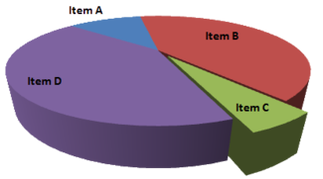
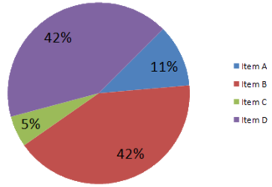
LE BUGIE DEI GRAFICI TORTA
L'elemento C sembra essere grande almeno quanto l'elemento A, mentre in realtà, è meno della metà
https://en.wikipedia.org/wiki/Misleading_graph

Slide 65
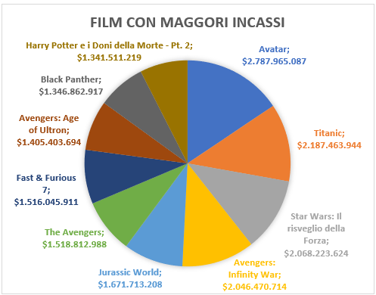
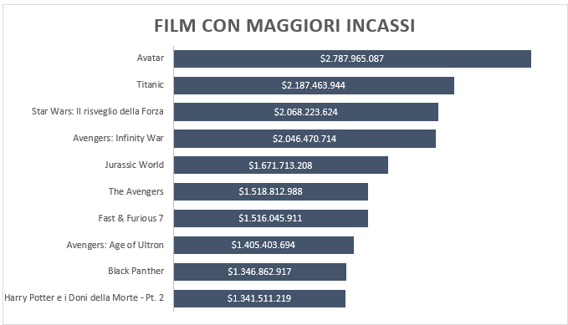

Slide 66
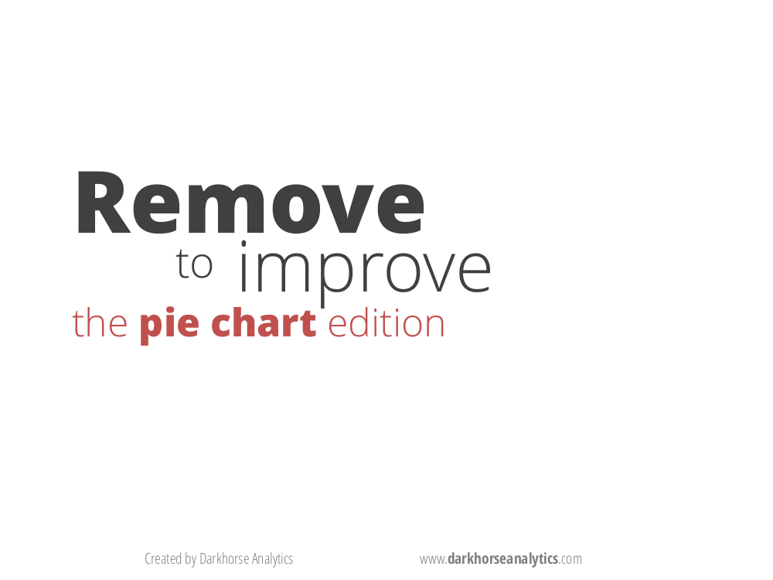
https://www.darkhorseanalytics.com/portfolio/2016/1/7/data-looks-better-naked-pie-charts

Slide 67
Remove
^{to} improve
the pie chart edition
www.darkhorseanalytics.com

Slide 68

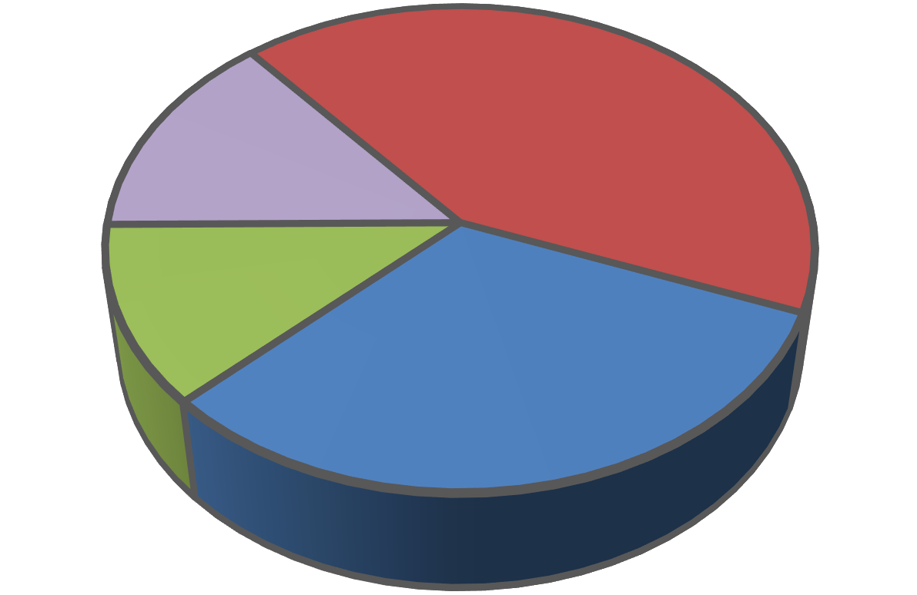
Remove backgrounds
Pig Meat Preferences
Bacon |  |  | 42%
Ribs | 14%
Ham | 12%
Other |  | 32%
www.darkhorseanalytics.com

Slide 69
Remove backgrounds
Pig Meat Preferences
Bacon |  |  | 42%
Ribs | 14%
Ham | 12%
Other |  | 32%
www.darkhorseanalytics.com

Slide 70
Remove backgrounds
Pig Meat Preferences
Bacon |  |  | 42%
Ribs | 14%
Ham | 12%
Other |  | 32%
www.darkhorseanalytics.com

Slide 71
Remove borders
Pig Meat Preferences
Bacon |  |  | 42%
Ribs | 14%
Ham | 12%
Other |  | 32%
www.darkhorseanalytics.com

Slide 72
Remove borders
Pig Meat Preferences
Bacon |  |  | 42%
Ribs | 14%
Ham | 12%
Other |  | 32%
www.darkhorseanalytics.com

Slide 73
Remove borders
Pig Meat Preferences
Bacon |  |  | 42%
Ribs | 14%
Ham | 12%
Other |  | 32%
www.darkhorseanalytics.com

Slide 74
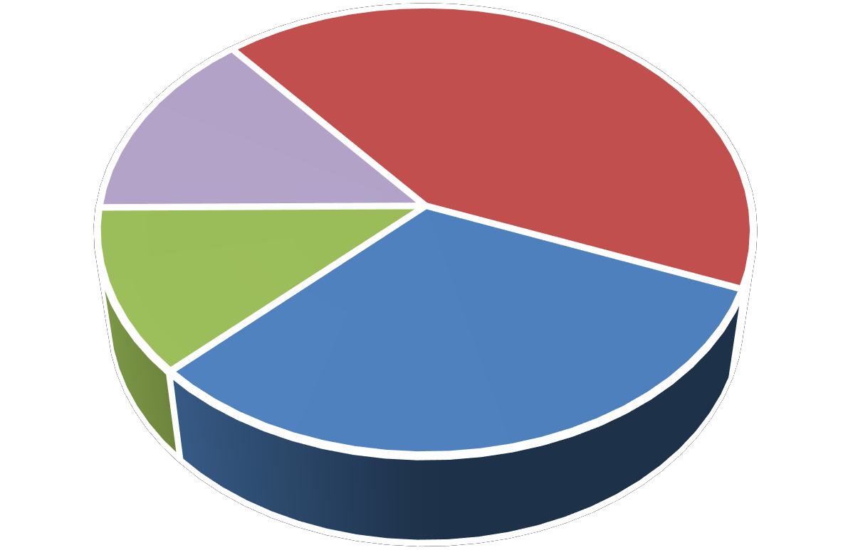
Remove borders
Pig Meat Preferences
Bacon |  |  | 42%
Ribs | 14%
Ham | 12%
Other |  | 32%
www.darkhorseanalytics.com

Slide 75
Remove redundant legend
Pig Meat Preferences
Bacon |  |  | 42%
Ribs | 14%
Ham | 12%
Other |  | 32%
www.darkhorseanalytics.com

Slide 76
Remove redundant legend
Pig Meat Preferences
Bacon |  |  | 42%
Ribs | 14%
Ham | 12%
Other |  | 32%
www.darkhorseanalytics.com

Slide 77
Remove redundant legend
Pig Meat Preferences
Bacon |  |  | 42%
Ribs | 14%
Ham | 12%
Other |  | 32%
www.darkhorseanalytics.com

Slide 78
Remove redundant legend
Pig Meat Preferences
Bacon |  |  | 42%
Ribs | 14%
Ham | 12%
Other |  | 32%
www.darkhorseanalytics.com

Slide 79
Remove redundant legend
Pig Meat Preferences
Bacon |  |  | 42%
Ribs | 14%
Ham | 12%
Other |  | 32%
www.darkhorseanalytics.com

Slide 80
Remove 3D
Pig Meat Preferences
Bacon |  |  | 42%
Ribs | 14%
Ham | 12%
Other |  | 32%
www.darkhorseanalytics.com

Slide 81
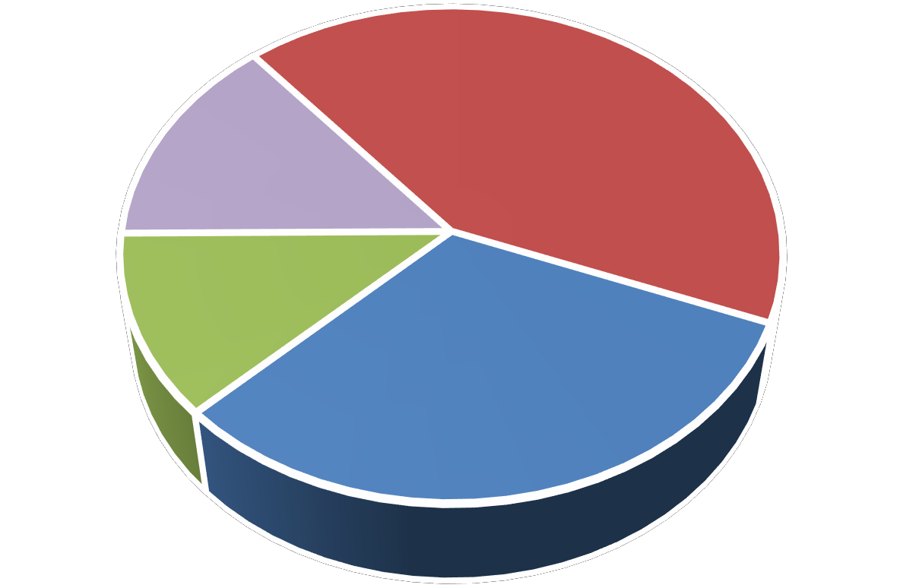
Remove 3D
Pig Meat Preferences
Bacon |  |  | 42%
Ribs | 14%
Ham | 12%
Other |  | 32%
www.darkhorseanalytics.com

Slide 82
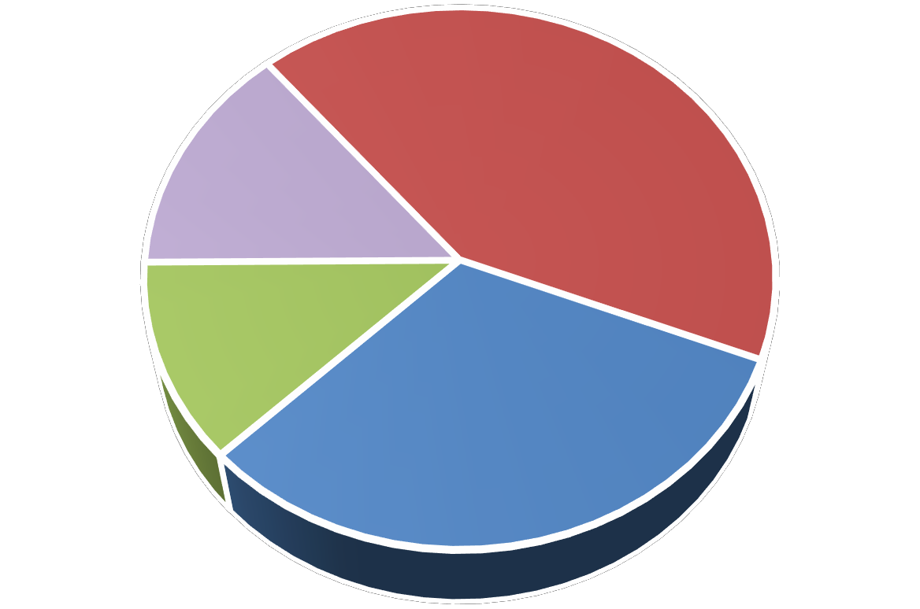
Remove 3D
Pig Meat Preferences
Bacon |  |  | 42%
Ribs | 14%
Ham | 12%
Other |  | 32%
www.darkhorseanalytics.com

Slide 83
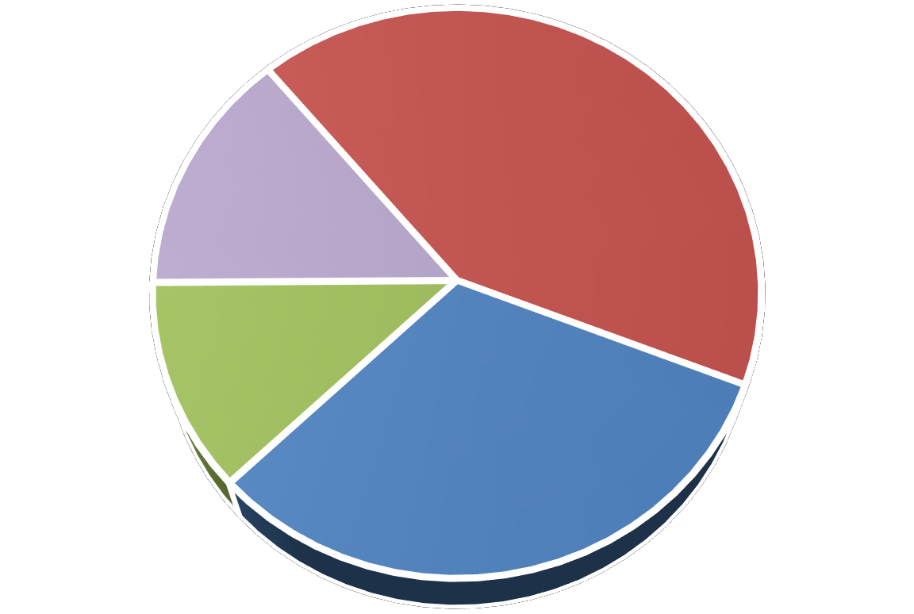
Remove 3D
Pig Meat Preferences
Bacon |  |  | 42%
Ribs | 14%
Ham | 12%
Other |  | 32%
www.darkhorseanalytics.com

Slide 84
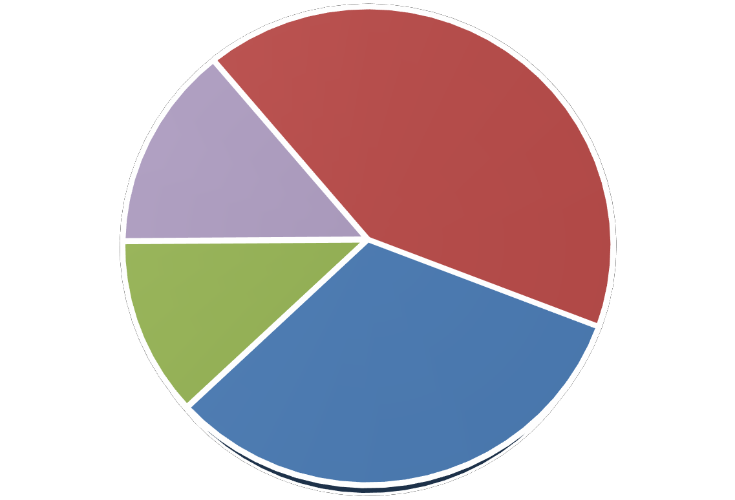
Remove 3D
Pig Meat Preferences
Bacon |  |  | 42%
Ribs | 14%
Ham | 12%
Other |  | 32%
www.darkhorseanalytics.com

Slide 85
Remove 3D
Pig Meat Preferences
Bacon |  |  | 42%
Ribs | 14%
Ham | 12%
Other |  | 32%
www.darkhorseanalytics.com

Slide 86
Remove Bolding
Pig Meat Preferences
Bacon |  |  | 42%
Ribs | 14%
Ham | 12%
Other |  | 32%
www.darkhorseanalytics.com

Slide 87
Remove Bolding
Pig Meat Preferences
Bacon |  |  | 42%
Ribs | 14%
Ham | 12%
Other |  | 32%
www.darkhorseanalytics.com

Slide 88
Remove Bolding
Pig Meat Preferences
Bacon |  |  | 42%
Ribs | 14%
Ham | 12%
Other |  | 32%
www.darkhorseanalytics.com

Slide 89
Remove Bolding
Pig Meat Preferences
Bacon |  |  | 42%
Ribs | 14%
Ham | 12%
Other |  | 32%
www.darkhorseanalytics.com

Slide 90
Remove Bolding
Pig Meat Preferences
Bacon |  |  | 42%
Ribs | 14%
Ham | 12%
Other |  | 32%
www.darkhorseanalytics.com

Slide 91
Reduce Colors
Pig Meat Preferences
Bacon |  |  | 42%
Ribs | 14%
Ham | 12%
Other |  | 32%
www.darkhorseanalytics.com

Slide 92
Reduce Colors
Pig Meat Preferences
Bacon |  |  | 42%
Ribs | 14%
Ham | 12%
Other |  | 32%
www.darkhorseanalytics.com

Slide 93
Reduce Colors
Pig Meat Preferences
Bacon |  |  | 42%
Ribs | 14%
Ham | 12%
Other |  | 32%
www.darkhorseanalytics.com

Slide 94
Reduce Colors
Pig Meat Preferences
Bacon |  |  | 42%
Ribs | 14%
Ham | 12%
Other |  | 32%
www.darkhorseanalytics.com

Slide 95
Reduce Colors
Pig Meat Preferences
Bacon |  |  | 42%
Ribs | 14%
Ham | 12%
Other |  | 32%
www.darkhorseanalytics.com

Slide 96
Remove the wedges
Pig Meat Preferences
Bacon |  |  | 42%
Ribs | 14%
Ham | 12%
Other |  | 32%
www.darkhorseanalytics.com

Slide 97
Remove the wedges
Pig Meat Preferences
Bacon |  |  | 42%
Ribs | 14%
Ham | 12%
Other |  | 32%
www.darkhorseanalytics.com

Slide 98
Remove the wedges
Pig Meat Preferences
Bacon |  |  | 42%
Ribs | 14%
Ham | 12%
Other |  | 32%
www.darkhorseanalytics.com

Slide 99
Remove the wedges
Pig Meat Preferences
Bacon |  |  | 42%
Ribs | 14%
Ham | 12%
Other |  | 32%
www.darkhorseanalytics.com

Slide 100
Remove the wedges
Pig Meat Preferences
Bacon |  |  | 42%
Ribs | 14%
Ham | 12%
Other |  | 32%
www.darkhorseanalytics.com

Slide 101
Thicken the lines
Pig Meat Preferences
Bacon |  |  | 42%
Ribs | 14%
Ham | 12%
Other |  | 32%
www.darkhorseanalytics.com

Slide 102
Thicken the lines
Pig Meat Preferences
Bacon
42%
Ribs
14%
Ham
12%
Other
32%
www.darkhorseanalytics.com

Slide 103
Thicken the lines
Pig Meat Preferences
Bacon
42%
Ribs
14%
Ham
12%
Other
32%
www.darkhorseanalytics.com

Slide 104
Thicken the lines
Pig Meat Preferences
Bacon |  |  |  | 42%
Ribs |  | 14%
Ham |  | 12%
Other |  |  | 32%
www.darkhorseanalytics.com

Slide 105
Thicken the lines
Pig Meat Preferences
Bacon |  |  |  | 42%
Ribs |  | 14%
Ham |  | 12%
Other |  |  | 32%
www.darkhorseanalytics.com

Slide 106
Emphasize the bacon
Pig Meat Preferences
Bacon |  |  |  | 42%
Ribs |  | 14%
Ham |  | 12%
Other |  |  | 32%
www.darkhorseanalytics.com

Slide 107
Emphasize the bacon
Pig Meat Preferences
Bacon |  |  |  | 42%
Ribs |  | 14%
Ham |  | 12%
Other |  |  | 32%
www.darkhorseanalytics.com

Slide 108
Less
^{is}more
(effective)
www.darkhorseanalytics.com

Slide 109
Less
^{is}more
(attractive)
www.darkhorseanalytics.com

Slide 110
Less
^{is}more
(impactive)
www.darkhorseanalytics.com

Slide 111

Before
Pig Meat Preferences
Bacon |  |  | 42%
Ribs | 14%
Ham | 12%
Other |  | 32%
www.darkhorseanalytics.com

Slide 112
After
Pig Meat Preferences
Bacon |  |  |  | 42%
Ribs |  | 14%
Ham |  | 12%
Other |  |  | 32%
www.darkhorseanalytics.com

Slide 113
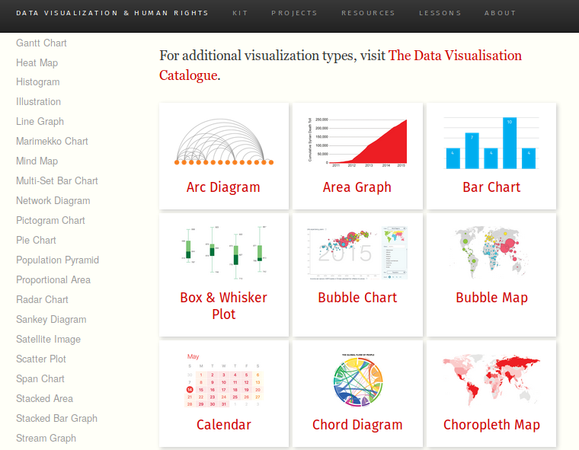

Quale grafico e con quale strumento

Slide 114
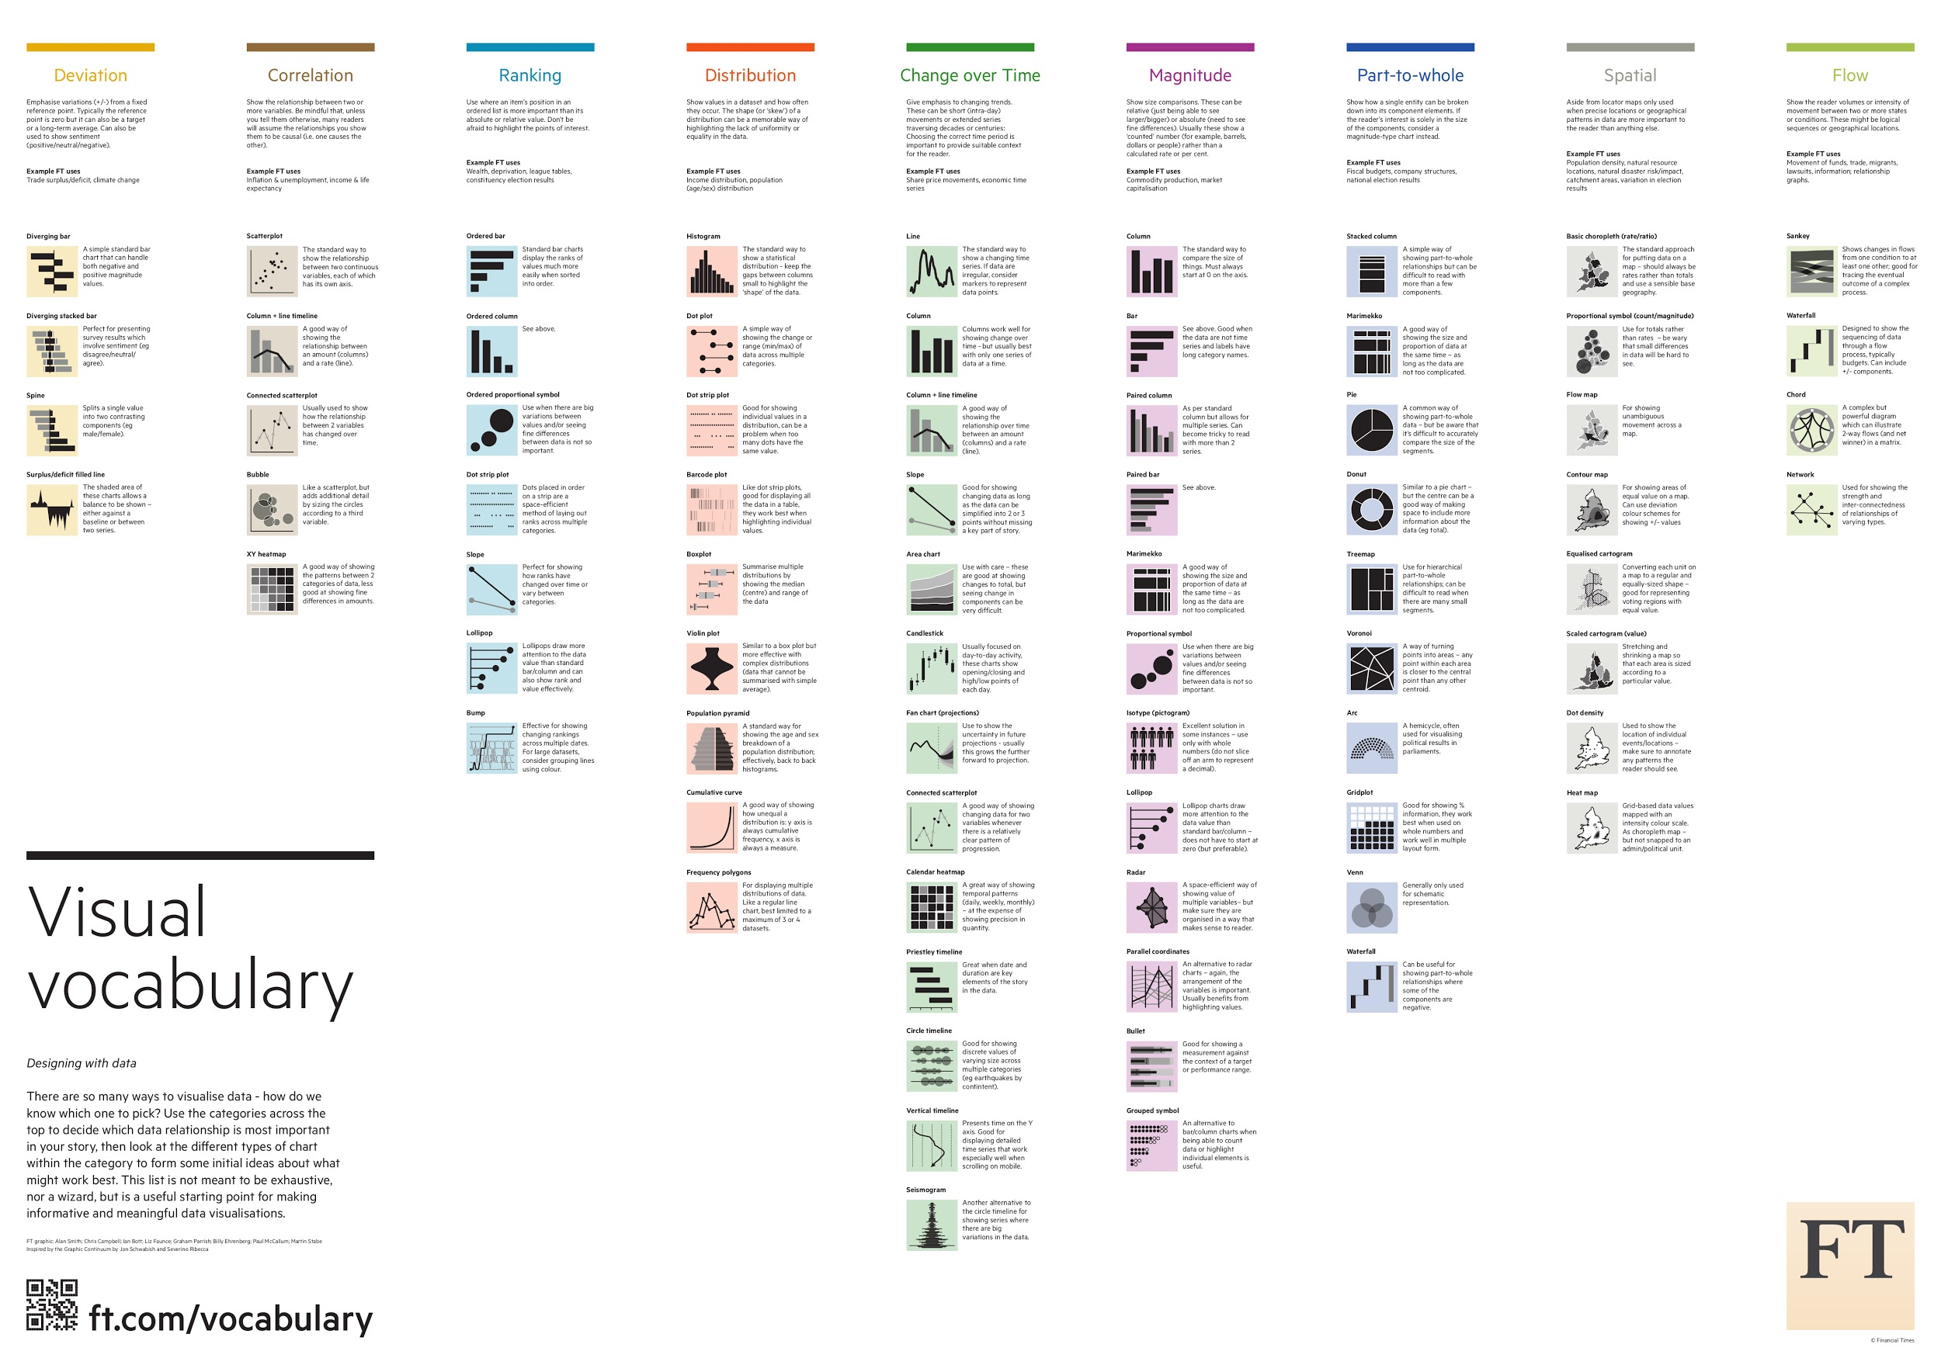
Il vocabolario visuale del Financial Times
https://github.com/ft-interactive/chart-doctor/blob/master/visual-vocabulary/Visual-vocabulary.pdf

Slide 115
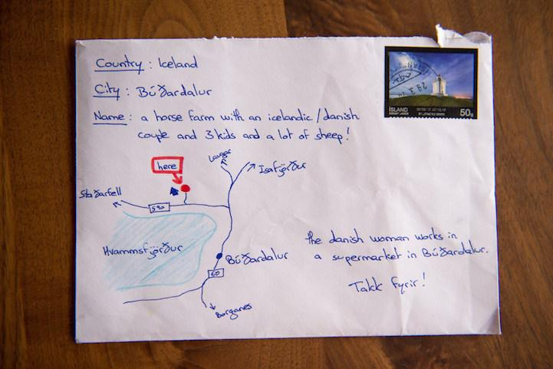
Comunicare con le mappe

Slide 116

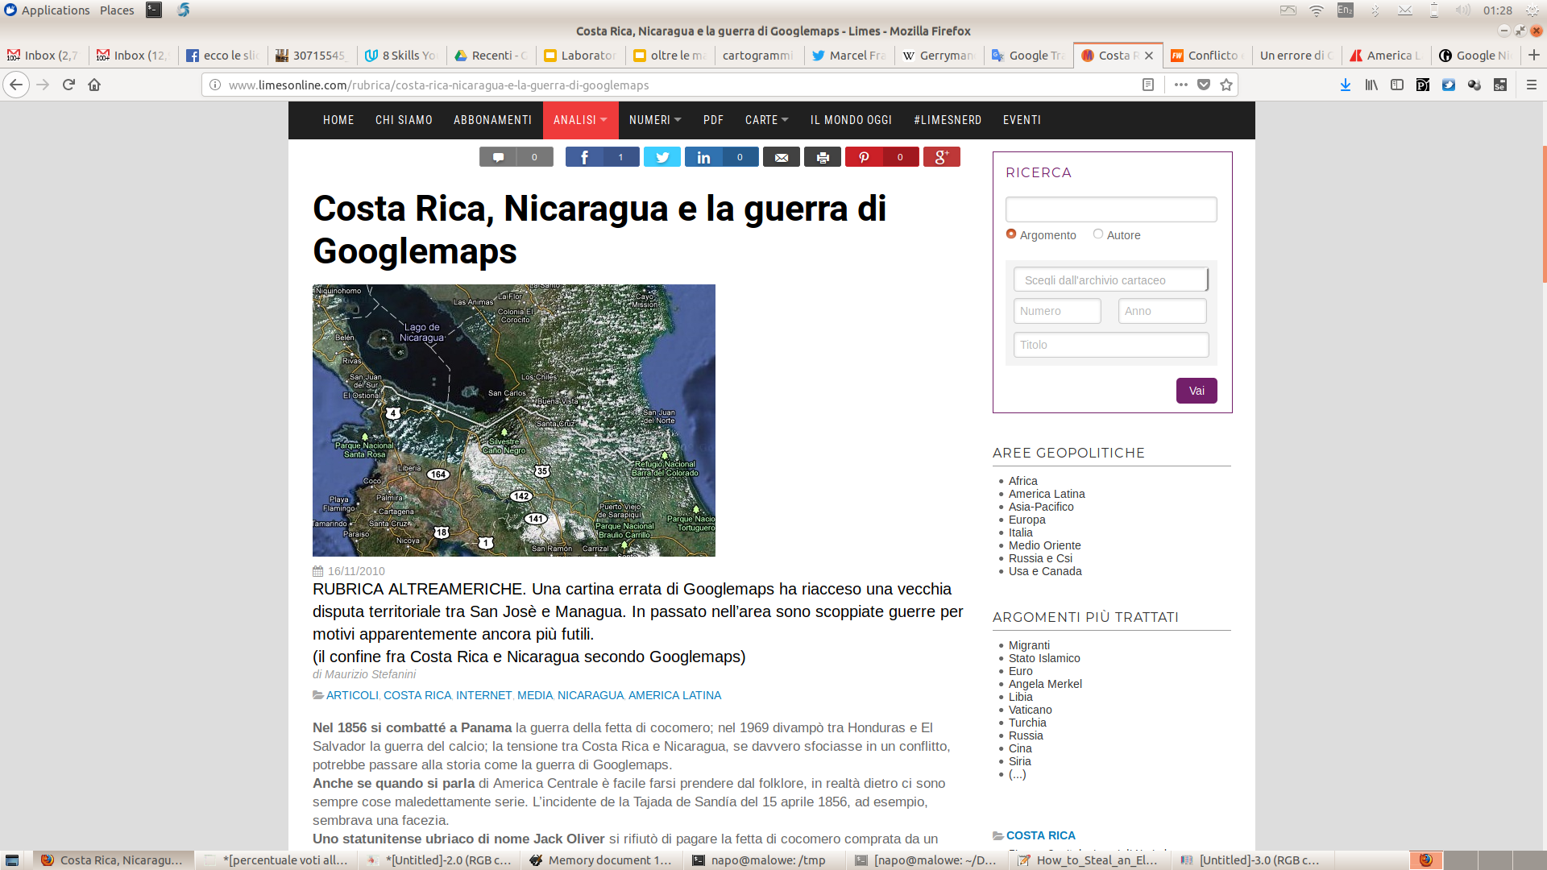
ATTENZIONE!!!
Una cartina errata di Googlemaps ha riacceso una vecchia disputa territoriale tra San Josè e Managua

Slide 117
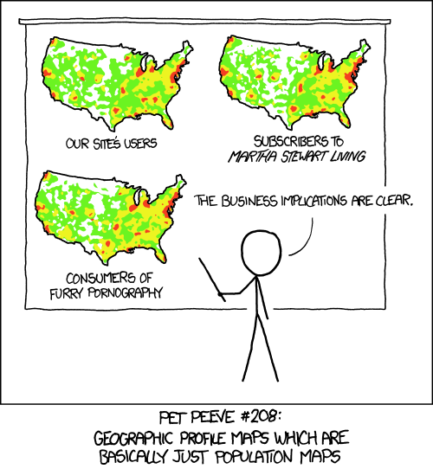
Qualche errore comune ….
La mappa sta comunicando???

Slide 118

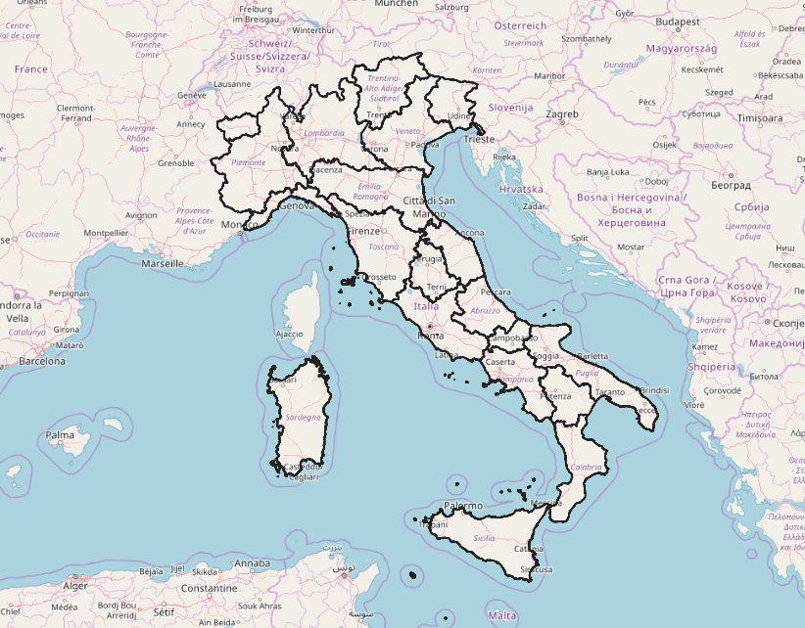
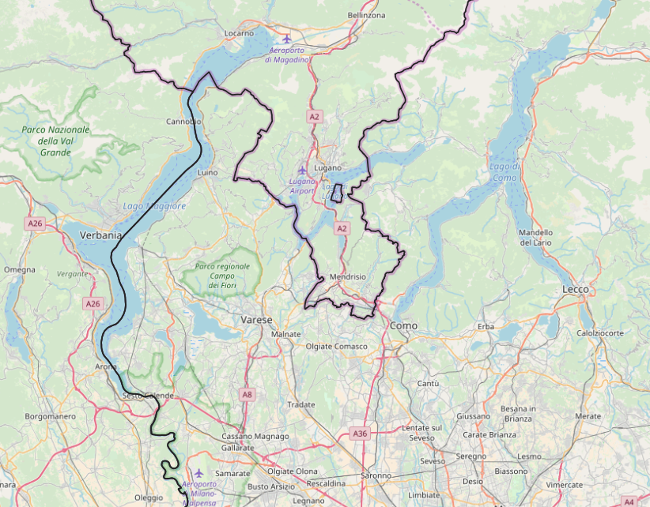
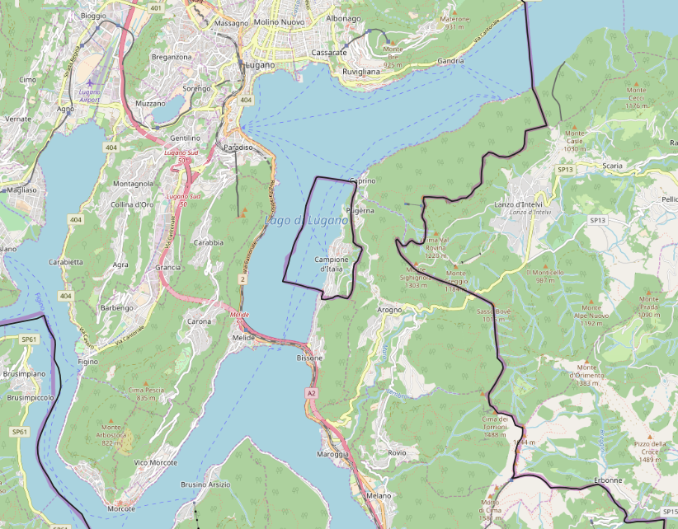
I confini non sempre sono contigui
I CONFINI:
ENCLAVE e EXCLAVE
https://www.openstreetmap.org/relation/46664

Slide 119


Conclusione
KISS
Keep It Simple and Sexy

Slide 120




Per contatti
Maurizio Napolitano
http://slideshare.net/napo
napolitano@fbk.eu
@napo
Ringraziamenti
The Nounproject per le icone
School of Data per tutorial e immagini
Matteo Moretti per i preziosi suggerimenti
Carlo Romagnoli per le torte

Slide 121
Risorse
Libri
"The Functional Art: An Introduction to Information Graphics and Visualization " di Alberto Cairo (2012)
"The Visual Display of Quantitative Information" di Edward R. Tufte (2001)
"How to Lie with Statistics" di Darrel Huff (1954)
Web
https://www.darkhorseanalytics.com/
https://en.wikipedia.org/wiki/Misleading_graph
http://callingbullshit.org/
https://www.slideshare.net/janwillemtulp/data-visualization-5724069
https://medium.com/@namwookkim/data-driven-guide-designing-expressive-information-graphics-e068a0c552e9
https://github.com/ft-interactive/chart-doctor/blob/master/visual-vocabulary/Visual-vocabulary.pdf
http://ft-interactive.github.io/visual-vocabulary/
STRUMENTI
google spreadsheet - http://docs.google.com
colorbrewer2 - http://colorbrewer2.org
datawrapper - http://datawrapper.de
rawgraphs - http://rawgraphs.io
infogram - http://infogram.com
dive - https://dive.media.mit.edu/

