Slide 1
Huawei BC&DR Solution
Business Continuity e Disaster Recovery,
Architetture e soluzioni
Emilio Tonelli, Solution Manager Huawei Technologies

Slide 2
Why Is the BC&DR Necessary?
Number of users whose services are adversely affected due to iCloud breakdown of Apple: 3,000,000
Economic loss of Amazon due to two system breakdowns: $7,000,000
Traffic dropped due to a 5-minute system breakdown of Google: 40%
Cloud services broke down for 13 times from 2007 to 2012, resulting in service interruptions for 568 hours and over 71.7 million USD economic loss.

Slide 3
Huawei BC&DR Solution Panorama
Remote disaster recovery center
Same-city disaster recovery center
Local production center
BC&DR Solution (Geo-Redundant Mode)
BC&DR Solution (Active-Passive Mode)
BC&DR Solution (Active-Active Mode)
BC&DR Solution (Active-Passive Mode)
HA Solution
> 100 km
≤ 100 km

Slide 4
HA Solution
Solution architecture
Highlights
Service-level robust reliability
VM
VM
VM
VM
VM
VM
0 service interruption
SAN
0 data loss
Other
Huawei

Slide 5
BC&DR Solution (Active-Passive Mode)
Solution Architecture
Highlights
WAN
Second-level RPO
I/O-based data replication, delivering close to 0 RPO
Production Center
DR Center
VM
VM
VM
VM
VM
VM
VM
VM
VM
VM
VM
VM
Optimal TCO
Interoperability among the entire class of storage products (low-, mid-, high-end)
Heterogeneous deployment, resource reuse
SAN
SAN
HyperReplicaiton
Visualized
Global topology and centralized alarm
Automatic and one-click DR testing and recovery
Other
Huawei
Huawei
Other

Slide 6
BC&DR Solution (Active-Active Mode)
Solution Architecture
Highlights
WAN
Active-active
6-layer active-active architecture, enabling active-active services
Zero service interruption and data loss
Production Center 1
Production Center 2
VM
VM
VM
VM
VM
VM
VM
VM
VM
VM
VM
VM
High performance
30% better performance using HyperMetro
Same performance when two DCs are deployed in the same place or 100 km apart
SAN
SAN
Visualized
Global topology and centralized alarm
Failover and automatic recovery
HyperMetro
Other
Huawei
Huawei
Other

Slide 7
BC&DR Solution (Geo-Redundant Mode)
Solution Architecture
Highlights
Cascaded Architecture
High security
Three pieces of data, each stored in a DC
Wider DR application scope
Production center
Same-city DR center
Remote DR center
A
SAN
Synchronous/
Asynchronous replication
SAN
Asynchronous replication
SAN
A
A’
A“
Smooth expansion
Smooth expansion from two same-city DCs to three DCs
Flexible deployments of cascaded and parallel architectures
Parallel Architecture
Production center
Same-city DR center
A
SAN
Synchronous/
Asynchronous replication
SAN
Remote DR center
Visualized
Global topology and centralized alarm
Automatic and one-click DR testing and recovery
A
A’
Asynchronous replication
SAN
A“

Slide 8
420+ Customers Choose Huawei BC&DR Solution
Russia Central Bank
Vunkovo Airport
Rostec
U.K. LycalMobile
Portugal WhiteStar
CPP
CNPC F9
Henan Public Security Department
Anhui Human Resources and Social Security Department
Spain Candelaria Hospital
UAE ADMA
Saudi Electricity Company
HKPU
China Life
Venezuela Previsora
Singapore StarHub
South Africa EMM
CCB in Chile

Slide 9
China Petrol (CPP) 0 Downtime Service System
Building Active-Active Data Centers to achieve 0 data loss and 0 business interruption for 56 core applications.

Slide 10
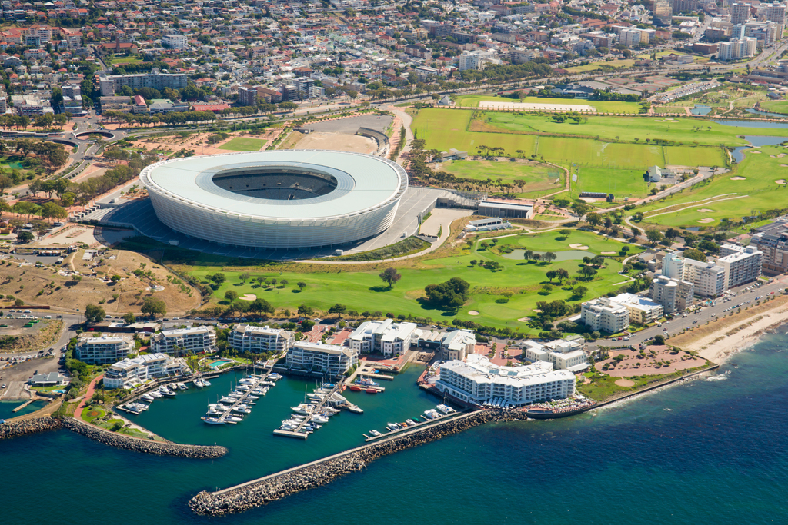
South Africa EMM 0 Downtime in Core Services
Building Active-Active Data Centers to achieve 0 data loss and 0 business interruption for over 30 core applications.

Slide 11
Ningbo E-Government Active-Active Cloud Data Center
Building Active-Active Data Centers to achieve 0 data loss, efficiency improved by 50% by using unified monitoring platform.

Slide 12
Portugal WhiteStar Geo-Redundant Mode BC&DR Solution
Geo-redundant BC&DR solution,
providing triple level protection from any interruption and meet the regulation of financial industry.

Slide 13
Spain's Candelaria Hospital 24/7 Online Service
Active-Active Cloud Data Centers ensure 24/7 online service, performance improved by 50%.

