Slide 1
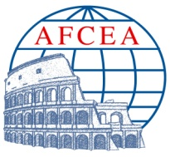
HOMELAND SECURITY Scenario della Minaccia: terrorismo e disastri naturali
Giorgio Franceschetti
Università Federico II, Napoli (Italy)
e
Jet Propulsion Laboratory (JPL-USA)
TechFOr - 18 Maggio 2010

Slide 2
TRAJECTORY OF
HOMELAND SECURITY SCENARIO
Management of our life is largely based on the availability of a number of paraphernalia, as transportation, communication, distribution of commodities (water, power, etc.), and so forth. Their operation is now largely based on an integrated network, the underlying cyber world, assuring easy access, interconnection, efficiency and safety. I will refer in the following to these belongings as our society commodities.
The first terrorist attack, 11 September 2001, was against people, while these were using a transportation commodity. A new discipline was borne: Homeland Security, devoted to defend people and commodities.
Then, it was recognized that the new discipline was certainly effective to mitigate danger and causalities in the event of natural disasters (earthquake, volcanic eruption, landslide, etc.). Accordingly, their previous attempts, namely Early Warning, was absorbed inside the Homeland Security discipline.

Slide 3
Trajectory of Homeland Security scenario (cnd)
The new discipline was moving inside a high-level technical area: scientists, engineers, industrial companies in the technical domain, are involved. But then it was recognized that security requires intelligence, i.e., detailed early knowledge: the currency to buy security is loss of privacy. And the original technical area is recently being enlarged to include law experts, see the Baia Workshop (Fall 2009), where 2 out of 10 Lecturers were coming from Law Schools.
However, it is easy to note that threats to our commodities may originate not necessarily from terrorists, but from ourselves: on April 9th, 2009, up to four fibre optics lines were intentionally cut around 2:00am, generating serious service problems across Santa Clara, San Benito and Santa Cruz counties. The result was a total mess: credit cards were not accepted, automatic cash machines were not working, ambulances could not be requested in emergencies, and so on. This situation lasted till 6:00pm of the same day. The conclusion is that some excited kids, coming out of a discothèque may easily impair our commodity usage: the underlying cyber world where the commodity usage is implanted is very delicate, probably unstable, and needs itself security.

Slide 4
Trajectory of Homeland Security scenario (cnd)
Is this the last stop of this journey? Probably not. There is a nice word in italian, Patria, that originates from the latin-word “pater”, i.e., “father”, that implies not only the homeland commodities, but also to its culture, traditions, ideal accomplishments that flourished over the centuries. Homeland Security should also take care of preserving these values, that are invaluable inheritage of the country. This requires to further open the door of the room with people in charge of Homeland Security mission: educators should be included, that should explore possible threats and implement appropriate remedies.
Obviously no single group may provide a full solution to the complete problem: a general statement is that we need competent people in charge, with vision and open broadband mind. But this requires time, being a long range accomplishment. In order to help its starting development, something may, or rather should be done.

Slide 5
.……. a fatemi presentare un piccolo esempio di realizzazione tecnica …….vedere attraverso I muri!

Slide 6
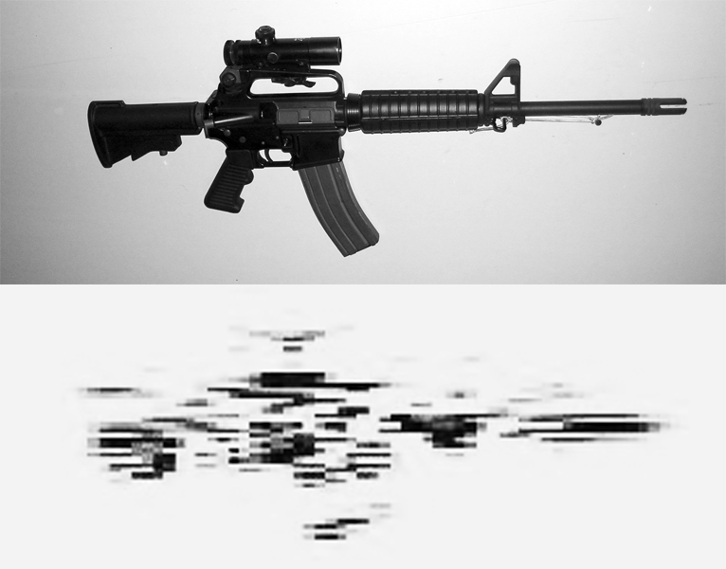
VEDERE ATTRAVERSO UN MURO
ImpSAR sensor No wall
Optical (top) and ImpSAR (bottom) images of the M20 rifle.
(Courtesy of Eureka Aerospace)

Slide 7
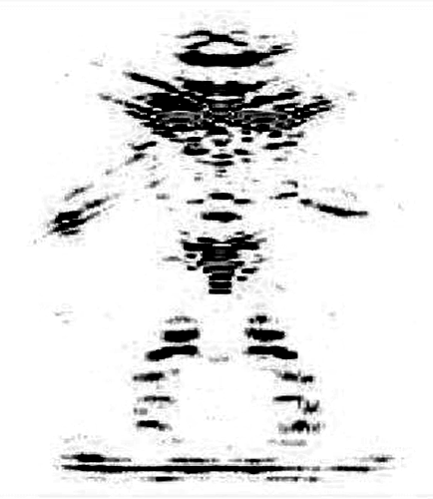
ImpSAR sensor No wall (cnd)
Optical (left) and ImpSAR (right) images of a human being.
(Courtesy of Eureka Aerospace)

Slide 8
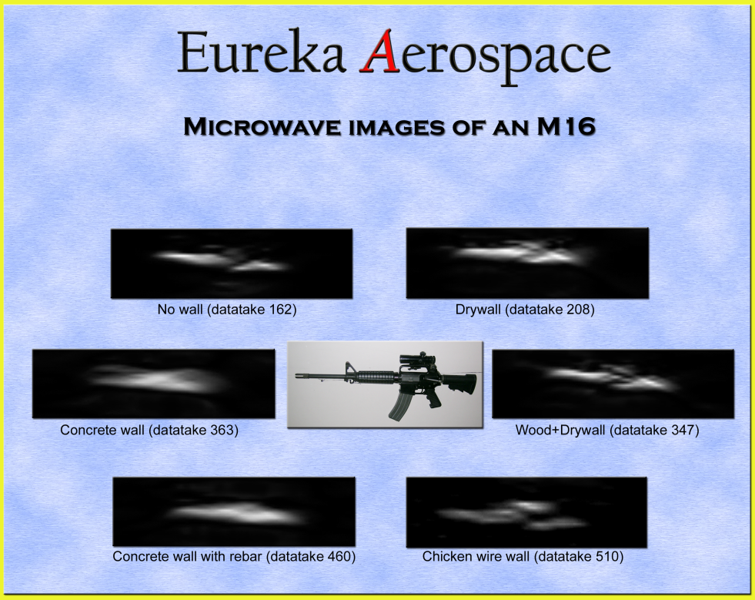
ImpSAR sensor Wall
(Courtesy of Eureka Aerospace)

Slide 9
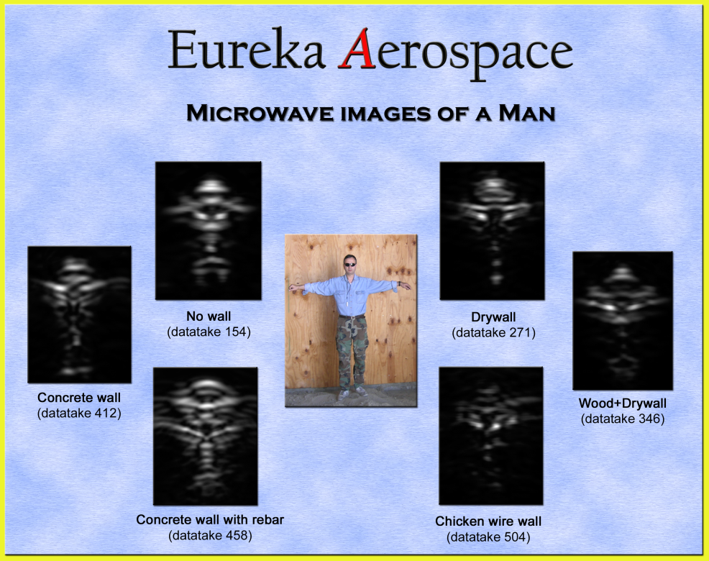
ImpSAR sensor Wall (cnd)
(Courtesy of Eureka Aerospace)

Slide 10
CONCLUSIONS
In the Homeland Security scenario technical and ethical problems are present: the former can be solved at scientific and industrial level; the latter require innovative vision at political level
In this presentation a possible solution for the particular case of non-invasive through-the-wall imaging has been detailed: the conclusion is drawn that even apparently odd technical problems can be managed
On the contrary, the ethical problems are very difficult to solve, especially if we give the meaning of Patria to the Homeland word. Blameable homogenization of the society is in progress, the value of culture is neglected, and chip models are imposed on the population by means of the powerful communication tools that are now available
What can we do ?

Slide 11
Conclusions (cnd)
Allons enfants de la Patrie
Andiamo, per i figli della Patria
Le jour de gloire est arrivé !
Il giorno della gloria è arrivato!
Contre nous de la tyrannie
Contro di noi della tirannia
L'étendard sanglant est levé ….
Lo stendardo insanguinato è stato sollevato ... …..

